Slide 1
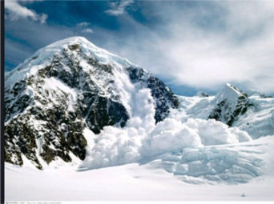
Alaska

Slide 2
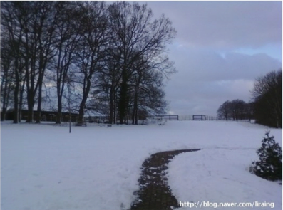
Winter in U. K.
Average temp in Jan: 4.1℃

