Slide 2
an·chor·wom·an
on a television or radio programme, especially a news programme, is the woman who presents it.

Slide 3
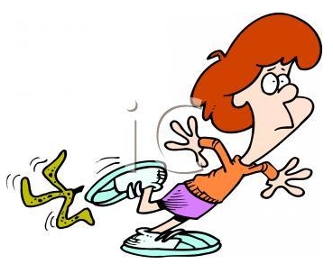
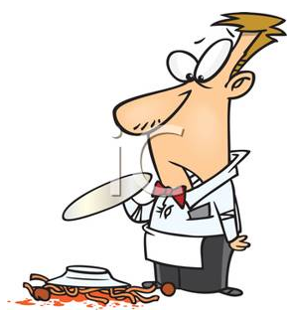
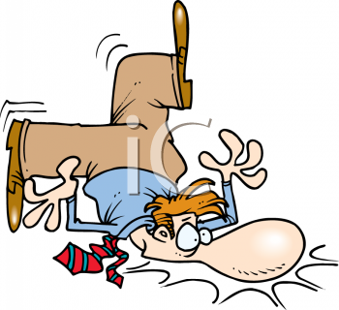

Slide 4
clumsy
moves or handles things in a careless, awkward way, often so that things are knocked over or broken
Sys.: awkward / bumbling - Ant.: skilful

Slide 5
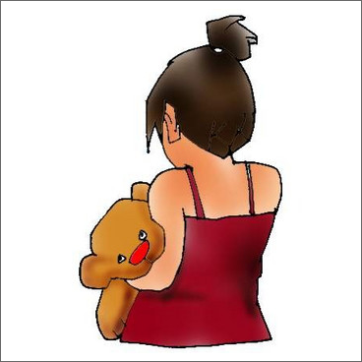
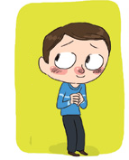
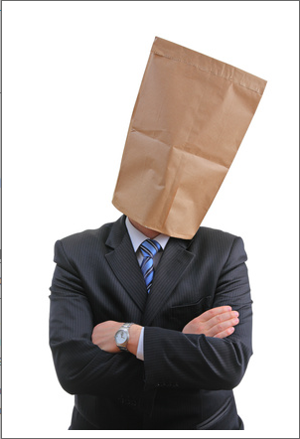

Slide 6
intro·vert·ed
quiet and shy and find it difficult to talk to other people.
Sys.: withdrawn Ant.: extroverted

Slide 7
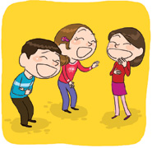
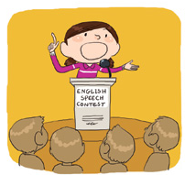
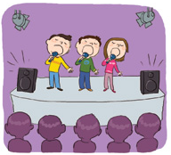

Slide 8
ex·tro·vert·ed
extroverted is very active, lively, and friendly. in BRIT, usually use extrovert.
Syn.: outgoing, sociable Ant.: introverted

Slide 9
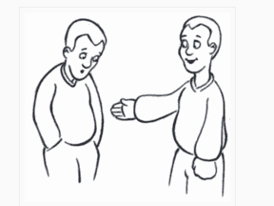
introverted vs extraverted

Slide 10
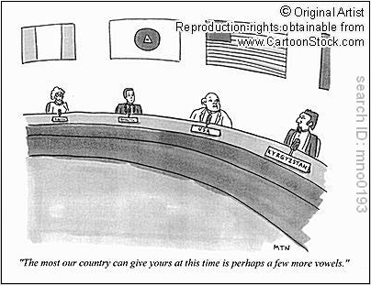

Slide 11
dip·lo·mat
discusses affairs with another country on behalf of his or her own country, usually working as a member of an embassy.
Syn.: ambassador, senior official

Slide 12
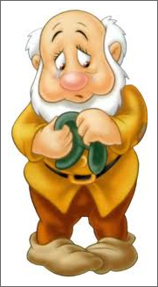
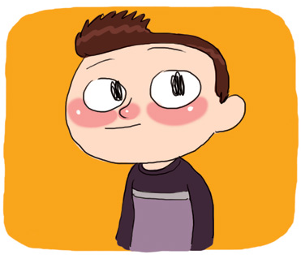

Slide 13
bash·ful
shy and easily embarrassed.
Syn.: shy, embarrassed

