Slide 1
Job Position

Slide 2
Salary

Slide 3
Foreign Language

Slide 4
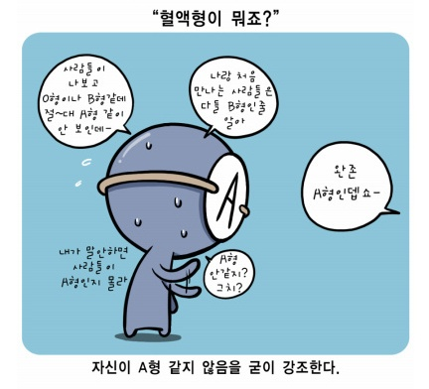
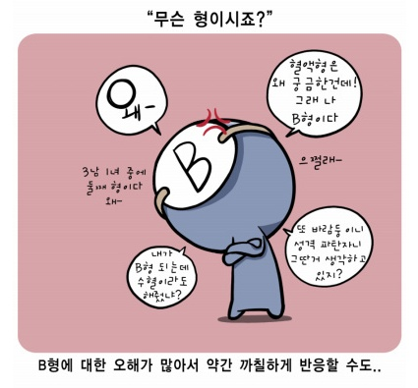
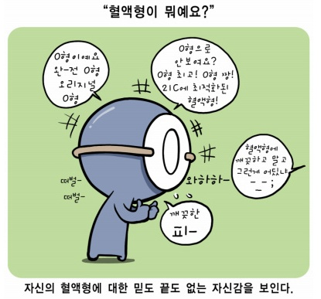
Personality

Slide 5
Relationship

