Slide 1
Tag Question
1. How to use tag questions
2. When you use tag questions

Slide 2
<Examples> - Sol is very cute, isn’t she? - Rachel has a daughter, doesn’t she?

Slide 3
Constructing Tag Questions
- (1) statement + negative tag question
- negative statement + (2) tag question

Slide 4
Constructing Tag Questions
- (1) statement + negative tag question
ex. You like my present, don’t you?
- negative statement + (2) tag question
ex. You didn’t buy a present yet,
did you?

Slide 5
falling intonation & rising intonation
- falling intonation:
- rising intonation:

Slide 6
falling intonation & rising intonation
- falling intonation: Confirmation
- rising intonation: Uncertain

Slide 7
falling intonation & rising intonation
- falling intonation: Confirmation
ex. You like my present, don’t you?
- rising intonation: Uncertain
ex. You didn’t buy a present yet,
did you?”

Slide 8
She plays the piano, doesn’t she?

Slide 9
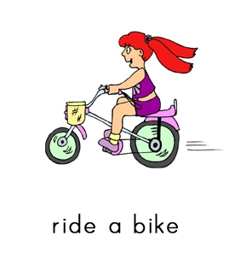
She is riding a bike, isn’t she?

Slide 10
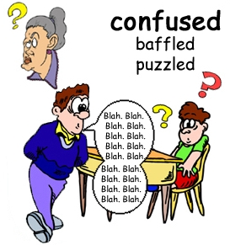
A: I don’t think it’s easy, isn’t it? B: No, it isn’t.

Slide 11
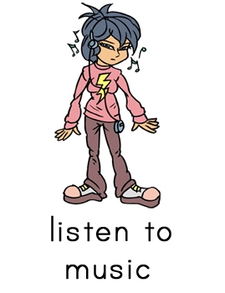
1. He is listening to music, ______he?

Slide 12
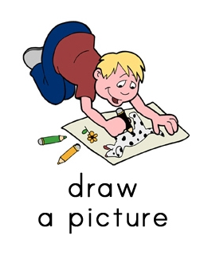
2. ____________________, doesn’ he?

Slide 13
3. A: There is a student asking a question, isn’t there? B: Yes, __________________.

Slide 14
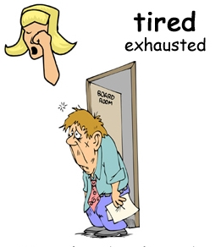
4. He would rather sleep, _________ he?

Slide 15
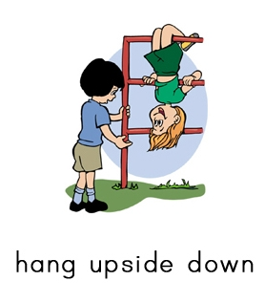
5. _________________________, can’t he?

Slide 16
6. A: You used to read a book, didn’t you? B: Yes, ___________.

Slide 17
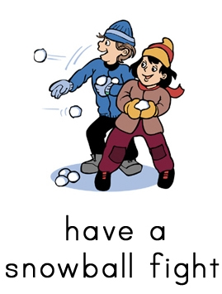
7. They will have a snowball fight, ___________ they?

Slide 18
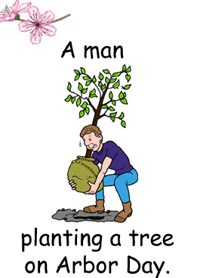
8. ___________________________, shouldn’t he?

Slide 19
9. A: He has a fever, doesn’t he? B: Yes, ____________.

Slide 20
For example, A: Hi, Anna. Are you OK? B: Oh, no. I have a headache all day long. A: You have to go hospital, don’t you? B: OK, thanks a lot. I’ll do that.

