Slide 1
A TICKET TO BEYONCE CONCERT

Slide 2
1) Thrilled
Super excited and happy
Sad and disappointed

Slide 3
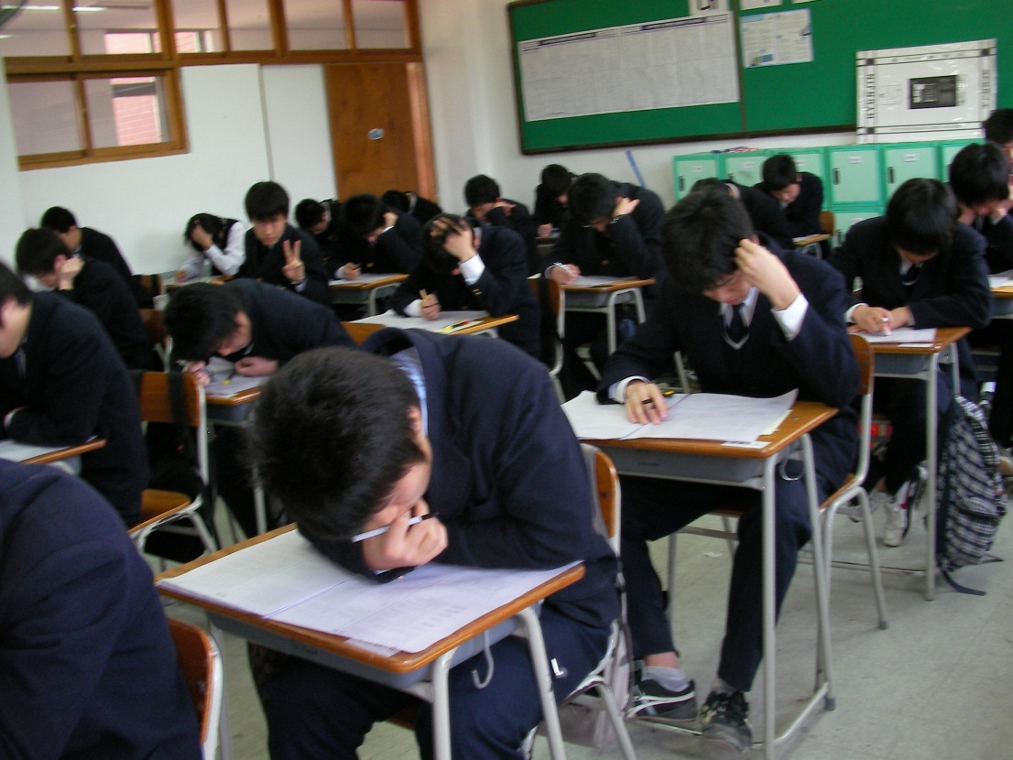
2) A senior
in high school
Someone who just entered high school
Someone in his/her last year of high school

Slide 4
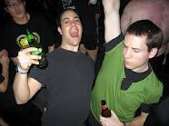
3) Let loose
To feel free and act out of control
To be stressed out

Slide 5
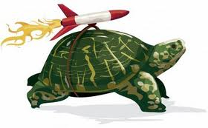
4) Boost up
To make something more powerful
To slow something down

Slide 6
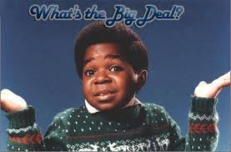
5) What the fuss is all about
Why something is so quiet
Why something is such a big deal

Slide 7
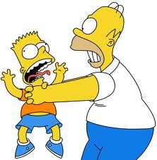
6) Be hassled
To be pushed and annoyed by someone
To be happy with someone

Slide 8
7) Overpriced
Too cheap for its value
Too expensive for its value

Slide 9
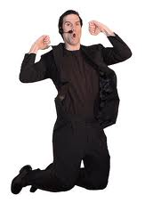
8) Get psyched
To feel nothing
To get crazy excited

Slide 10
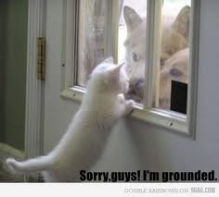
9) Be grounded
Not allowed to go out
Not allowed to eat

Slide 11
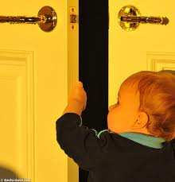
10) Sneak out
To stay where you are
To leave quietly and unnoticeably

Slide 12
Thrilled : Super excited and happy
A senior in high school : Someone in his/her last year in high school
Let loose : To feel free and act out of control
Boost up : To make something more powerful
What the fuss is all about : Why something is such a big deal
Be hassled : To be pushed and annoyed by someone
Overpriced : Too expensive for its value
Get psyched : To get crazy excited
Be grounded : Not allowed to go out
Sneak out : To leave quietly and unnoticeably

