Slide 1
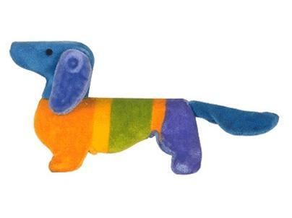
My name is Waldi.

Slide 2
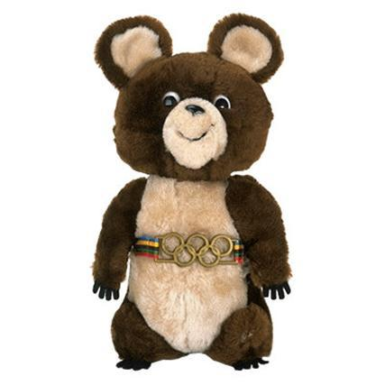
My name is Misha.

Slide 3
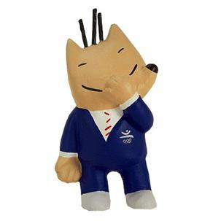
My name is Cobi

Slide 4
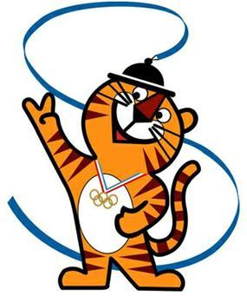
My name is Hodori.

Slide 5
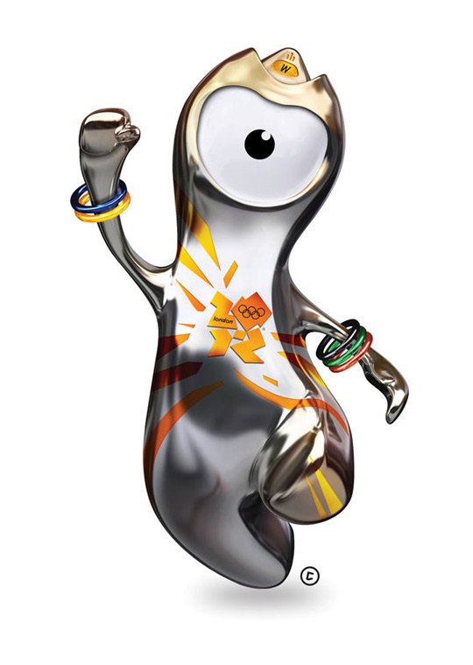
My name is Wenlock

Slide 6
Olympic mascots
The first official Olympic mascot
1972
Munich Olympic
1980
Moscow Olympic
1992
Barcelona Olympic
1988 Seoul Olympic
Head The appearance of the Olympic Stadium roof
Wrist Five colors Olympic Bracelet
Eye Olympic record Camera Lens

Slide 8
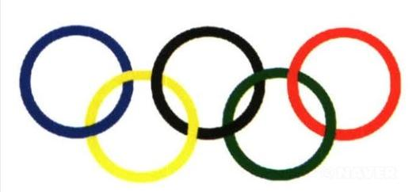
Olympic symbol
Africa
America
Europe
Asia
Oceania
These rings means five continents participated in the olympic

Slide 9
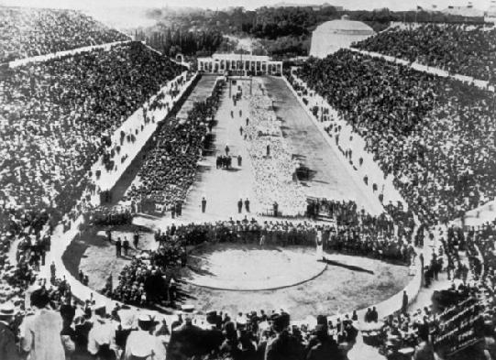
The Olympic Games are the world’s oldest multisporting event.

Slide 10
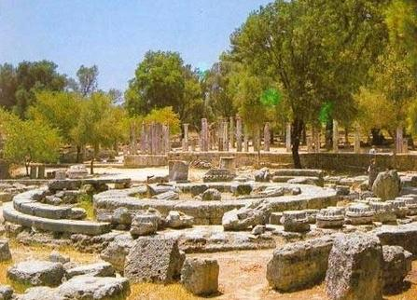
They started in 776 B.C in a place called Olympia in Greece.

Slide 11
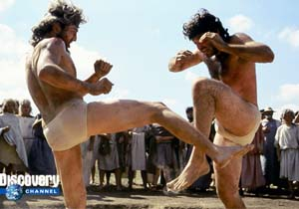
Instead of fighting, the warriors competed in sporting events.

Slide 12
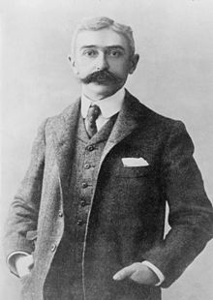
A Frenchman named Pierre de Coubertin organized
the first modern Olympic Games

Slide 13
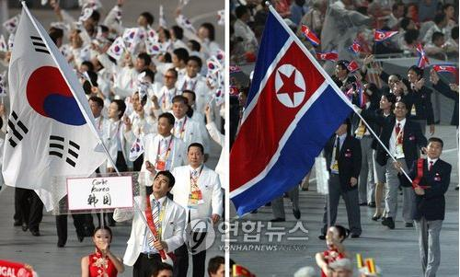
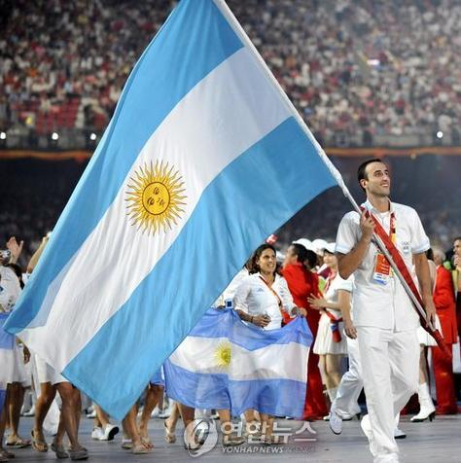
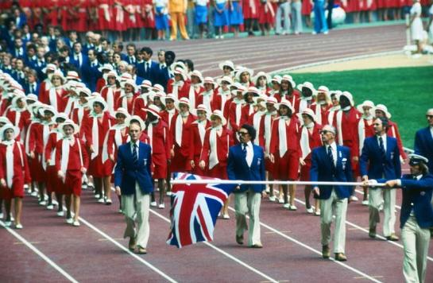
The recent games
in Athens involved
11,100 participants
from 202 countries.

Slide 14
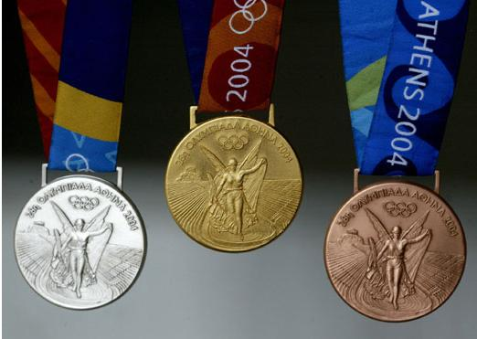
Winners get a gold, silver or bronze medal.

