Slide 1
Reading lesson
By Cindy

Slide 2
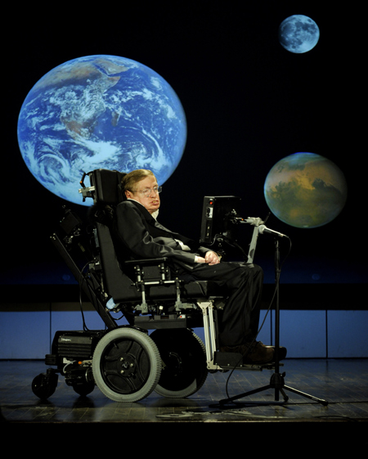

Slide 3
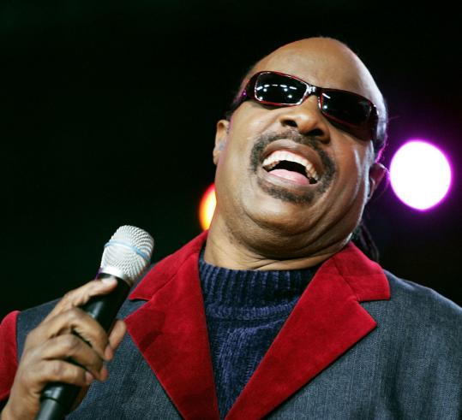
stevie wonder

Slide 4
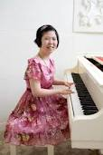
Lee Hee Ah

Slide 5
THE MIRACLE

Slide 6
Isn’t she lovely
Isn’t she lovely Isn’t she wonderfull Isn’t she precious Less than one minute old I never thought through love we’d be Making one as lovely as she But isn’t she lovely made from love
Isn’t she pretty Truly the angel’s best Boy, I’m so happy We have been heaven blessed I can’t believe what God has done through us he’s given life to one But isn’t she lovely made from love
Isn’t she lovely Life and love are the same Life is Aisha The meaning of her name Londie, it could have not been done Without you who conceived the one That’s so very lovely made from love

Slide 7
WHY HE MADE THIS SONG?
WHAT IS THE NAME OF HER DAUGTHER?
HOW DID HE FEEL ABOUT HER?
HOW DO YOU THINK YOU CAN’T SEE YOUR BABY?

Slide 8
One of the most famous blind individuals is singer and composer Stevie Wonder.
Of all the disabilities that can affect the human body, few are more severe and life changing than blindness. The reason is obvious; being able to see is considered one of the most basic abilities we have. Being able to perceive the shapes, colors and textures of the environment with our eyes is important because it allows us to understand our surroundings.
Sight isn't something that's easy to make do without, as anyone who's stumbled about in the dark can attest. But sometimes we take things like that for granted — it's terrifying and fundamentally alien for some to imagine an entire life without the ability to see.
Unfortunately, blindness is a sad truth, since the eye is one of the most sensitive parts of the body. It's easy to damage it, and some are even born blind. However, it's a mistake to assume that all blind people are helpless and unable to take care of themselves.
Many people think that if a person can't see, there's no hope for them to ever lead a normal life or pursue the things they love. But this is simply false, as the large number of famous blind people who have managed to make a name for themselves attests.
Stevie Wonder was born in Michigan 1950. He was six weeks premature, and so the blood vessels of his eyes were not fully formed, and their growth was aborted with his early emergence from his mother's womb. This resulted in his retinas detaching, a condition known as retinopathy of prematurity, rendering him blind from the day he was born.
However, his blindness didn't stop him from pursuing his hobby of making music. Stevie began learning to play various instruments at an early age. He was talented with the piano, harmonica, drums and bass, and he also participated in his church choir. Ronnie White, the founder of the blues group called The Miracles, discovered Stevie's talent through his brother.
He then took Stevie and his mother to Motown Records, where Stevie was signed to the Tamla label. The producer, who had called him the eighth wonder of the world, gave him his stage.
By the age of 13, Stevie Wonder had released his very first hit, and his career continued from there and still survives today. He has left a huge mark on the musical industry as one of the most famous artists of the modern age.
All this was accomplished in spite of his blindness, which in many ways was merely a setback in the grand scheme of things. He still managed to hone his talent, overcoming his blindness and doing what he does best.
This isn't to say that it isn't important to Protect Your Eyesight, but blindness definitely shouldn't be treated as the absolute end of the world.
Stevie Wonder is but one of the many people in the world who have improved their lives in the face of disabilities and hardships.

Slide 9
http://www.cdlponline.org/index.cfm?fuseaction=activity1&topicID=5&storyID=70

