Slide 1
Role-models in the world
(Listening Lesson Plan)
Today: about Kim Yu-na
Instructor: Deborah Kang
(Oct. 05^{th.} 2012)

Slide 2
contents
About this lesson
Aims
Materials
Language skills
Language systems
Assumptions
Anticipated errors
References
Lean in
Pre activity
Main activity
Post activity
And
some materials and
worksheets
for students

Slide 3
About This Lesson
Today’s Title: Kim Yu-na (Figure Skater)
Instructor: Deborah Kang
Level: High Intermediate (Adults)
Students: 8 (Corporate Workers)
Length: 30 minutes
Seating Type: Horse shoe

Slide 4
Aims
This lesson is for adult learners. We have 2 class for each topic and especially this lesson plan is the first class for listening mainly.
In this lesson, students will be able to
Learn vocabulary (pronunciation, meaning) by listening to the mp3(native speakers) and having a dictation part.
Understand Kim Yu-na’s success story by listening to the summarized story into a short text.
Practice writing by filling in the blanks and make sentences in the right order.
Develop speaking by answering the questions from the instructor and making a short presentation

Slide 5
Materials
White or Black Board & Markers
Laptop & Speakers
Listening Files (Original, Chunk, Key-Vocabulary)
Some Pictures (Famous Sports Players & Details)
English Text (Original, Chunk, Blank – for Students)
Korean Text (Pre-text, Original – for Students)
Vocabulary worksheet (for Students)
Handout for Writing & Speaking Exercise
(English Sentence Order, Korean Order - for Students)

Slide 6
Language Skiils
Reading: Vocabulary worksheet, blank text
Listening: Article about Kim Yu-na, a figure skater and right pronunciation related to some vocabulary.
And also Kim yu-na’s English interview.
Writing: Vocabulary dictation, phrases dictation, make sentences, writing an essay about a famous sports player
Speaking: Questions and answers with the instructor, make a whole text in a story order, make a short presentation about a famous sports player

Slide 7
Language Systems
Phonology: sounds from some difficult words
Lexis: vocabulary used in explaining famous people’s achievement and professional sports player
Grammar: the past tense used in writing historical events
Function: introduction of famous sports player

Slide 8
Assumptions
Students already know:
- how the class is set up and run
(2 classes for one topic, 30 minutes for each class)
- the instructor’s style of teaching and arranging their seats
- some vocabulary’s meaning and pronunciation
- the way of making short sentences
All students are corporate workers and more than 35years old
All students want to get a skill of understanding English and also making a presentation in English
All students are tired because of their hard work and very early class time

Slide 9
Anticipated Errors and Solutions
Ss may have different pace in reading the pre-text.
→ The instructor can skip this pre-text because this is for just predicting about today’s Role-model.
Ss may be in different level about understanding voca.
→ The instructor gives some advice and time for Ss. to check the words they know or don’t know.
Ss may have different knowledge in writing right spelling.
→ If some students don’t know right letters, ask them to let the word blank because this is listening class not spelling.
Ss may need more time to fill in the blanks.
→ The instructor allows Ss to fill in only as many as they can.
Ss may have difficulty making some sentences.
→ If some Ss can’t make creative sentences based on today’s contents, ask them to remember sentences used key voca.

Slide 10
References
Students book used in this TESOL course
한국어 듣기 교수법(the teaching skill for listening class for adult Korean language learners), Text book in Korea univ, pp. 157~174
http://www.youtube.com/watch?v=SUNCyUX1J5U&feature=relmfu
Some images from naver.com / image page
http://www.jonghapbooks.com/htm/community.php?bd_id=pds&bd_vt=4&b_ix=120
영어로 읽는 세계 롤모델 50인(50 Role-models in the world in English), 종합출판, pp. 210~220)

Slide 11
Lead - In
Materials
: Laptop & Speakers, Short Video (in English)
Total time
: 2 minutes

Slide 12
Time
: 2 minutes
Set Up
: Whole Class
Q-A with Ss
Procedure:
Hello, everyone! I am a multiplier and also your instructor Deborah Kang.
We are continuing to learn about famous people in the world, right?
So, you may wonder who is for today.
Do you like to watch sports broadcasting?
Which sports do you like?
Do you have any favorite sports players?
Have you ever heard “국민여동생”?
(Korea’s sweetheart)
(To the next page)

Slide 13
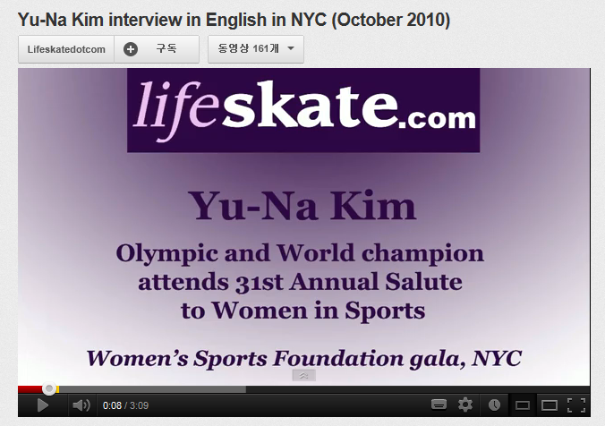
Q-A with Ss
Video Play
: only 1 minute
Do you think who is Korea’s sweetheart in the field of sports?
I will show you a short video.
http://www.youtube.com/watch?v=SUNCyUX1J5U&feature=relmfu

Slide 14
Pre-activity
Materials
: Laptop & Speakers, Voca-mp3, Voca-Worksheet
Board (or PPT file & Projector), Pre-text (in Korean)
Total Time
: 9 minutes

Slide 15
Time
: 2 minutes
Set Up
: Whole Class
Individually
Procedure:
As you could see, we will learn about the figure skater, Kim Yu-na.
First of all, I will give you a handout on her.
Please, read it for a while.
(To the next page)

Slide 16
Pre-Text about Kim Yu-na (in Korean)
김연아는 2010년 동계 올림픽 여자 싱글 챔피언, 2009년 세계 선수권 챔피언이다. 또한 대한민국 최초의 올림픽 피겨 스케이팅 메달리스트이자 세계 선수권 메달리스트이기도 하다. 김연아는 2009년 4대륙 피겨 스케이팅 선수권 대회 우승, ISU 그랑프리 파이널 3회 우승을 비롯해, 참가한 모든 국제 대회에서 입상한 경력을 가지고 있다. 2009년 세계 선수권에서 총점 207.71을 기록해 여자 싱글 최초로 200점을 돌파하였고, 2010년 밴쿠버 동계 올림픽에서는 쇼트 프로그램 78.50점, 프리 스케이팅 150.06점, 총점 228.56점으로 세계 최고 기록을 경신하였다.
김연아는 주니어 데뷔 후 역대 참여한 경기에서 3위 밖으로 밀려난 적이 없으며, 이런 기록은 1960년 캐롤 헤이스 이후 김연아가 처음이다. 2010년 월드컵 이후 뉴욕 타임즈에 세계에서 가장 영향력 있는 100인에 꼽혔다.
(material for pre-listening guiding text)
(hand it out to students)

Slide 17
Time
: 4 minutes
Set Up
: Whole Class
(hand a blank paper out to the students)
Procedure:
1. PRE-LISTENING
Now, you will listen to some vocabulary.
<Instruction>
You will listen to some vocabulary.
Each vocabulary is recorded twice.
Listen carefully and write them down on your blank page as many as you can.
Please, don’t cheat. Work individually.
(To the next page)

Slide 18
Procedure:
<Demonstration>
Look at me, first.
If you listen to “world championship” twice such as “world championship, world championship”, write down on your paper just once.
(I write “world championship” once, on the board.)
(To the next page)

Slide 19
Procedure:
<CCQ>
Are you working with alone?
How many times can you listen to?
Do you just listen to the vocabulary?
What do you have to do?
OK.
Are you ready?
Here we go.
(I play MP3.)
)

Slide 20
Time
: 3 minutes
Set Up
: Whole Class
Procedure:
2. VOCABULARY
How many words did you write?
Tell me the words, please.
(check the vocabulary with all students and I just pronounce once to save time.
And then, hand out “English-Korean vocabulary sheet” to each student for them to check the right spelling and meaning of the words.
And finally, pronounce all words together.)

Slide 21
Vocabulary
vocabulary | meaning | vocabulary | meaning
Kim Yu-na | 김연아 | Be able to | ~할 수 있다
Figure skater | 피겨스케이트선수 | Expert | 전문가
Medal | 메달 | Be endowed with | 부여 받다
Even though | 비록~일지라도 | Outstanding | 뛰어난
Participate in | ~에 참가하다 | Effort | 노력
International | 국제적인 | Flawless | 흠이 없는
Competition | 경쟁, 대회 | Nationalist | 민족주의자
Artistic performance | 예술적인 공연 | Fervor | 열정
Professional | 전문적인 | Goodwill Ambassador | 친선대사
Show off | 뽐내다 | ceaseless | 끊임없는
(material for checking the vocabulary, hand it out to students)

Slide 22
Main activity
Materials
: Board & Markers, Laptop & Speakers, Listening Files (Original, Chunk), English Text (Original, Chunk, Blank)
Total Time
: 16 minutes

Slide 23
Time
: 4 minutes
Set Up
: Whole Class
Procedure:
1. Listening for the Main Idea
<Instruction>
From now on, you will listen to the main text about the figure skater Yu-na Kim.
You will just listen only one time.
Don’t write down anything, just listen.
<CCQ>
Do you have to write down anything?
How many times are you listening to?

Slide 24
Time
: 7 minutes
Set Up
: Whole Class
Procedure:
2. Listening for Details
<Instruction>
(Hand out the text which has some blanks)
This time is for listening to details.
I will turn on the player and you will listen to the text twice.
As listening to, fill in the blank, please.
The blanks are not only for vocabulary but for some phrases and chunks.
If you don’t know right spelling, you can write some words as you heard.
Please, pay attention to the sounds and whole story not right spelling each.
(To the next page)

Slide 25
Procedure:
<CCQ>
How many times will I play?
Are you just listening?
What are you supposed to do?
If you don’t know the right spelling, do you have to leave it empty?
Do you have to understand whole story?
Now, let’s get it started.

Slide 26
Text with Blanks
Kim Yu-na is the first Korean to win a medal at the World Championships. She is one of the most famous and talented figure skaters in the world. Now, she has fans all over the world.
Kim Yu-na was born on September 5, 1990 in Bucheon, Gyeonggi-do. She started to learn skating when she was 6 years old. she was very young, she practiced very hard. In 2002, she an international competition for the first time. She won a gold medal at the Triglav Trophy.

Slide 27
Text with Blanks
When she was 12 years old, she to win the senior title at the South Korean Figure Skating Championship. The same year, she won her second international in Croatia. When she was 14 years old, Yu-na won at the 2005 World Junior Figure Skating Championship. She her wonderful skating skills at the competition. She became famous for her and speedy performances. Soon, Yu-na became a world-famous figure skater. In 2006, she , Canada for training with her coach Brian Orser. He was a famous professional figure skater. In fact, he was in Canadian history.

Slide 28
Text with Blanks
On March 28, 2009, she won a gold medal for the first time in Korean history at the World Figure Skating Championships. She showed off her beautiful skating skills to the world, and won the world title. “Even with a little mistake, I was able to do well. world champion was my dream .” she said after winning the competition. Many figure skating experts say, “Kim Yu-na in figure skating.” There is not an ice link for professional figure skating training in Korea, but her hard training and ceaseless efforts resulted in and artistic performance.

Slide 29
Text with Blanks
She , winning the gold medal in the 2010 Vancouver Winter Olympics. Her triumph Korean nationalist . She is a and the first female athlete who has become the UNICEF Goodwill Ambassador. Now, she is the role model of countless future figure skaters.

Slide 30
Whole Text
Kim Yu-na is the first Korean figure skater / to win a medal / at the World Championships.
She is one of the most famous / and talented figure skaters / in the world.
Now, she has fans / all over the world.
Kim Yu-na was born / on September 5, 1990 / in Bucheon, Gyeonggi-do.
She started to learn / skating / when she was 6 years old.
Even though she was very young, / she practiced very hard.
In 2002, / she participated / in an international competition / for the first time.
She won / a gold medal / at the Triglav Trophy.

Slide 31
Whole Text
When she was 12 years old, / she became the youngest female / to win the senior title / at the South Korean Figure Skating Championships.
The same year, / she won / her second international competition / in Croatia.
When she was 14 years old, / Yu-na won / at the 2005 World Junior Figure Skating Championship.
She showed off / her wonderful skating skills / at the competition.
She became famous / for her artistic and speedy performances.
Soon, Yu-na became / a world-famous figure skater.
In 2006, / she moved to Toronto, Canada / for training / with her coach Brian Orser.

Slide 32
Whole Text
He was a famous professional figure skater.
In fact, / he was one of the most successful skaters / in Canadian history.
On March 28, 2009, / she won a gold medal / for the first time / in Korean history / at the World Figure Skating Championships.
She showed off / her beautiful skating skills / to the world, / and won the world title.
“Even with a little mistake, / I was able to do well.
Being the world champion / was my dream / and I just did it.” / she said / after winning the competition.
Many figure skating experts say, / “Kim Yu-na is endowed with / an outstanding gift / in figure skating.”

Slide 33
Whole Text
There is not an ice link / for professional figure skating training / in Korea, / but her hard training and ceaseless efforts / resulted in / flawless and artistic performance.
She set a record / with the highest score ever, / winning the gold medal / in the 2010 Vancouver Winter Olympics.
Her triumph stirred up / Korean nationalist fervor.
She is a legendary figure skater / and the first female athlete / who has become the UNICEF Goodwill Ambassador.
Now, / she is the role model / of countless future figure skaters.

Slide 34
Time
: 5 minutes
Set Up
: Whole Class
Procedure:
3. Check the blanks and the story
Now check the blanks and the whole text out with all together.
(I will show the right phrases while we are listening to the text.
Use chunk mp3.)
Do you understand the story?
Do you want to listen one more?
Yes : Play more
No : Go to the next step.

Slide 35
Post-activity
Materials
:Handout for Writing & Speaking Exercise (English Sentence Order- for Homework), Some words & pictures, whole text
Total Time
: 3 minutes

Slide 36
Time
: 3 minutes
Set Up
: Whole Class
Procedure:
Free Production
and Conclude Lesson
You have learned about Kim Yu-na by listening to the text and also learned about some vocabulary.
<Instruction>
And now, I will give you some words and pictures regarding today’s text.
Please, think about the right order and also make some sentences related to the Kim Yu-na’s story.
Bring your sentences by next class.

Slide 37
Procedure:
<Demonstration>
For example, if you have “Champion” and “Bucheon”, “Bucheon” is the first word and the next one is “Champion.”
And also you can make sentences such as “Kim Yu-na was born in Bucheon”. Another sentence is “She became the world champion at the World Figure Skating Championship”.
You don’t have to make the same sentence with original text.
Just use the story.

Slide 38
Procedure:
<CCQ>
Will you have some words or pictures?
Do you make a long and whole story?
Do you have to use the words or pictures when you make some sentences?
When will you bring the sentences?
(Hand some words & pictures out to the Ss.)

Slide 39
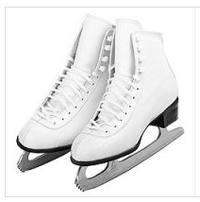
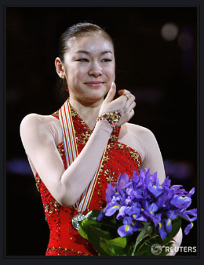
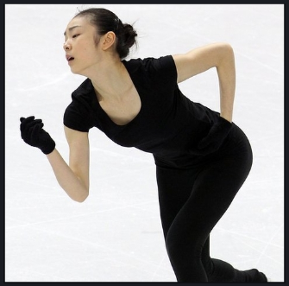
Words & Pictures for Homework
Figure skater
Fans (people)
Practice
Show off
Skating skills
Performance
History
Championship
record

Slide 40
Procedure:
Say Good-bye
Thank you for coming and good job today.
We will continue to work more next time.
So I hope to see you in the next class.
Have a good day and see you next time!
(In the next class, we will work on group activities such as vocabulary game and make story in the right order.
And also we have time to present each student’s famous sport player.)

