Slide 1
Warmer Activity

Slide 2
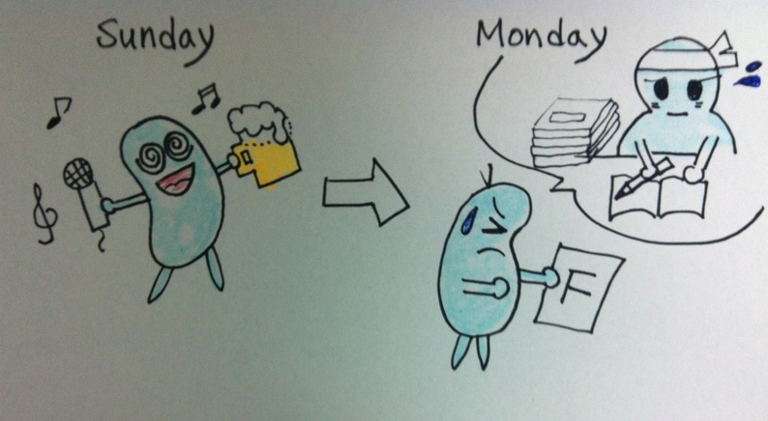
“ You should have studied hard. “

Slide 3
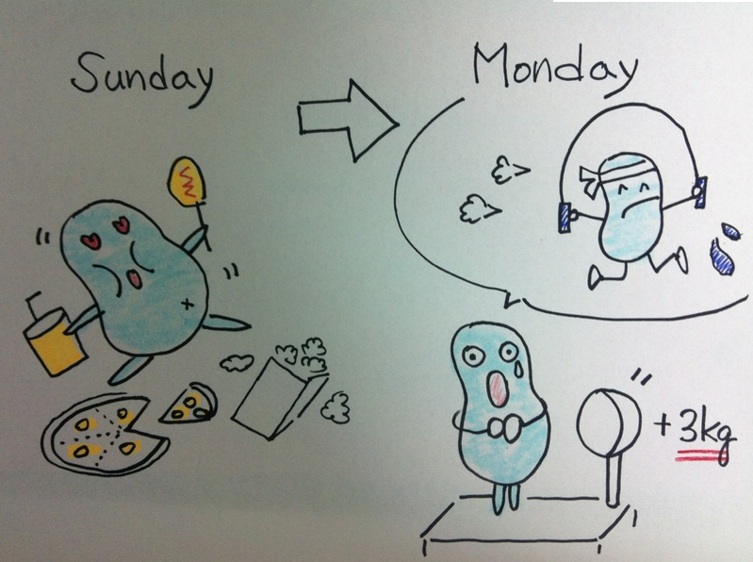
“ You should have done exercise. “

Slide 4
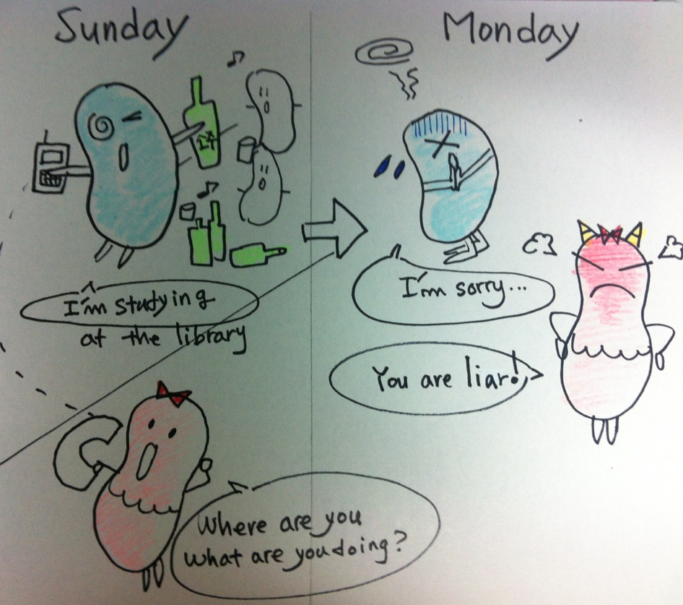
“ You should have told the truth. “

Slide 5
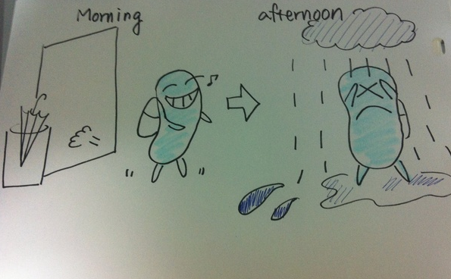
“ You should have taken your umbrella. “

Slide 6
+Past Participle
You should have studied hard.
You should have done exercise.
You should have told the truth.
You should have taken your umbrella.

Slide 7
should have +past participle
I | should | have | studied hard.
You |  |  | done exercise.
He / She | ought to |  | told the truth.
We / They |  |  | taken umbrella.

