Slide 1
Used to game
Name:

Slide 2
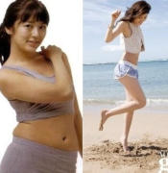
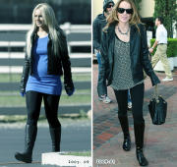
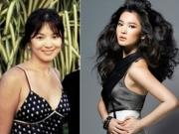

Slide 3
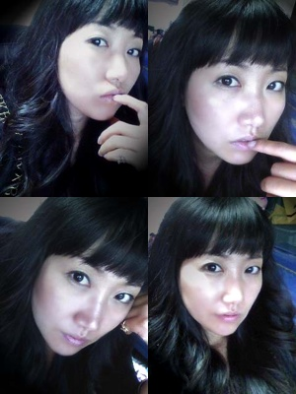

Slide 4
used to Form
I You We They He She It | used to | work have play | in a factory a piano tennis

Slide 5
Choose ‘ used to’ or present simple ‘I play or he lives’
I _______________ tennis. I stopped playing a few years ago.
Do you play any sports?
yes, I ____________ basketball.
3. Do you have a car?
No, I ____________________ one, but I sold out.

