Slide 2
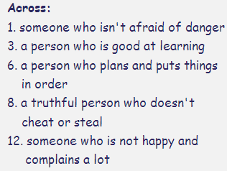
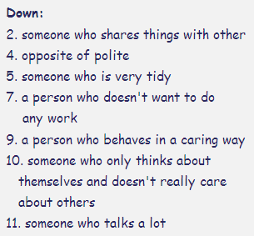

Slide 6
Honest
Well- spoken
Sensitive
Sensible
Funny
Shy
Confident
Strict
Easygoing
Talkative
Fun-loving
Withdrawn
Whiney
Aggressive
Romantic
Boring
Mean
Positive
Caring
Thoughtful
Brave
Smart
Loving
Spontaneous

Slide 7
Honest
Well- spoken
Funny
Shy
Confident
Strict
Easygoing
Talkative
Whiney
Aggressive
Romantic
Boring
Thoughtful
Mean
Brave
Smart
Loving
Spontaneous

Slide 8
Energetic
Hard-working
Sensitive
Rude
Giving
Capable
Sweet
Outgoing
Cool
Playful
Withdrawn
Obsessive
Well-read
Generous
Charismatic
Humble
Pushy
Uptight
Understanding
Responsible
Kind
Emotional
Punctual
Moody

Slide 9
Energetic
Hard-working
Sensitive
Rude
Giving
Capable
Sweet
Outgoing
Cool
Playful
Withdrawn
Obsessive
Well-read
Generous
Charismatic
Humble
Pushy
Uptight
Understanding
Responsible
Kind
Emotional
Punctual
Moody

Slide 10
Kate
Ian
Tina
Jenny

Slide 11
Lina
Jenise
Esther
Jennifer

Slide 12
Ben
Ben
Ben
Ben

Slide 13
I think I am …
I want to be…
I think I am …
I want to be…

Slide 14
Positive
Negative
Honest
Funny
Confident
Easygoing
Well-traveled
Whiney
Romantic
Thoughtful
Loving
Well-spoken
Caring
Charismatic
Kind
Punctual
Hard-working
Capable
Outgoing
Playful
Generous
Humble
Responsible
Intelligent
Giving
Sweet
Cool
Calm
Positive
Energetic
Sensible
Fun-loving
Shy
Strict
Talkative
Aggressive
Self-centered
Cold-hearted
Boring
Controlling
Mean
Negative
Weird
Goofy
Emotional
Messy
Moody
Picky
Rude
Disrespectful
Obsessive
Pushy
Cranky
Sarcastic
Uptight
Private
Wishy washy
Withdrawn
Sensitive

Slide 15
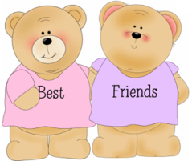
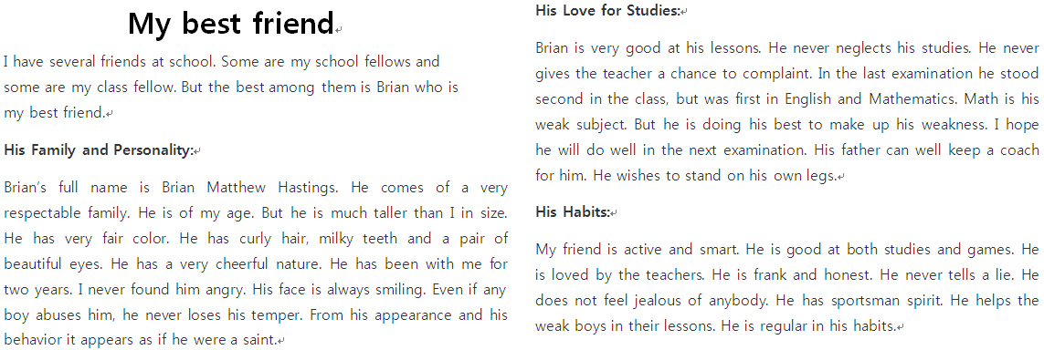
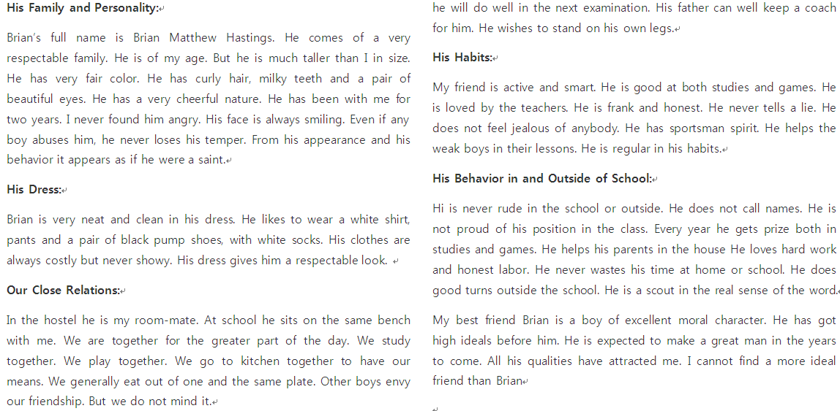

Slide 16
By

Slide 17
