Slide 1
 | MON | TUE | WED | THU | FRI | SAT | SUN
ENGLISH
JAPANESE
MATH
SCIENCE
KOREAN

Slide 2
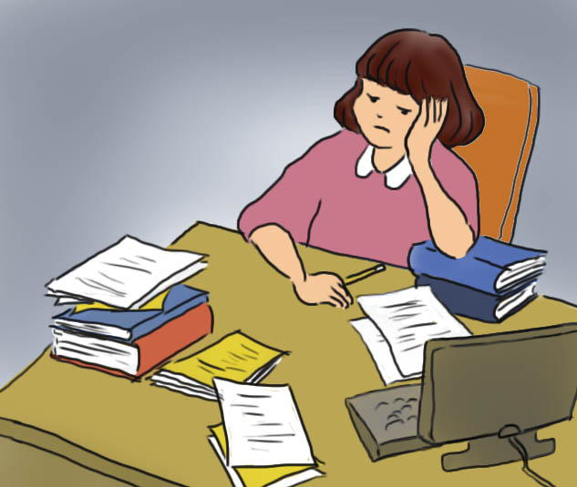

Slide 3
 Verb + -ed/-ing = adjective - Verb + -ed = Adjective tells how somebody feels - Verb+ -ing = Adjective tells the cause of feelings
(bore) (tire) (depress) (interest)
Mia is | bored. tired. | Studying is | Boring. Tiring.

Slide 4
Task 1
 Circle the correct adjectives.
1. He ate ten hamburgers. We were ( shocked / shocking ).
2. The ( bored / boring ) student was sleepy in class.
3. She was ( surprised / surprising ) at the news.
4. The Halloween costumes were ( scared / scaring ).
Task 2
Complete the sentences using the given words.
The project is so (confuse) .
It was (embarrass) to fall down.
Jane is (scare) of the dark.
Jennifer’s grades were (satisfy) .
The (worry) woman started to cry.

Slide 5
Task 3
Complete the sentences using –ed/-ing adjectives.
It’s been snowing all day.
This weather is .
Liz is a very person.
She Knows a lot, she’s traveled a lot, and she’s done lots of different things.
3. The kitchen hadn’t been cleaned in ages.
It was really .
I have been working very hard all day and now I’m .
I’m starting a new job next week.
I’m very about it.

Slide 6
 Let’s find more verb.
Excite | Embarrass | Surprise
Disappoint | Satisfy | Interest
Shock | Annoy | Depress
Worry
 Choose one or more words. Make the words in to adjectives. And Tell your partner your experience using the adjectives.

