Slide 1
5 Essential nutrients for health
2013. 10. 26

Slide 2
Protein

Slide 3
Carbohydrate

Slide 4
Calcium

Slide 5
Vitamin

Slide 6
Fat

Slide 7
Food groups 5
Fruit and vegetables
Starchy foods
Meat, fish, eggs and beans
Milk and dairy foods
Foods containing fat and sugar

Slide 8
Fruit and vegetables

Slide 9
Starchy foods

Slide 10
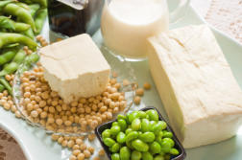
Meat, fish, eggs and beans

Slide 11
Milk and dairy foods

Slide 12
Foods containing fat and sugar

