Slide 1
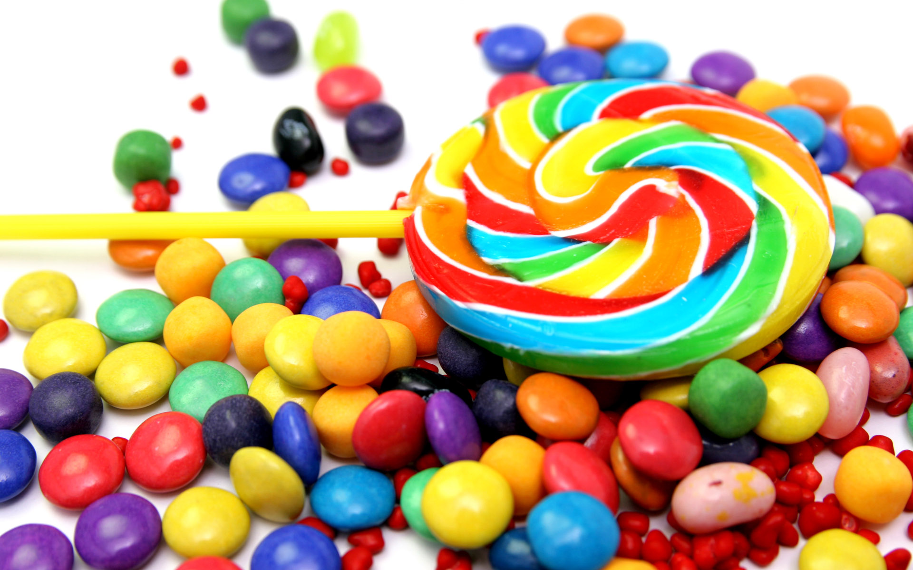
Jeopardy

Slide 2

10points | 20points | 30points | 40points | 50points
1 | 2 | 3 | 4 | 5
6 | 7 | 8 | 9 | 10
11 | 12 | 13 | 14 | 15
16 | 17 | 18 | 19 | 20

Slide 3

Q. Who invented the chocolate chip cookies?
    Betty Crocker
    Ruth Graves Wakefield
    Andrew Nestlé
    Kenneth Wakefield
Notes:
No.1 question

Slide 4
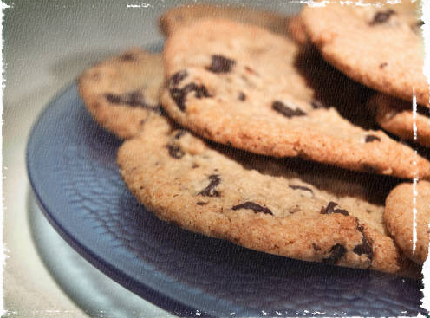
Q. How was chocolate chip cookies invented?
Answer
Notes:
No.2 question

Slide 5
By accident
Notes:
No.2 answer

Slide 6
Q. Please explain “Skyrocketed”
Answer
Notes:
No.4 question

Slide 7
A. For price, rate, amount increase
steeply or rapidly.
Notes:
No.4 answer

Slide 8
Q. What Ruth named her new invention of chocolate cookies?
Answer
Notes:
No.5 question

Slide 9
Chocolate Crunch Cookie
Notes:
No.5 answer

Slide 10
  Q. The invention of the chocolate chip cookie happened in which year?
    1920
    1930
    1933
    1950
Notes:
No.6 question

Slide 11
Q. What kind of chocolate did Ruth put into the cookie dough when she discovered she was out of baker’s chocolate?
Answer
Notes:
No.8 question

Slide 12
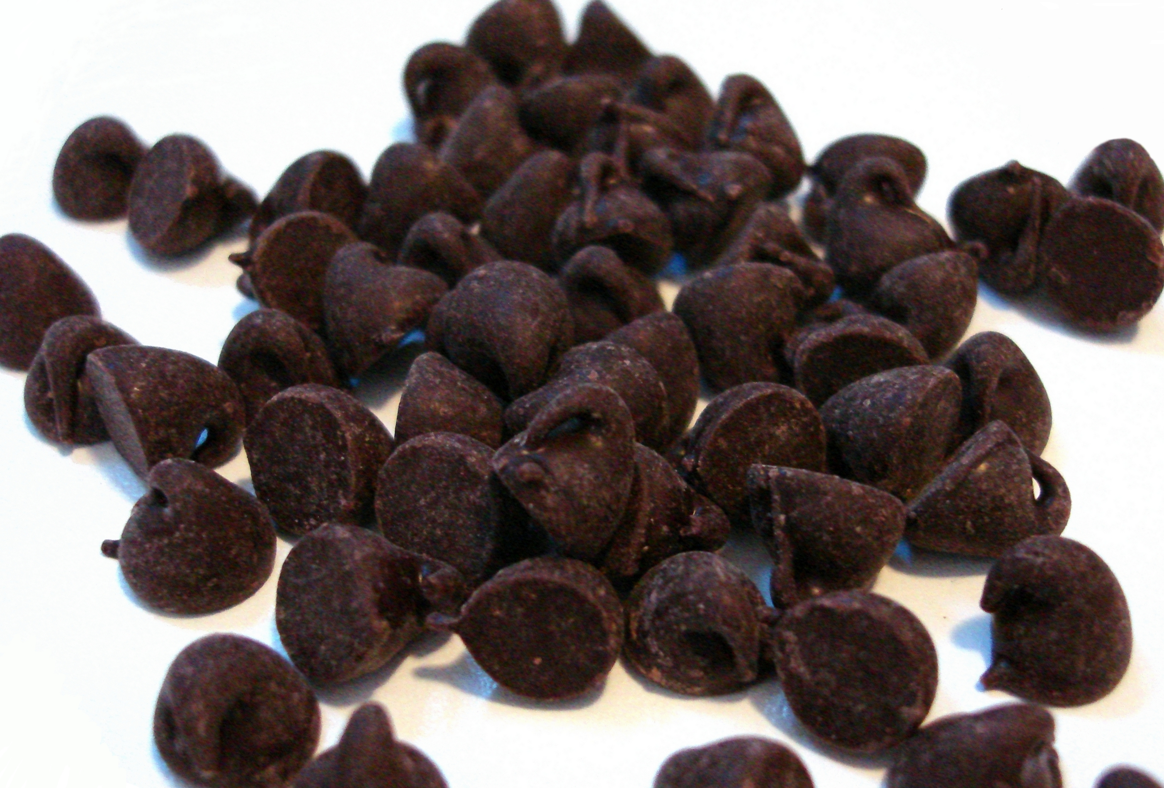

Nestle semi-sweet chocolate
Notes:
No.8 answer

Slide 13
Q. What was the popular old colonial recipe that Mrs. Wakefield used to serve the guest?
Answer
Notes:
No.9 question

Slide 14
Chocolate Butter Drop Do cookies
Notes:
No.9 answer

Slide 15
Q. Due to the enormous popularity of the cookie recipes, sales of which chocolates skyrocketed?
Answer
Notes:
No.10 question

Slide 16
Nestlé
Notes:
No.10 answer

Slide 17
Q. Who was Kenneth?
Answer
Notes:
No.11 question

Slide 18
A. Ruth’s husband
Notes:
No.11 answer

Slide 19
Q. Which one is not the dry ingredient?
  Sugar
  Flour
  Baking powder
  Egg
Notes:
No.12 question

Slide 20
Q. Besides as a dietician, what Mrs. Wakefield did at the same time?
Answer
Notes:
No.13 question

Slide 21
Food lecturer
Notes:
No.13 answer

Slide 22
Q. Where did she published the recipe?
Whitman and Massachusetts newspapers
New York Times
Life and Style
Boston and New England newspapers
Notes:
No.15 question

Slide 23
Q. What is chocolate made of?
Answer
Notes:
No.17 question

Slide 24
Cocoa bean, sugar, milk,
, cocoa butter and etc.
Notes:
No.17 answer

Slide 25
Please pronounce “flour”.
Notes:
No.18 question

Slide 26
Please explain the meaning of
“Necessity is the mother of invention”
Answer
Notes:
No.19 question

Slide 27
When people really need to do something, they will figure out a way to do it.

Slide 28
Q. What was the name of the guest house that Mr. and Mrs. Wakefield ran at that time?
Notes:
Extra Q

Slide 29
Toll House Inn

Slide 30
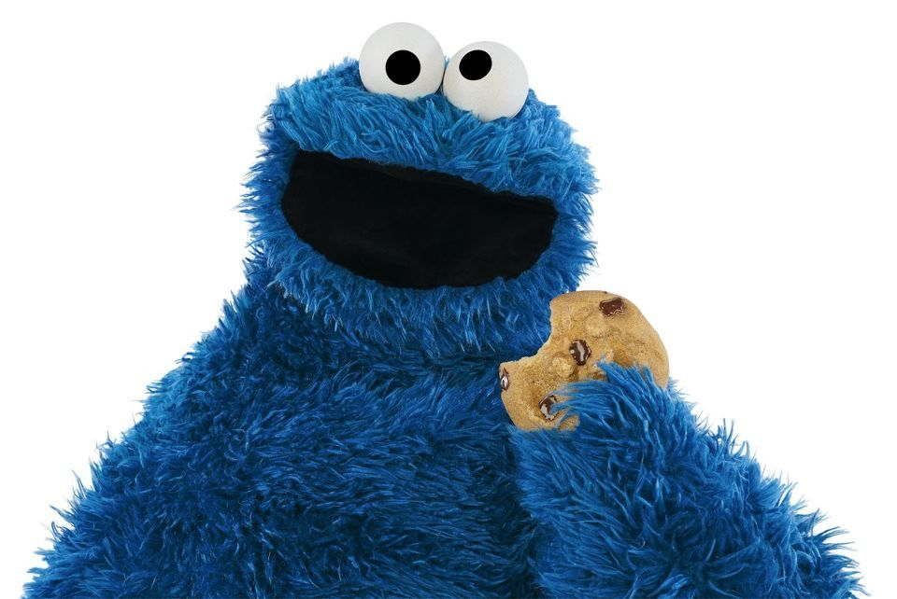
Great!

Slide 31

-50
Notes:
7 16 20

Slide 32

+100
Notes:
3 14

