Slide 1
Speed words game
Fun Fun
Fun Fun
Kelly Nayoung Kang

Slide 2
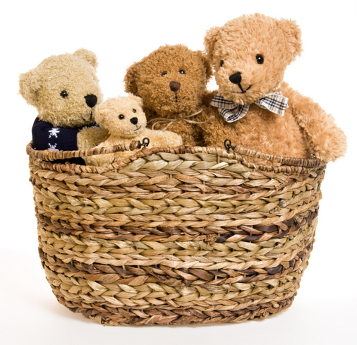
Teddy bear Store

Slide 3
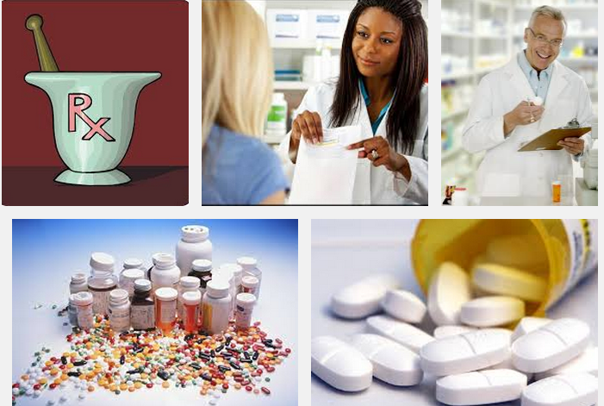
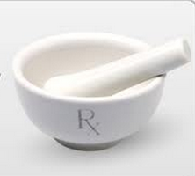
Pharmacy

Slide 4
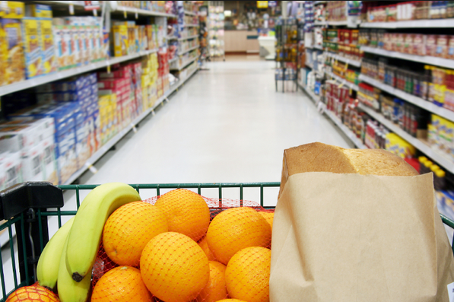
Grocery store

Slide 5
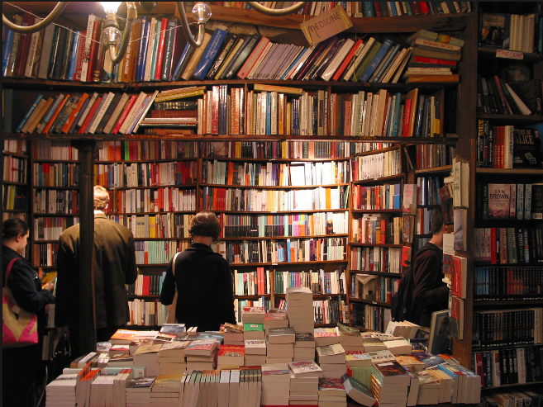
Book store

Slide 6

Clothes store

Slide 7
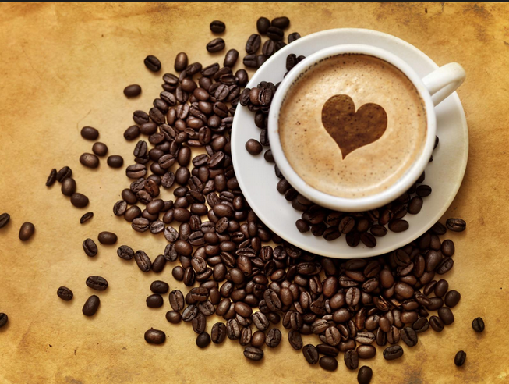
Cafe

Slide 8
Seating arrangements

Slide 9
A : Can I help you?
B : Yes, I'm looking for ( ). that matches this dress.
A : How do you like this one?
B : Yeah, it's OK. I'll take it. How much does it cost?
A : Oh, it's only $85.
How much is it?
How much do you charge for it?
How much do I owe you?
How much is this?
What's the price?

