Slide 1
Reading Lesson Plan
-Jessica JO-
“ A New Life for Trash”

Slide 2
● What do you recycle?
clothes book toy cooking foil
vegetable water can plastic bottle
newspaper paper glass tooth brush

Slide 3
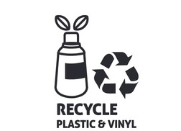
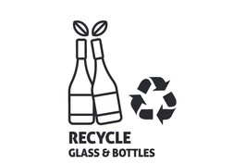
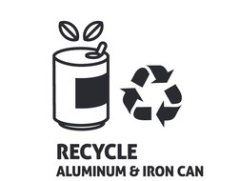
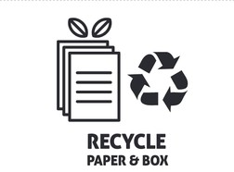
Recycle

Slide 4
●Vocabulary
-Write the correct definition of each word or phrase.
1. garbage ___________________ 6. Problem ____________________
2. recycle ____________________ 7. Wrong ____________________
3. break down _____________________ 8. Planet ____________________
4. useful ____________________ 9. Turn into ____________________
5. mark _____________________ 10. Throw away ____________________

Slide 5
●Vocabulary answers
1. garbage 쓰레기 6. Problem 문제점
2. recycle 재활용하다 7. Wrong 틀린, 맞지않은
3. break down 분해하다 8. Planet 행성
4. useful 유용한 9. Turn into ~으로 변하다, 바뀌다
5. mark 표시,마크 10. Throw away 내버리다

Slide 6
● Complete the sentences.
-complete the sentences with the correct words.
1. Trash is buried and ___________________ underground.
2. Tom does not like to take out the yucky and smelly ___________________.
3. The ship was ________ with a red cross.
4. You can __________________ your toys lf you no longer play with them.
5. The spy gave a _________________________tip to the police.
6. It is _____________to steal other people’s things.
7. A caterpillar ___________________ a butterfly.
8. Do you know the closest ___________________ to the Earth?
9. Do not____________________ your garbage anywhere.
10. Try to face your _________________________instead of running away.
Garbage problem break down planet recycle
mark throw away useful turn into wrong

Slide 7
● Complete the sentences.
-complete the sentences with the correct words.
1. Trash is buried and __broken down__ underground.
2. Tom does not like to take out the yucky and smelly _ garbage___.
3. The ship was __ mark___ with a red cross.
4. You can __ recycle______ your toys lf you no longer play with them.
5. The spy gave a ___useful___ tip to the police.
6. It is _ wrong___ to steal other people’s things.
7. A caterpillar _ turns into___ a butterfly.
8. Do you know the closest __ planet____ to the Earth?
9. Do not ___throw away___ your garbage anywhere.
10. Try to face your ____problems____ instead of running away.
Garbage problem break down planet recycle
mark throw away useful turn into wrong

Slide 8
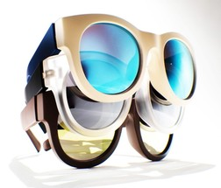
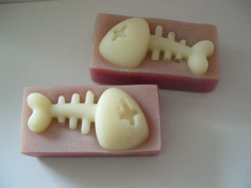
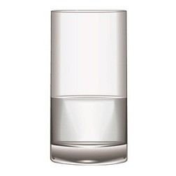
● Choose the correct answers
1. What is the passage mainly about?
ⓐImportance of recycling
ⓑImportance of saving garbage?
ⓒOut dirty planet.
2. Which can NOT be recycled?
ⓐ glass ⓑ plastic ⓒ fish bone
ⓐ glass ⓑ plastic ⓒ fish bone

Slide 9
● Choose the correct answers
1. What is the passage mainly about?
ⓐImportance of recycling
ⓑImportance of saving garbage?
ⓒOut dirty planet.
2. Which can NOT be recycled?
ⓐ glass ⓑ plastic ⓒ fish bone
ⓐ glass ⓑ plastic ⓒ fish bone

Slide 10
● Complete the sentences.
3. According to the passage, which is true?
ⓐ It takes ten years to break down plastic.
ⓑ Not everything can be recycled.
ⓒ Glass can be recycled and become sings.
4. How can we save trees and energy?
ⓐ by recycling paper
ⓑ by collecting glass
ⓒ by making furniture
5. Which sentence best tells about recycling?
ⓐ It means not taking something new.
ⓑ It means giving something old getting something new.
ⓒ It means taking something old and making it new.
6. What does plastic NOT become after recycling?
ⓐ a piece of furniture
ⓑ signs on the roads
ⓒ trees

Slide 11
● Complete the sentences.
3. According to the passage, which is true?
ⓐ It takes ten years to break down plastic.
ⓑ Not everything can be recycled.
ⓒ Glass can be recycled and become sings.
4. How can we save trees and energy?
ⓐ by recycling paper
ⓑ by collecting glass
ⓒ by making furniture
5. Which sentence best tells about recycling?
ⓐ It means not taking something new.
ⓑ It means giving something old getting something new.
ⓒ It means taking something old and making it new.
6. What does plastic NOT become after recycling?
ⓐ a piece of furniture
ⓑ signs on the roads
ⓒ trees

Slide 12
●Choose the correct answers (True/ False)
By recycling, you can keep the Earth clean.
All the garbage could be recycled.
Recycled plastic can become garbage cans.
Glass cannot be recycled.

Slide 13
●Choose the correct answers (True/ False)
By recycling, you can keep the Earth clean.
True
All the garbage could be recycled.
False
Recycled plastic can become garbage cans.
True
Glass cannot be recycled.
False

Slide 14
● Complete the graphic organizer
★ turns into a big garbage can ★ become furniture or signs on the road
★ needs a long time to rot away ★ become a clean planet
Plastic Water Bottle
If you don’t recycle
●Plastic ___________________
__________________
●The Earth ________________
____________________________
If you recycle
●Plastic____________________
____________________
●The Earth________________
____________________

Slide 15
● Complete the graphic organizer
★ turns into a big garbage can ★ become furniture or signs on the road
★ needs a long time to rot away ★ become a clean planet
Plastic Water Bottle
If you don’t recycle
●Plastic needs a long time to rot away.
●The Earth turns into a big garbage can.
If you recycle
●Plastic _becomes furniture signs on the road.
●The Earth _becomes a clean planet.

Slide 16
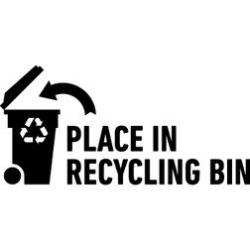
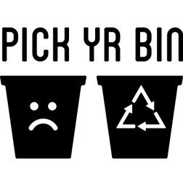
● Write the passage summary. You can refer to the graphic organizer.
A New Life for Trash
You can help the Earth by recycling. If you don’t recycle
a plastic water bottle, plastic ___________________
_________________________________________________Than, the Earth
________________________________________________________________.
But if you recycle, plastic_____________________________________
_________________________________________. And the Earth ________________
_______________________________________________.

Slide 17
● Write the passage summary. You can refer to the graphic organizer.
A New Life for Trash
You can help the Earth by recycling.
If you don’t recycle a plastic water bottle,
plastic __needs a long time to rot away. Than, the Earth
____turns into a big garbage can.__
But if you recycle, plastic __becomes furniture or signs on
the road. And the Earth become a clean planet._____

