Slide 1
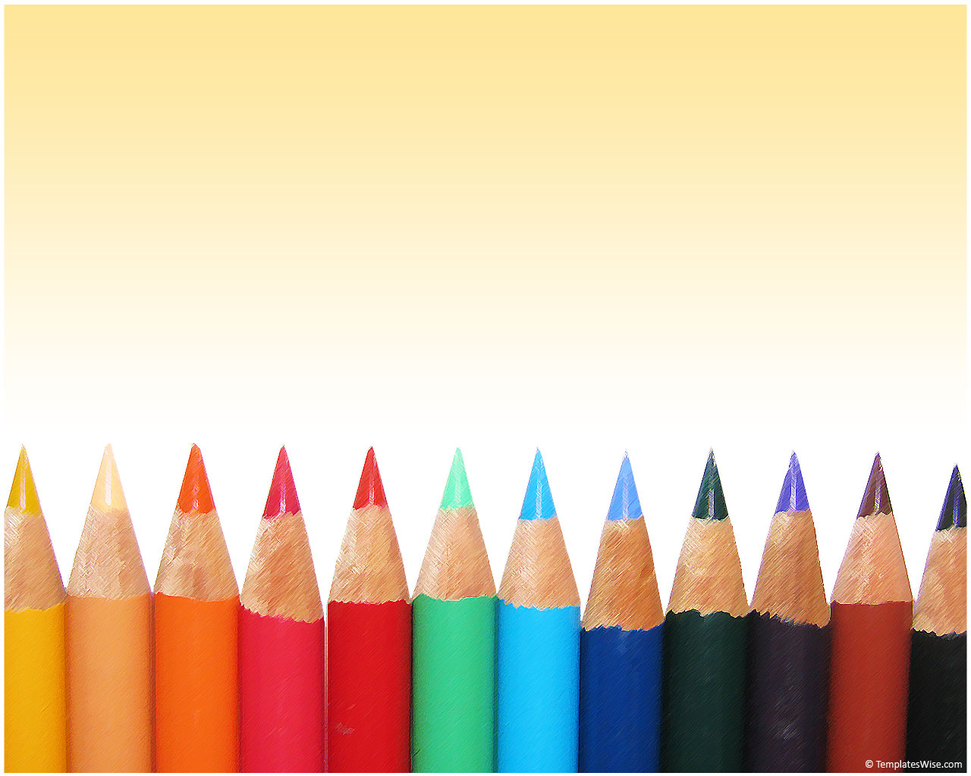
PREPOSITION POWER !!
Jessica Jo

Slide 2
What are PREPOSITIONS?
Words which show relationships among other words in the sentence.
The relationships include direction, place, time, cause, manner and amount.

Slide 3
Let’s start with Lesson !!!
PREPOSITIONS OF
PLACE

Slide 4
‘‘ AT ’’
We use “at” to refer to a specific & precise place. (when we see it as a point)
At the bus stop.
At the back of the bus.
At the top of the page.
At the bottom of the page.
At the front of the cinema.

Slide 5
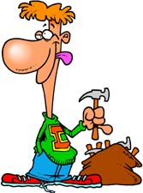
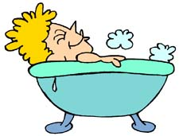
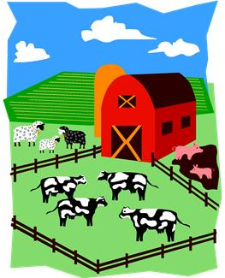
‘‘ IN ’’
We use “in” to refer to something that is inside a space, often with four walls around it.
The hammers are in the bag.
There are some cows in the field.
Tim is in the bathtub.
The mouse is in the box.

Slide 6
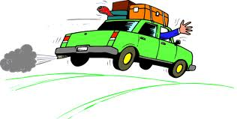
‘‘ ON ’’
We use “on” if something is on a horizontal or vertical surface.
The picture is on the wall.
On the front cover of the magazine.
The spider is on the ceiling.
We are travelling on the road.

Slide 7
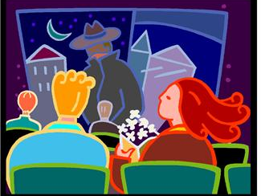
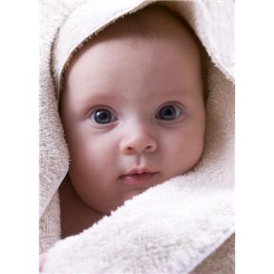
‘‘ OVER ’’
With numbers in a general sense, “over” means “more than”.
There were over 1,000 people at the station.
You have to be over 18 yrs of age to see the film.
We also use “over” if something is covering another thing.
He had a towel over his face.

Slide 8
‘‘ ABOVE ’’
To describe a point on a scale (such as a thermometer) that is higher than the starting point.
Fifteen degrees above zero.
100 meters above sea level
To refer to an object that is higher than another object.
There is a light above your desk.
There is a mirror above the washbasin.

Slide 9
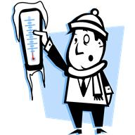
‘‘ BELOW ’’
To describe a point on a scale (such as a thermometer) that is lower than the starting point
Three degrees below zero.
Twenty metres below sea level.
The author's name was printed below the title.

Slide 10
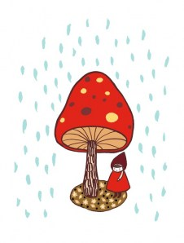
‘‘ UNDER ’’
To describe something that is physically lower than another thing. In many cases you can use “below” as well.
They stood under a tree (= below its branches) to avoid getting wet.
Her shoes were under the bed.

Slide 11
‘‘ NEAR / NEARBY / CLOSE TO’’
Near & Close to: To describe things that are within a short distance of one another.
Jane’s house is close to/near the beach.
Nearby = not far away
I noticed a policeman standing nearby.
Incorrect: I noticed a policeman standing nearby to the vehicle/ nearby the vehicle
Trainer’s Note: Nearby is used with only one point of reference.

Slide 12
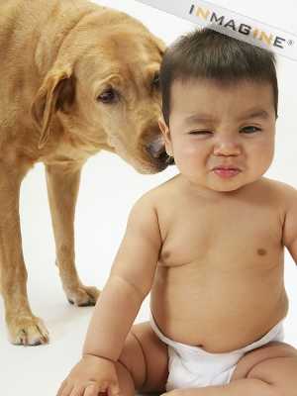
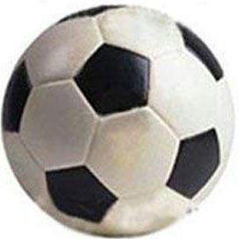
‘‘ NEXT TO / BESIDE ’’
To describe something that is very close to another thing, and almost touching that thing.
He sat next to me at my birthday party.
Go and sit beside the dog.
Trainer’s Note: Do not use ‘Besides’ !
It means except/other than.
Eg: Do you play any other sports besides football?

Slide 13
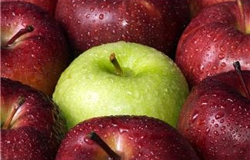
‘‘ BETWEEN vs. AMONG ’’
Between: To describe something that is between
two people/places/groups
A pile of books lay between the students
A narrow path ran between two rows of houses
Among: To describe something that is in the middle of
many things.
The green apple is among the red ones.

Slide 14
‘‘ OPPOSITE’’
We use “opposite” for two things that are facing one another.
They sat opposite each other in the meeting room.
Our office is right opposite the police station.
Trainer’s Note: Do not say ‘opposite to the police station’

Slide 15
Hmmm….
I was just wondering..

Slide 16
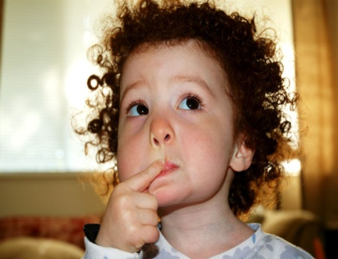
In the bed OR On the bed ??
Both.
ON the bed = laying (or standing/sitting) on top of the covers of the bed.
IN the bed = between the covers, retired for the night, and preparing to sleep; or possibly between the covers and resting due to sickness, etc.
In the corner OR At the corner ??
We say 'in the corner of a room', but 'at the corner (or 'on the corner') of a street‘

Slide 17
I live ON/AT/IN Downing Street ??
For an exact point on the street, use at.
Eg: I live at 10 Downing Street.
With street/avenue names, use on.
Eg: I live on Downing Street.
The best shopping places are on the 5th avenue.
Trainer’s Note: Do not use ‘the’ with street names.

Slide 18
Congratulations !!
You have Preposition Power !

