Slide 1
Greatest American Speeches
“… government of the people, by the people, for the people shall not perish from the earth”
“… ask not what your country can do for you—ask what you can do for your country”

Slide 2
Creed
e.g.)
  Apostles’ Creed
  “Be honest” is the creed of my life
A creed is a set of beliefs, principles, or opinions that strongly influence the way people live or work

Slide 3
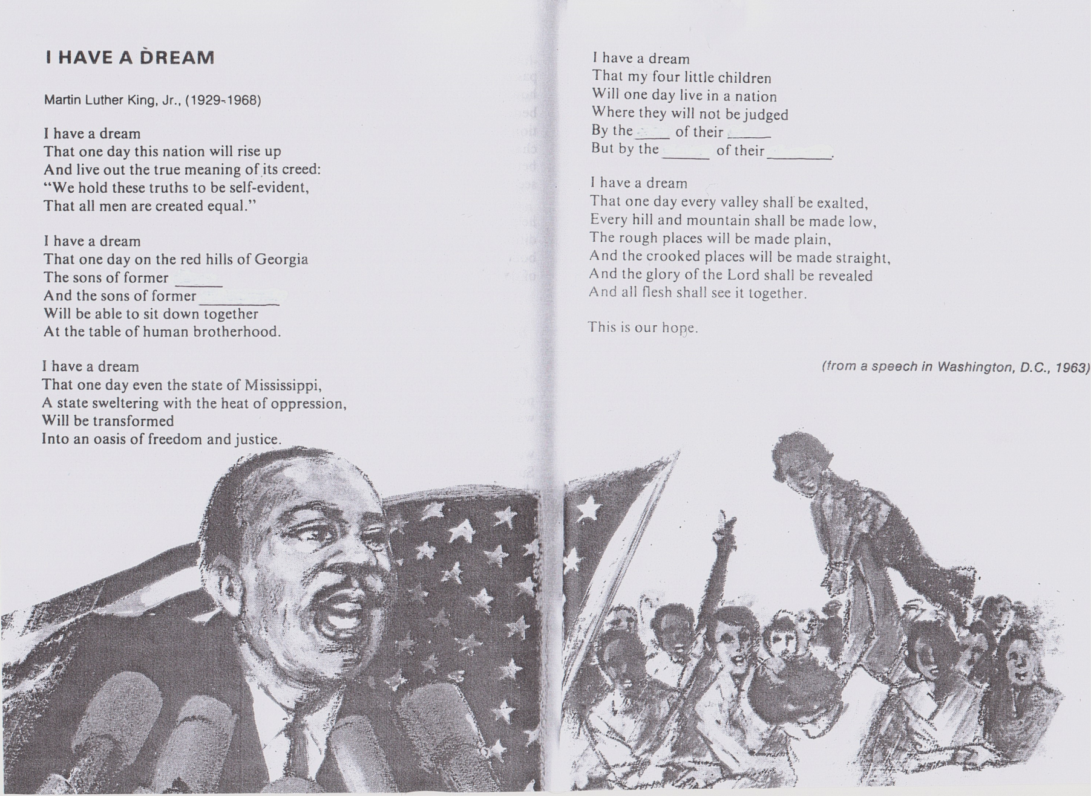
97th WD – Reading Lesson Plan
I HAVE A DREAM - from a speech of M. L. King Jr.
Matt (Jaeyong Chung)

Slide 4
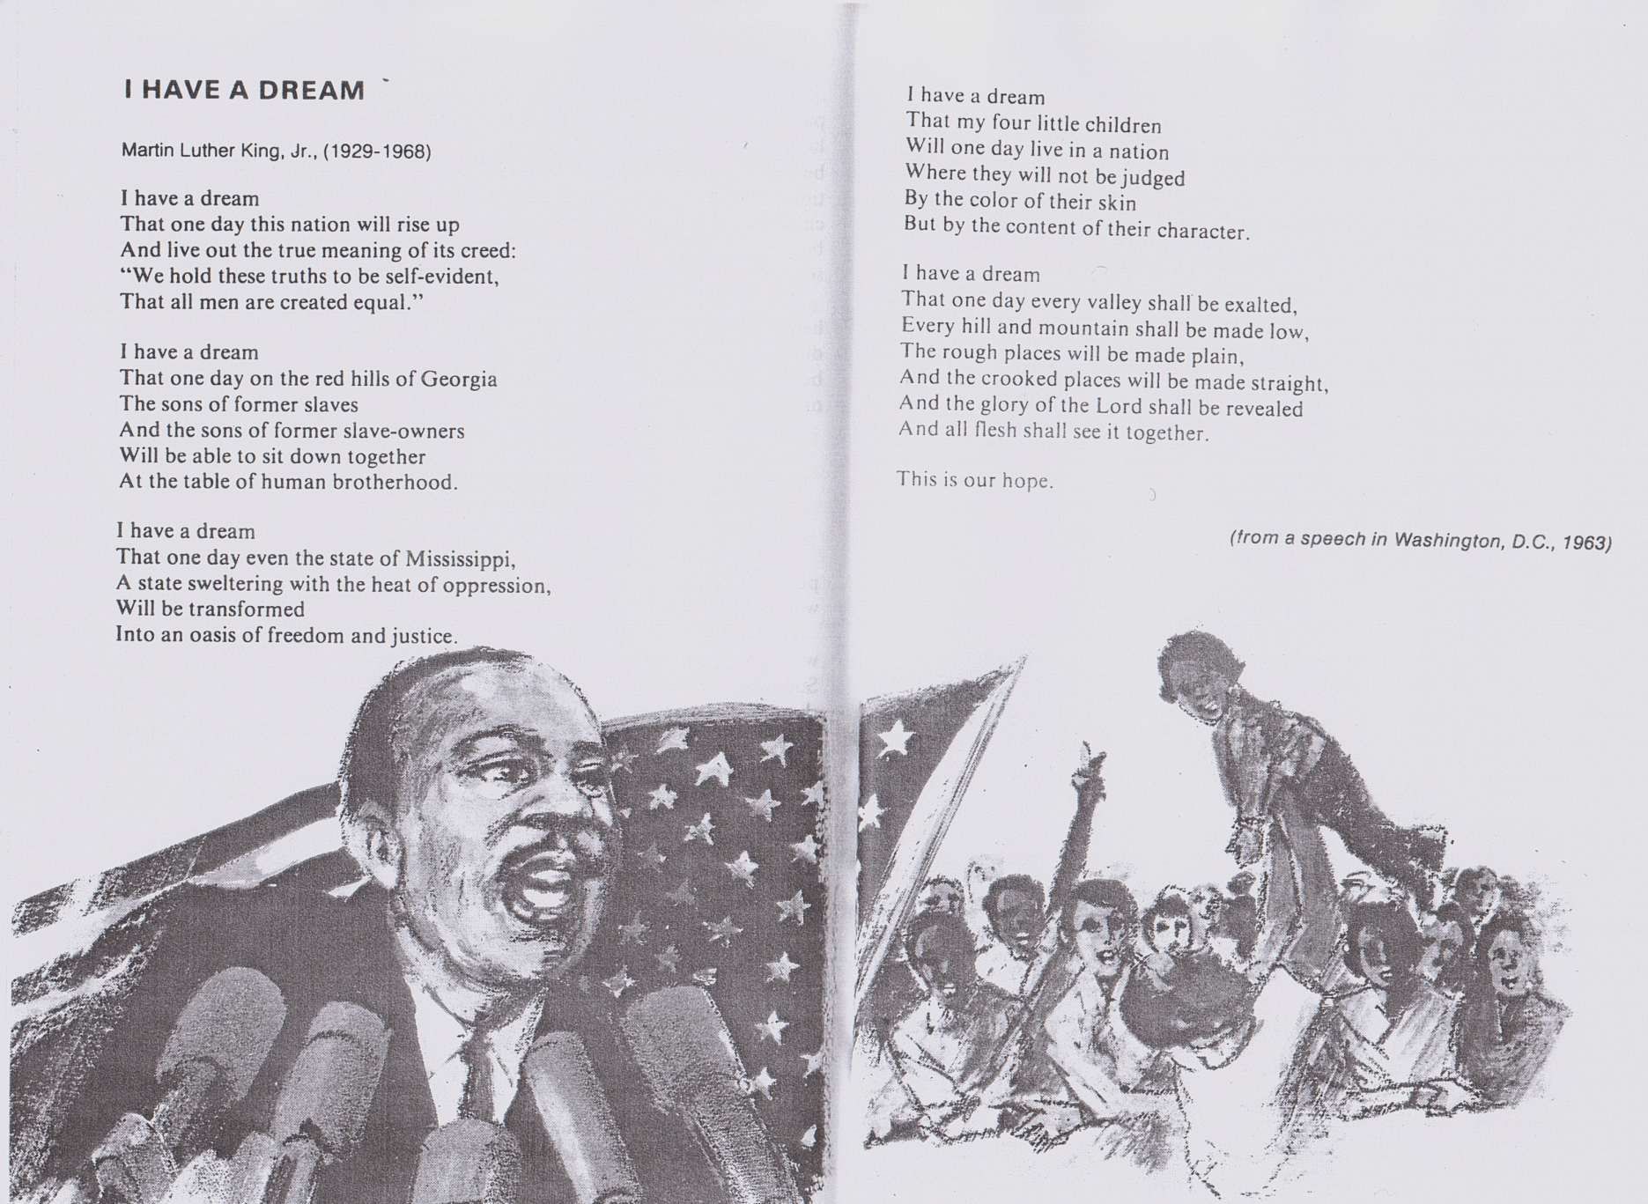
97th WD – Reading Lesson Plan
I HAVE A DREAM - from a speech of M. L. King Jr.
Matt (Jaeyong Chung)

Slide 5
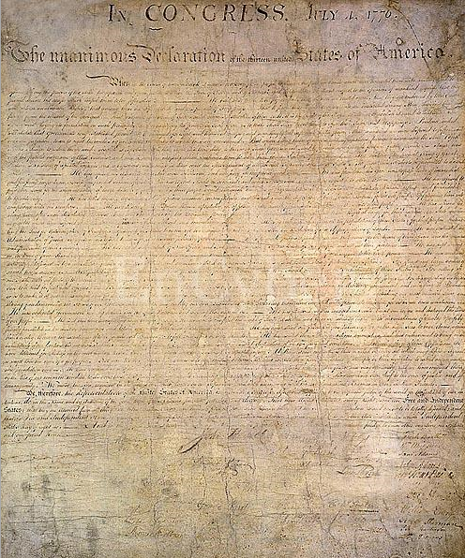
97th WD – Reading Lesson Plan
The Declaration of United States of America
“We hold these truths to be self-evident, that all men are created equal, …”
- in the beginning of 2nd paragraph
Matt (Jaeyong Chung)

Slide 6
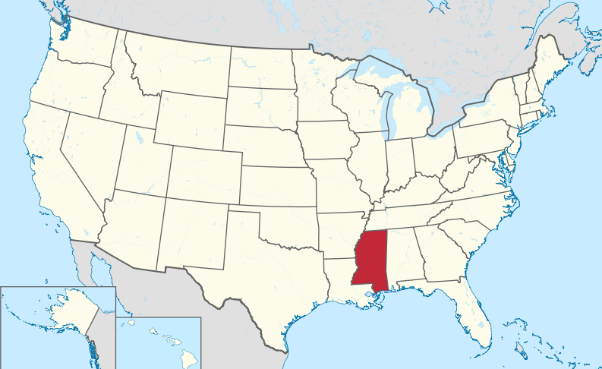
Vocabulary
live out
creed
self-evident
swelter
exalt
crook
Mississippi in United States
97th WD – Reading Lesson Plan
Matt (Jaeyong Chung)

Slide 7
Vocabulary
Word | Description
live out something | To do in reality something that you think about, believe in, dream of, etc
creed | A creed is a set of beliefs, principles, or opinions that strongly influence the way people live or work
self-evident | A fact or situation that is self-evident is so obvious that there is no need for proof or explanation
swelter | If you swelter, you are very uncomfortable because the weather is extremely hot
exalt | To exalt someone or something means to praise them very highly
crooked | If you describe something as crooked, especially something that is usually straight, you mean that it is bent or twisted
97th WD – Reading Lesson Plan
Matt (Jaeyong Chung)

