Slide 1
Lead-in Materials

Slide 2
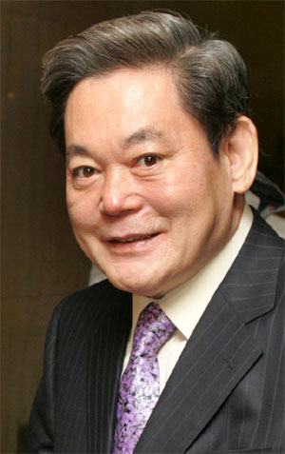
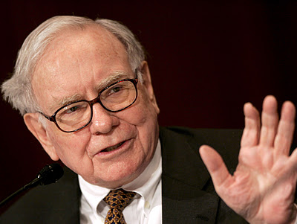

Slide 3
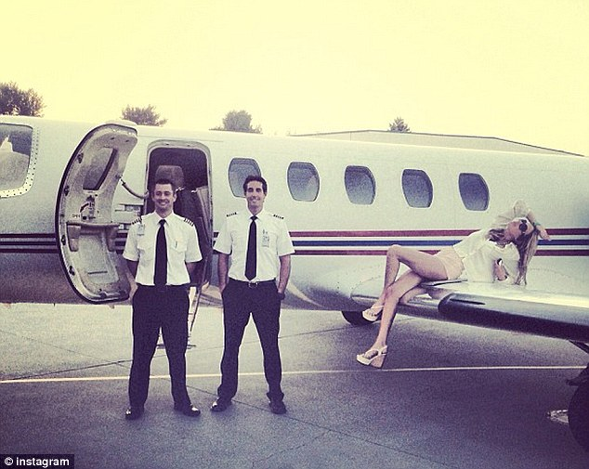
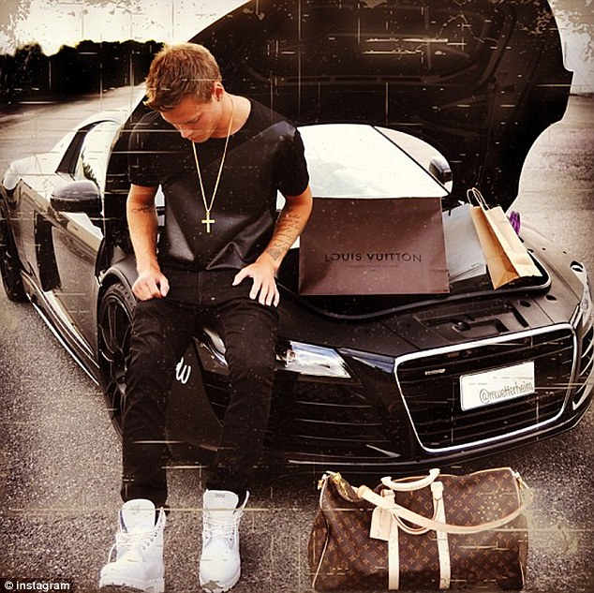

Slide 4
http://www.iheadlinenews.co.kr/news/articleView.html?idxno=171
http://kim-zibsa.tistory.com/24
http://www.dailydealmedia.com/789e-commerce-and-social-media-drive-sales-of-luxury-brands/
http://piic1.blogspot.kr/2012/01/luxury-private-jets.html

Slide 5
Pre-teach Vocabulary

Slide 6
One-way street

Slide 7
Sustain

Slide 8
Sit back and relax

Slide 9
Ideas
Solution
Plan
Rule
Come up with something

Slide 10
Floating along

Slide 11
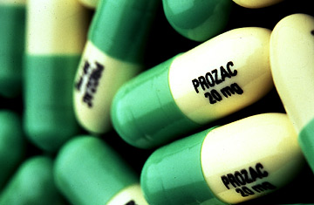
Anti-Depressant (Prozac)

Slide 12
Reference
http://calibermag.org/articles/celebrate-in-august/womana%C2%80%C2%99s-feet-in-a-hammock-with-ocean-in-background-2/
http://www.dreamstime.com/royalty-free-stock-photos-idea-bulb-above-man-s-head-image19064618
http://www.spokesman.com/blogs/hbo/2012/jul/13/floating-along/
http://www.sportsworldi.com/Articles/EntCulture/Article.asp?aid=20140304020606&subctg1=15&cid=1140150000000
http://sabotagetimes.com/life/losing-my-mind-on-anti-depressants/
http://health.chosun.com/site/data/html_dir/2011/10/24/2011102402077.html

