Slide 1
http://youtu.be/JDvDCqLCdEE

Slide 2
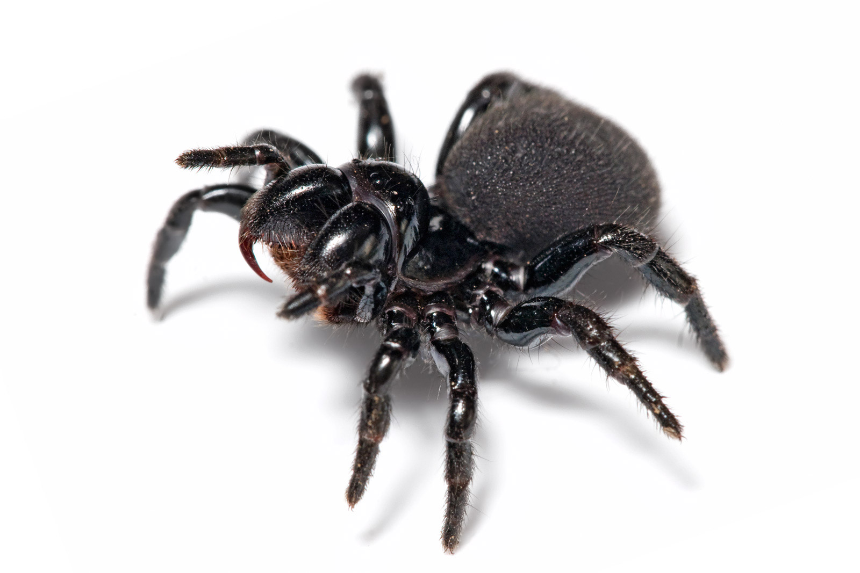
Arachnophobia

Slide 3
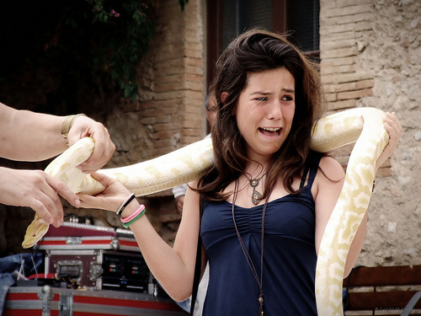
Ophidiophobia

Slide 4

Acrophobia

Slide 5
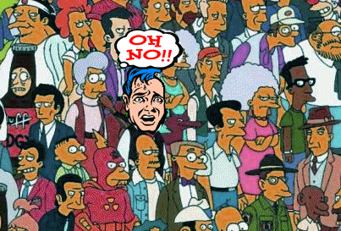
Agoraphobia

Slide 6
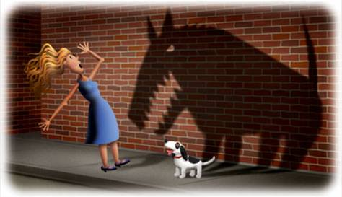
Cynophobia

Slide 7

Trypanophobia

Slide 8
Anxiety disorder
Irrational fear
Get queasy
Become housebound

