Slide 1
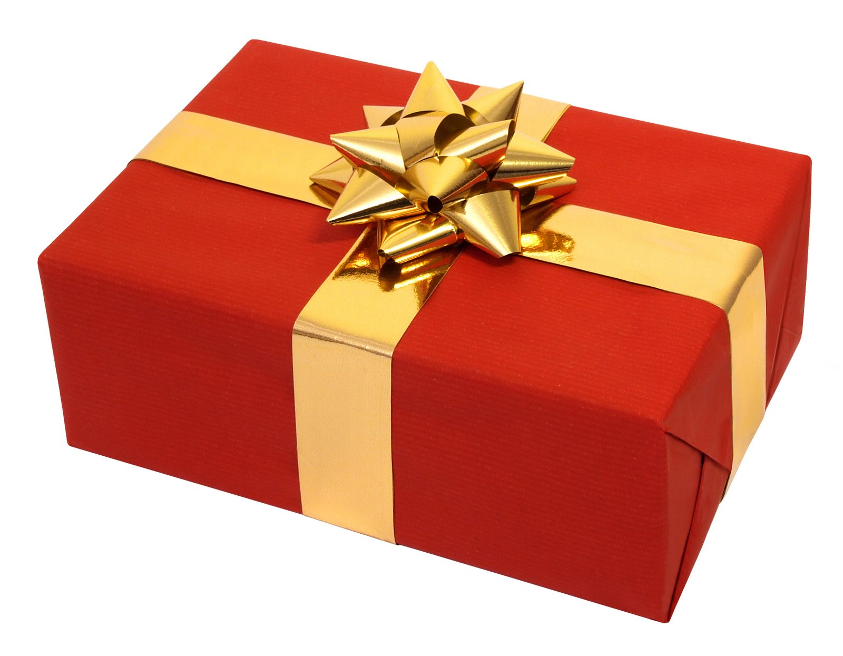
Notes:
Present

Slide 2
Notes:
1. Envision : to picture in the mind, imagine

Slide 3
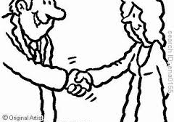
Notes:
2. Acquaintance : a person with whom one has been in contact but who is not a close friend
Make the acquaintance of come into social contact with

Slide 4
Notes:
3. Adoration : 1. deep love or esteem
2. the act of worship

Slide 5
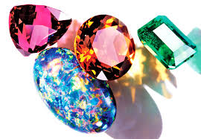
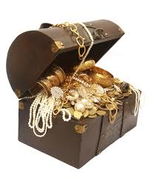
Notes:
4. Gem
a precious or semiprecious stone used in jewellery as a decoration; jewel
a beloved or highly prized person
treasure

Slide 6
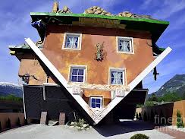
Notes:
Profoundly
Coming from a great depth
Thoroughgoing, far reaching
Penetrating beyond what is superficial or obvious
Unqualified, absoulte

