Slide 1
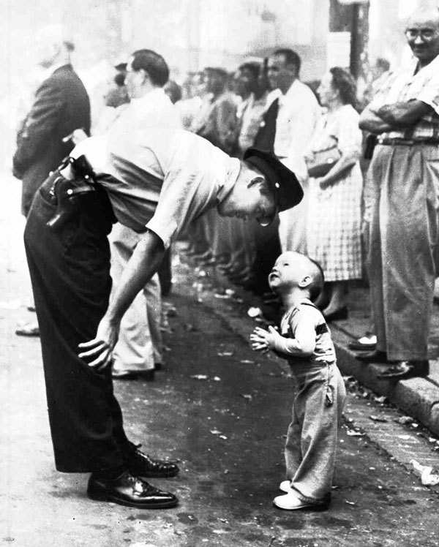
Faith and Confidence
Faith and Confidence, 1958 by William C. Beall
This picture was snapped on September 10, 1957
during the Chinese Merchants Associates parade.
During the parade, a policeman bent over to tell
a young boy to be careful and step back up
on the sidewalk, because the boy had stepped
into the street to get closer to
the dancing dragons.
Beall said that he wasn’t expecting for it
to be the “most-applauded photograph ever
to appear in the Washington Daily News”.
Faith and Confidence, 1958 by William C. Beall

Slide 2
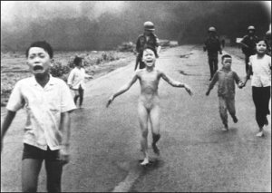
The little girl of Vietnam
On June 8, 1972, a US fighter jet bombed the population of Trang Bang in Vietnam with napalm. Kim Phuc was there with her family. With her clothes on fire, the nine year old girl ran away along with other children. At one point, her clothes burned out. This picture was shot, at that moment, by the famous photographer Nick Ut. Kim stayed in hospital for 14 months. The girl underwent 17 operations for skin grafts. Anyone looking at this photograph can see the intensity of the despair and human suffering created by wars (still raging in Afghanistan, Chechnya, Columbia, Congo, Iraq, occupied Palestine and Somalia), especially the effects on children and women. Today, Pham Thi Kim Phuc, the little girl in the photo, is married with two children. She lives in Canada where she presides over the Kim Phuc Foundation where the mission is to help child victims of war. She is also an ambassador for UNESCO.

Slide 3
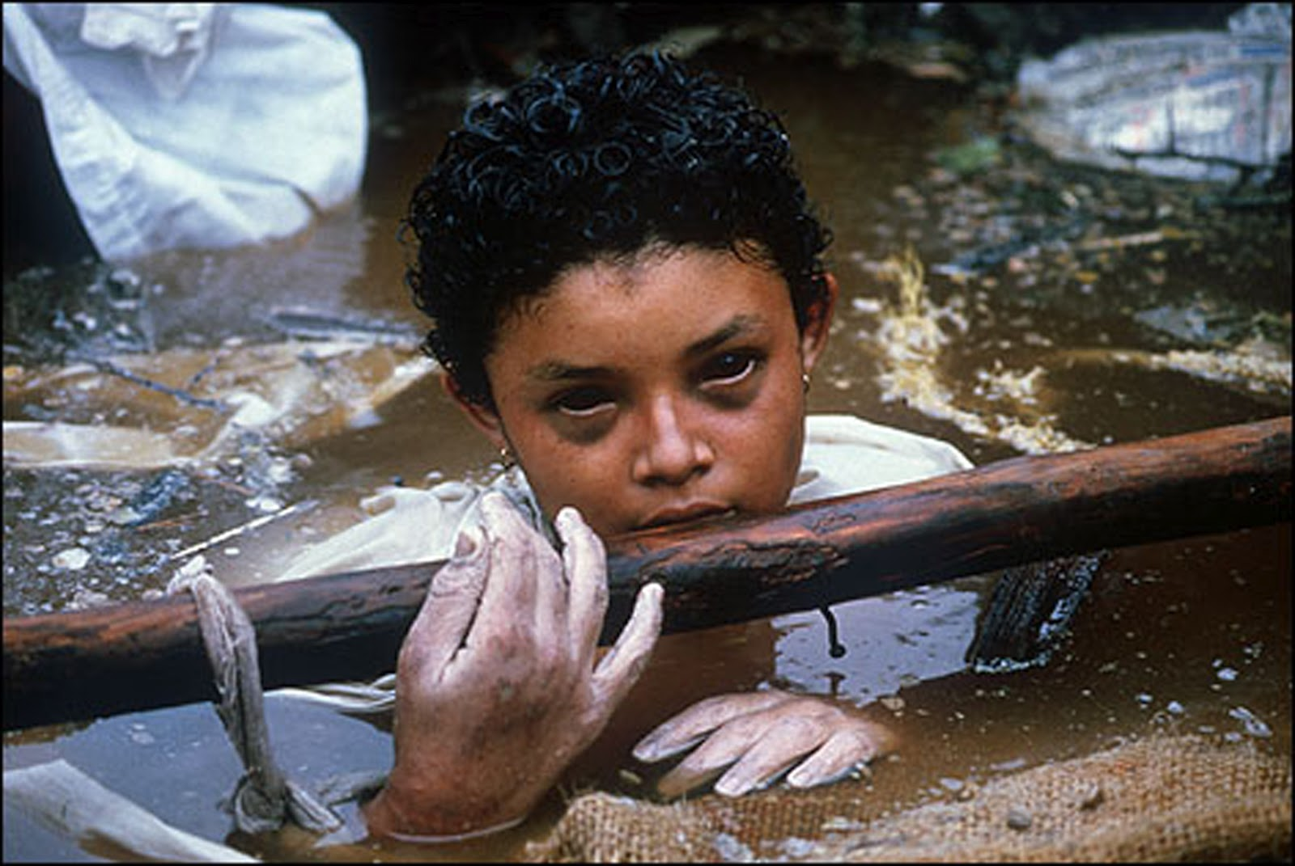
The agony of omayra
Omayra Sanchez was a little girl who died during the eruption of the Nevado del Ruiz volcano, which destroyed the town of Armero, Colombia, in 1985. Omayra was stuck for three days in the mud, water, corpses of relatives and debris from her home. She was 13 years old. Rescuers found that it was impossible to save her as they would have had to amputate her legs. The other option was to use a pump-turbine to suck the sticky mud. The only pump available was too far away and unavailable. Omayra was strong till the last moment of her life. According to aid workers and journalists who were with her for three days, she was thinking about returning to school and passing exams. Thanks to photographer Frank Fournier, the image of Omayra travelled the world exposing the indifference of the Colombian government to ordinary, destitute Columbians (which has not changed much today). The photograph was published several months after the young girl died. Many view this picture of 1985 as the beginning of what we now call the globalization of agony.

Slide 4
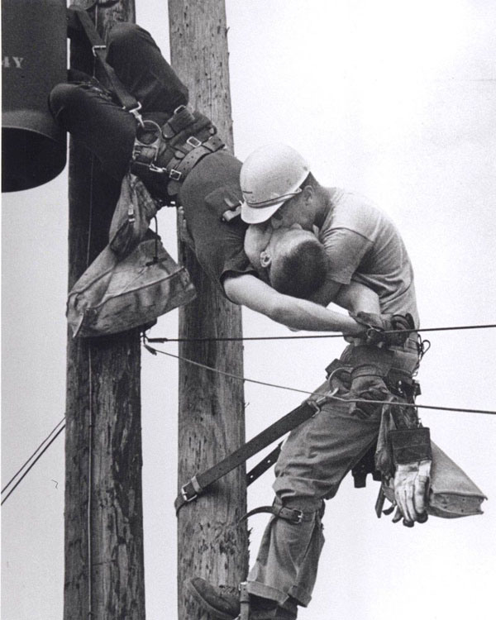
The kiss of life
Rocco Morabito, 1967
This photo shows two power linemen, Randall Champion and J. D. Thompson, at the top of a utility pole. They had been performing routine maintenance when Champion brushed one of the high voltage lines at the very top. These are the lines that can be heard “singing” with electricity. Over 4000 volts entered Champion’s body and instantly stopped his heart (an electric chair uses about 2000 volts).
His safety harness prevented a fall, and Thompson, who had been ascending below him, quickly reached him and performed mouth-to-mouth resuscitation. He was unable to perform CPR given the circumstances, but continued breathing into Champion’s lungs until he felt a slight pulse, then unbuckled his harness and descended with him on his shoulder. Thompson and another worker administered CPR on the ground, and Champion was moderately revived by the time paramedics arrived, eventually making a full recovery.

Slide 5
The kiss of life

Slide 6
The agony of Omayra

Slide 7
The little girl of Vietman

