Slide 1
Planning reception

Slide 2
[THE CEREMONY]
4:00 P.M
Congratulations! You are married, and the party is about to begin.

Slide 3
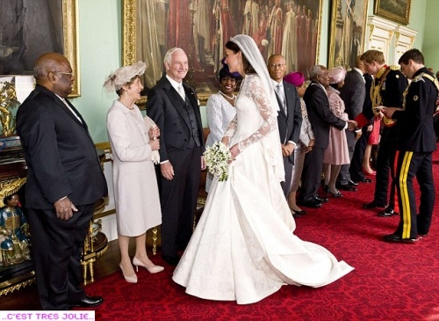
[THE RECEIVING LINE]
5:00 P.M
Couples today often forgo this tradition, but it is the one sure way to greet each guest.

Slide 4
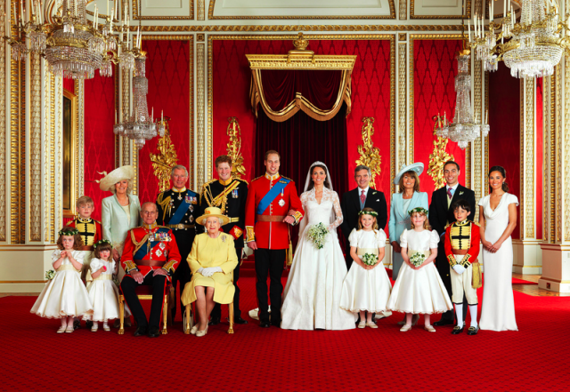
[FORMAL PORTRAITS]
6:00 P.M
Before joining the guests at the reception, the wedding party has their pictures taken.

Slide 5
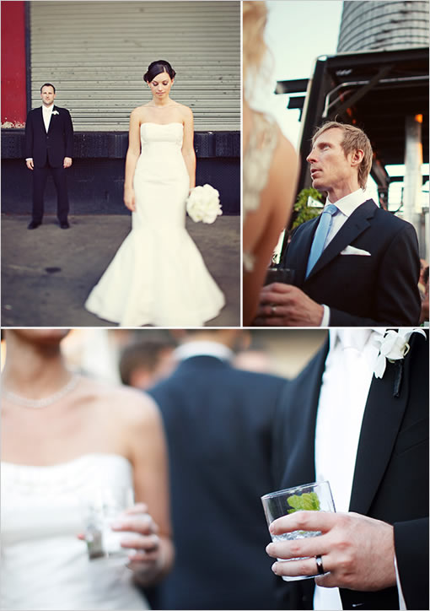
[COCKTAIL HOUR]
6:30 P.M
The first dance for everyone to mix and mingle, to preview the style of your party.

Slide 6
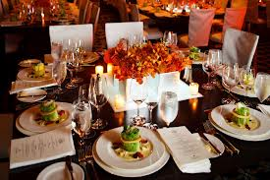
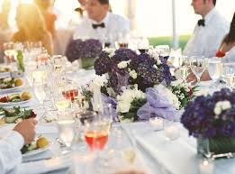
[DINNER]
7:30 P.M
Guests collect their table cards and find their places in the dining room.

Slide 7
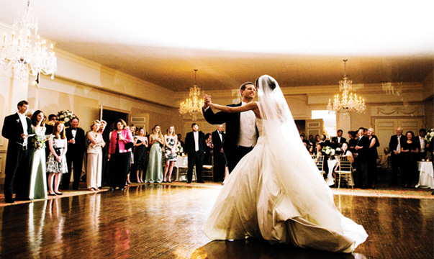
[THE FIRST DANCE]
7:45 P.M
The bride and groom glide across the dance floor to their special song.

Slide 8
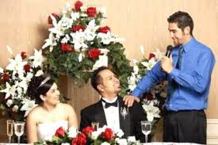
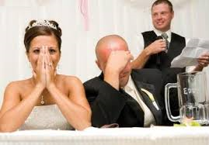
[THE TOASTS]
8:15 P.M
The best man raises his glass, and often the newlyweds say a few words, too.

Slide 9
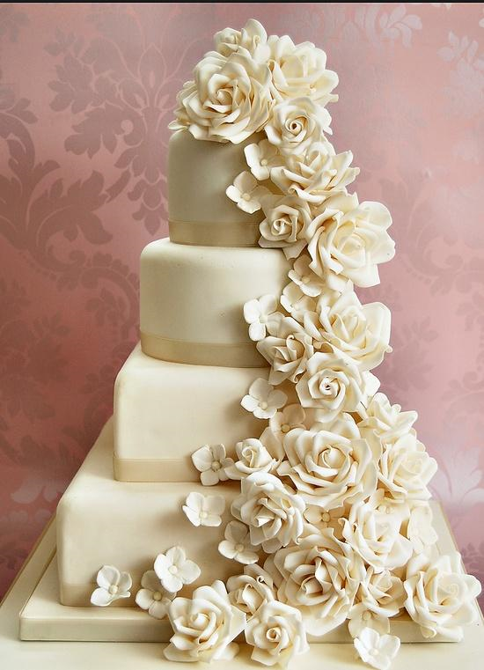
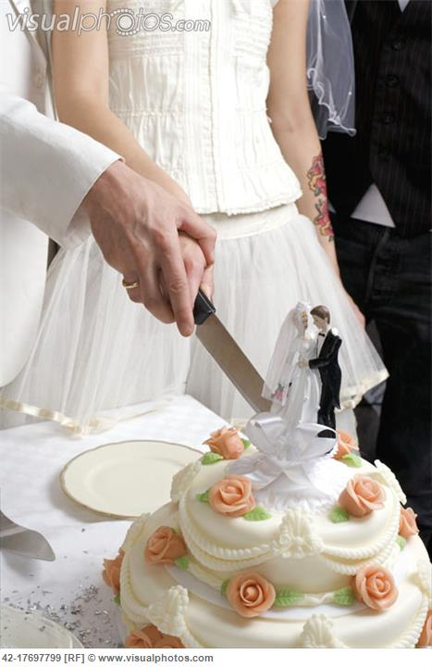
[CUTTING THE CAKE]
9:00 P.M
With his hand over hers, the newlyweds slice the cake together, then share the first piece.

Slide 10
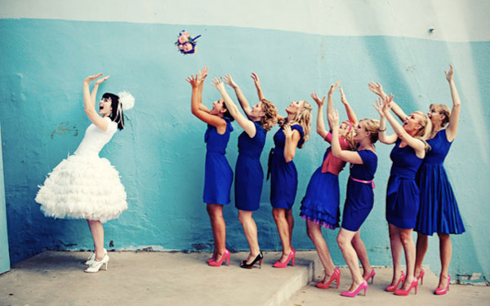
[TOSSING THE BOUQUET]
10:00 P.M
When the bride parts with her bouquet, the one who catches it is said to be the next to marry.

Slide 11
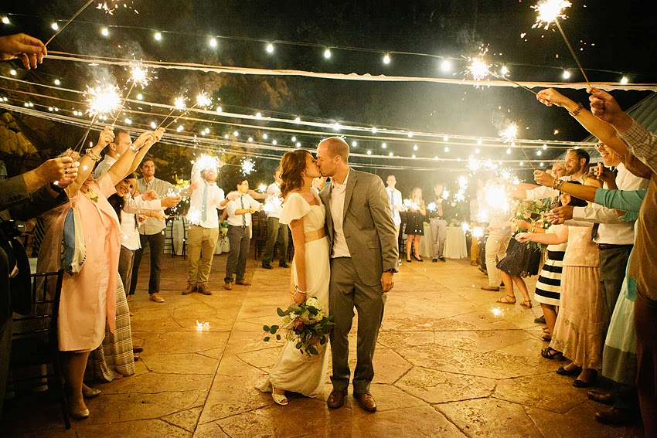
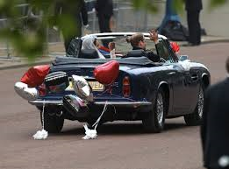
[GOING AWAY]
10:30 P.M
The newlyweds depart, the guests wish them farewell, and the party winds down.

