Slide 1
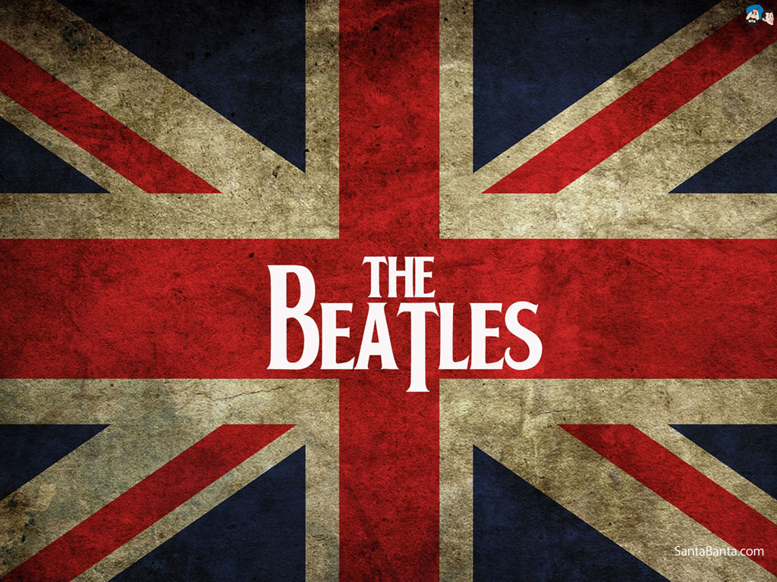
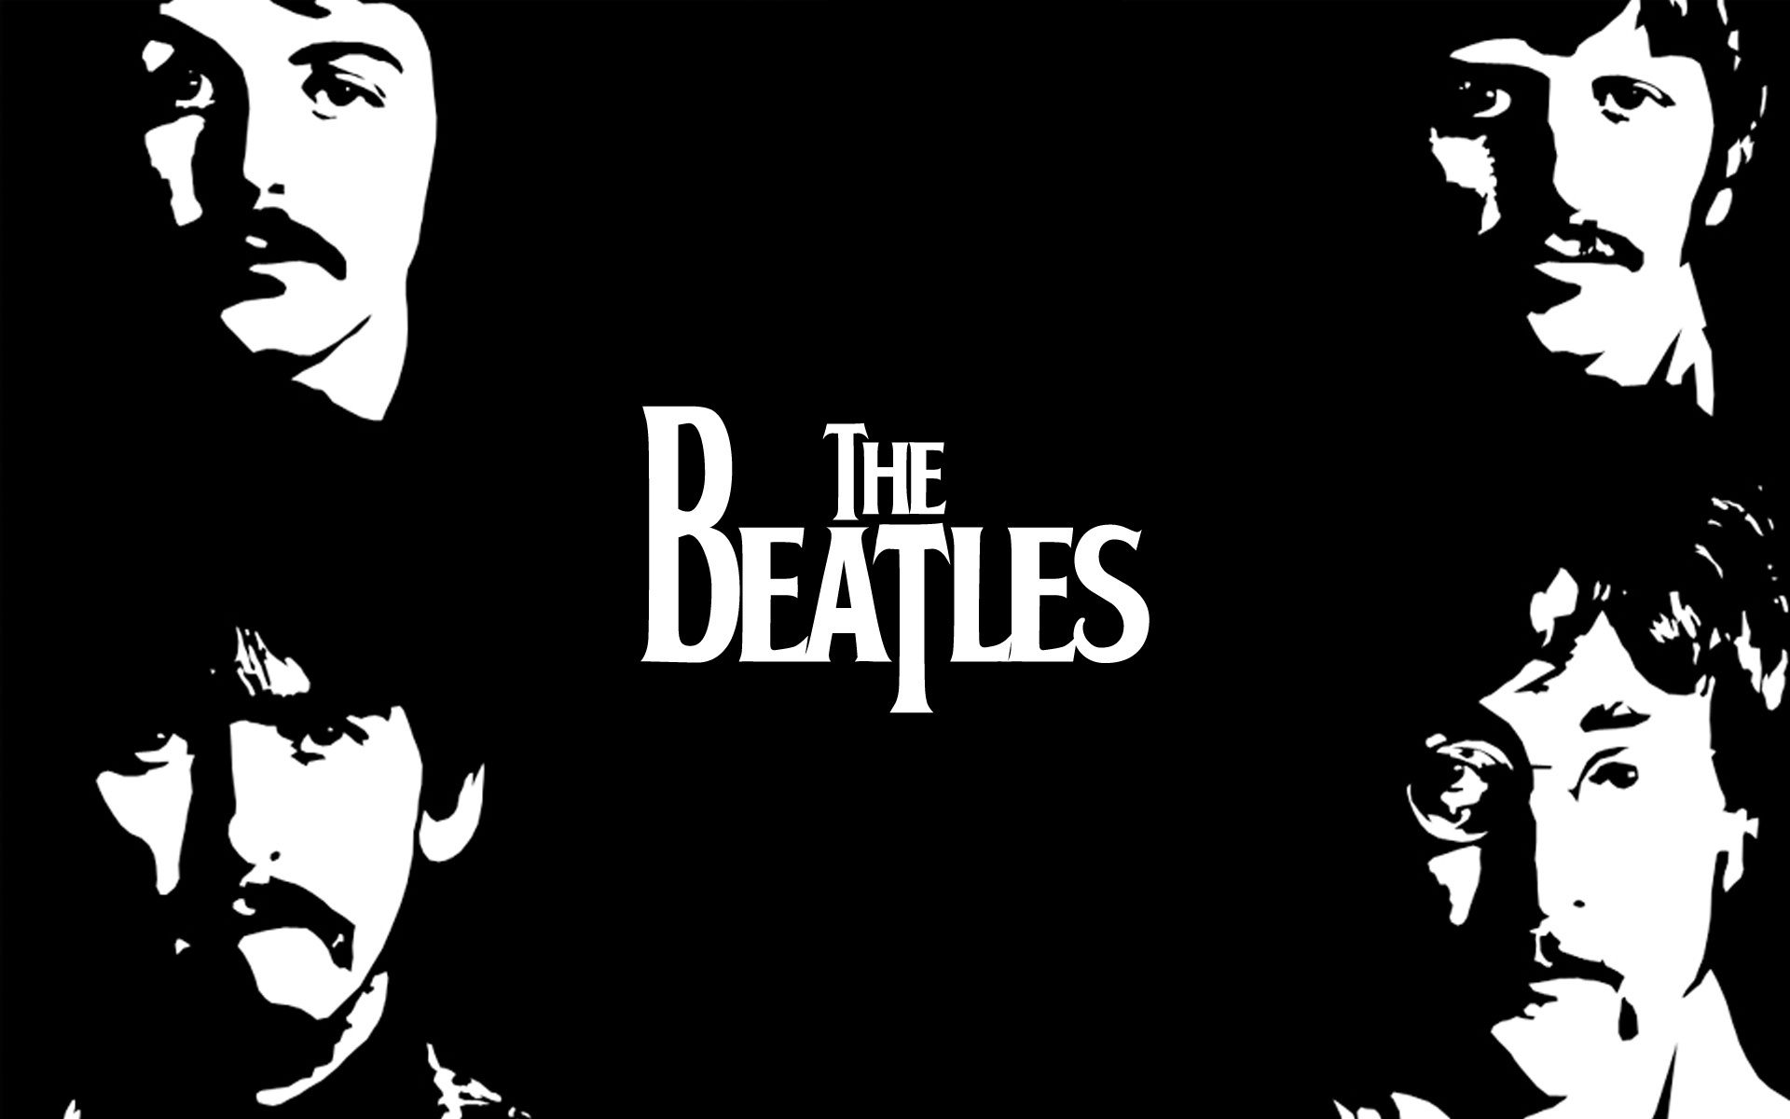
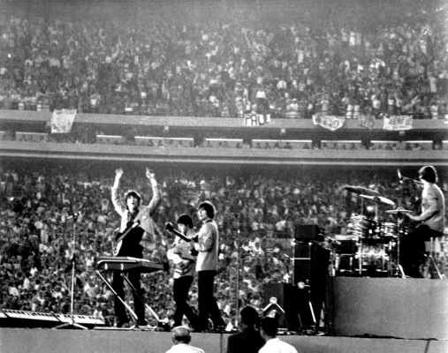
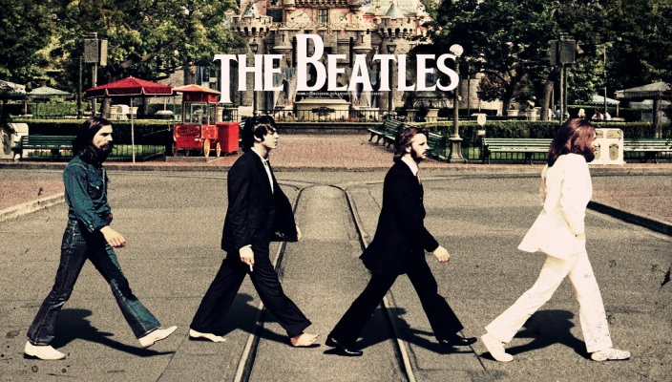
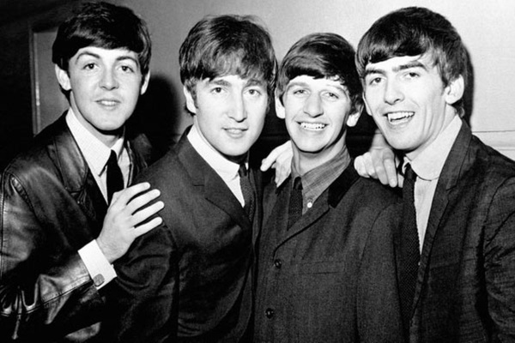
The Beatles, Fab Four
The Beatles were formed in England in 1960. The members are John Lennon, Paul McCartney, George
Harrison and Ringo Starr. The Song, Yesterday was composed in 1965 and it marked the group’s first
recorded use of classical music elements such as strings.

