Slide 1
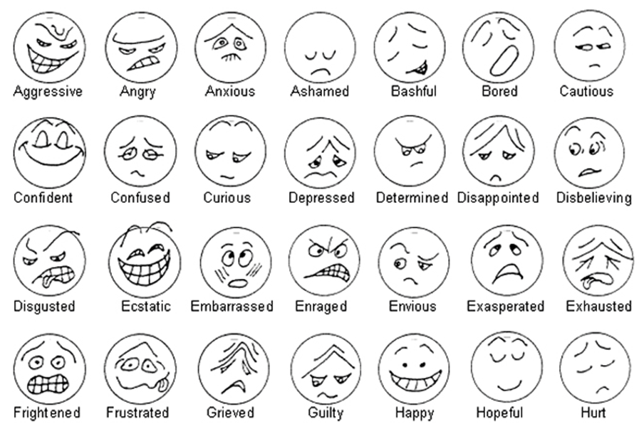
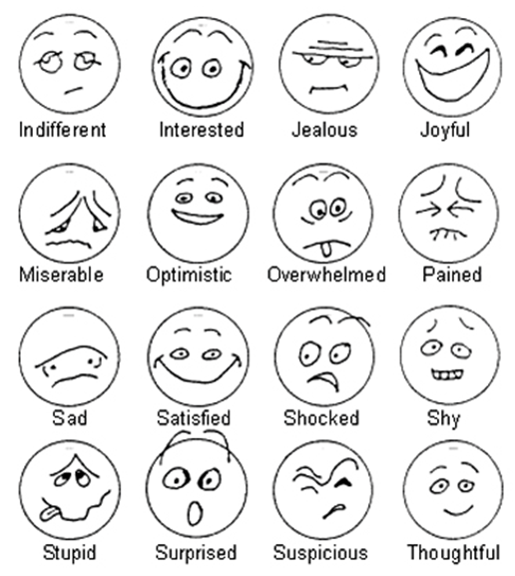
How different things can affect how you feel

Slide 2
Look at the questions and make notes to help you answer them.
What makes you laugh?
What frightens you?
What makes you feel depressed?
What helps you to relax?
What do you really detest?
What makes you stressed?
What makes you feel embarrassed?
What makes you happy?

Slide 3
Useful language for describing what affects your feelings:
One thing that really frightens/embarrasses me is when……
I hate/love it when……….
It really annoys me when………
I find ………. very embarrassing/relaxing/annoying.
……… makes me happy/relaxed/depressed.
I can’t stand/cope with……….

Slide 4
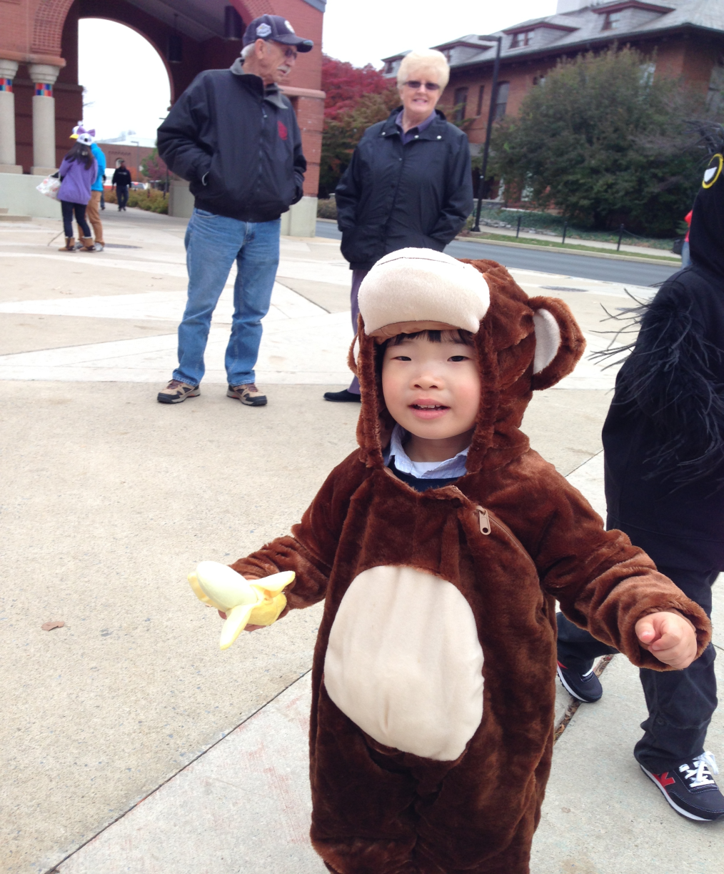
Lucas
One thing that really frightens him is when his mom shouts.
Lucas loves it when people give him gifts.
It really annoys him when he must go to bed.
He finds taking a bath very relaxing.
Drinking milk makes him happy.
He can’t stand sharing his toys.

Slide 5
Useful language for describing what affects your feelings:
One thing that really frightens/embarrasses me is when….
I hate/love it when……….
It really annoys me when………
I find ………. very embarrassing/relaxing/annoying.
……… makes me happy/relaxed/depressed.
I can’t stand/cope with……….

Slide 6
Error correction

