Slide 1
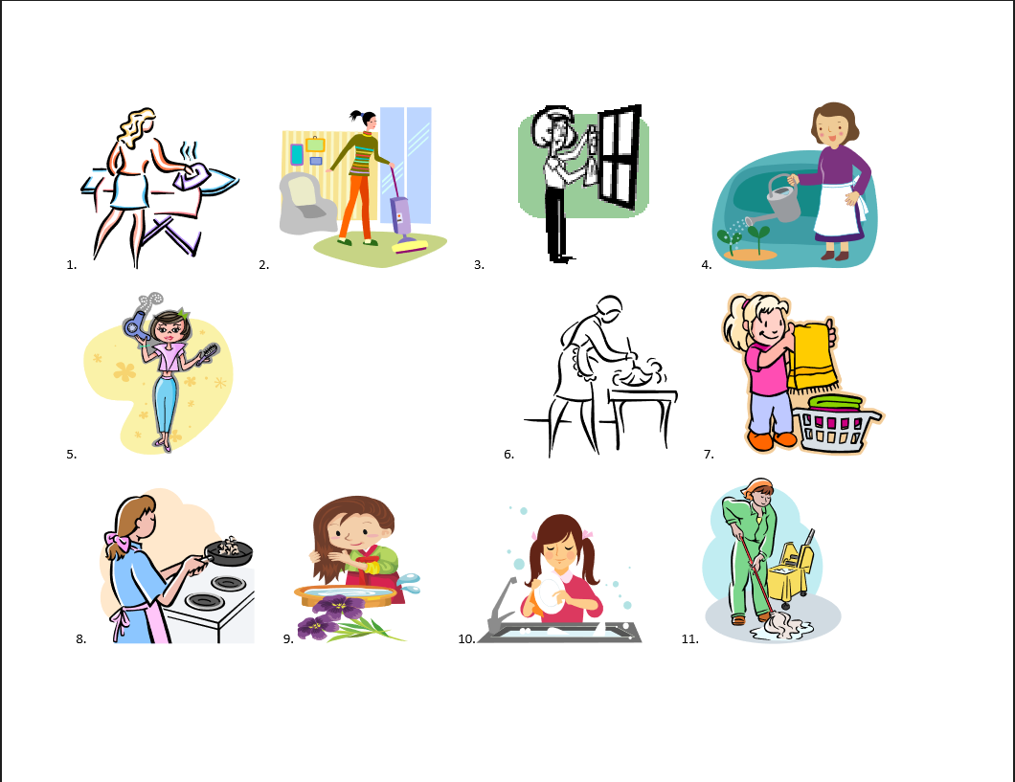
Explain what she does every day.

Slide 2
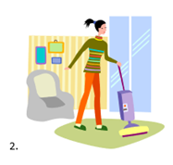
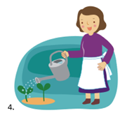
1. She irons clothes.
3. She cleans the window.
2. She uses vacuum cleaner.
4. She waters the plant.

Slide 3
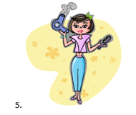
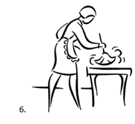
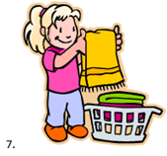
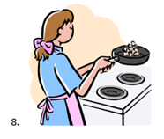
5. She dries her hair.
7. She folds the laundry.
6. She clears table with a duster.
8. She cooks meal.

Slide 4
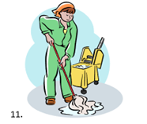
9. She blushes her hair.
11. She mops the floor.
10. She washes the dishes.

Slide 5
What she did last week?

Slide 6
1. She ironed clothes.
3. She cleaned the window.
2. She used vacuum cleaner.
4. She watered the plant.

Slide 7
5. She dried her hair.
7. She folded the laundry.
6. She cleared table with a duster.
8. She cooked meal.

Slide 8
9. She blushed her hair.
11. She mopped the floor.
10. She washed the dishes.

Slide 9
What she does everyday?
What she did last week?
Last week Past
Everyday Now
Future
Q: Is she cleaning now?
A: NO
Q: Is she ironing clothes now?
A: NO
Q: Is she mopping the floor now?
A: NO
Q: When did she cook the meal?
A: Last week
Q: When did she dry her hair?
A: Last week

Slide 10
What she does everyday?
What she did last week?
Last week Past
Everyday Now
Future
She ironed clothes.
She used vacuum cleaner.
She cleaned the window.
She watered the plant.
She dried her hair.
She cleared table with a duster.
She folded the laundry.
She cooked meals.
She blushed her hair.
She washed the dishes.
She mopped the floor.
1. She irons clothes.
2. She uses vacuum cleaner.
3. She cleans the window.
4. She waters the plant.
5. She dries her hair.
6. She clears table with a duster.
7. She folds the laundry.
8. She cooks meals.
9. She blushes her hair.
11. She mops the floor.

Slide 11
Pronunciation
Three ways of pronouncing “-ed”
a. /t/ when the verb ends with voiceless consonant sounds like in “watched”, “worked” and “cooked” b. /d/ when the verb ends with vowel sounds or voiced consonant sounds like in “prepared”, “played” and “used” (I add “played” to the table and model an example sentence) c. /Id/ when the verb ends with /d/ or /t/ like in “waited”, “folded” and“ visited” (I add “visited” to the table and model an example sentence)
Change some sentences into one beginning with “He, I, You, They”
She ironed clothes.
→→ He, I, You, They ironed clothes.
She used vacuum cleaner.
→→ He, I, You, They used vacuum cleaner.
She cleaned the window.
→→ He, I, You, They cleaned the window.

Slide 12
“What you did last week?”
Make 3-4 students in each group.
Each group will be given by T, a set of picture cards. (14 cards)
Each group puts the cards in a pile face down.
The picture cards show what the student did last week.
Students take it in turn to pick up a card.
The other students have to try to guess what the student holding the card did last week.
Students use the question form Did you…?
When a student guesses correctly, they keep the picture card. The student with the most picture cards at the end of the game wins.

Slide 13
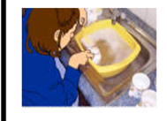
Pictures

Slide 14
Pictures
Slipped off the table
Played tennis
Watched TV
Walked to school
Practiced Japanese
Cooked dinner
Played football
Missed the bus
Opened the window
Washed the dishes
Asked a question
Studied English
Stayed in a hotel
Visited Australia

Slide 15
Don’t forget!
H.W: Use these verbs we learned and make sentences.
Ironed
Used
Cleaned
Watered
Folded
Dried
Cleared
Cooked
Blushed
Washed
Mopped

