Slide 1
Simterview

Slide 2
Preparation
Development
Refinement
Launch, before/during/after

Slide 3
Prep: The Team
In House:
Out House:
Me
Marketing
PR
R&D
Sales
Adam’s Adverts
AFD
IT Techom

Slide 4
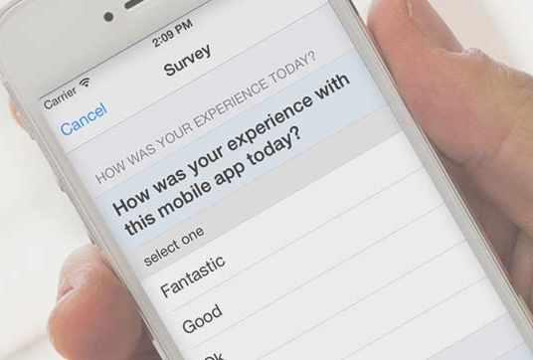
Prep: The Research
What’s everyone else doing?
Surveys
Tech Requirements/Scope

Slide 5
Prep: Strategy Dev
The Plan
Marketing Strategy
Profit/Cost Strategy

Slide 6
Prep: Design Dev
Design
Wire-framing

Slide 7
Development: The Backend
Coding
Functions
Security

Slide 8
Development: The Prototype
Users and their Feedback
What we think
users do
What users
actually do

Slide 9
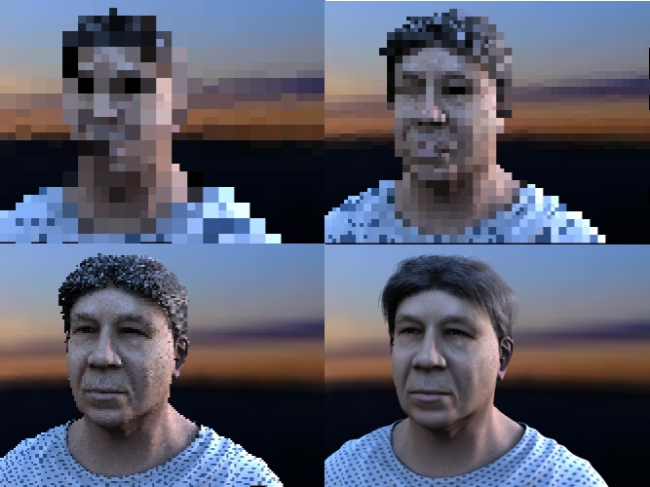
Refinement: Polish

Slide 10
Preparation
Development
User feedback
Refinement
Launch, before/during/after

Slide 11
The Launch
Prep
Advertising/Marketing
MORE feedback
Future Updates

