Slide 1
Gamification
Pre-MBA Course
Hyunjoo (Carol) Jo

Slide 2
Gamification = Game+~ fy = ~fication
Gamification is
the use of game thinking and game mechanics in non-game contexts
to engage users in solving problems
and increase users' self contributions

Slide 3
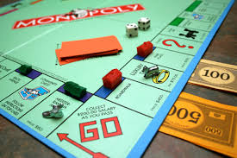

Slide 4
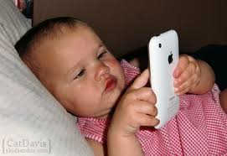

Slide 5
Why Gamification in the Education?

Slide 6
Game Mechanics & Thinking
Fast Feedback: Immediate feedback or response to actions
Transparency: Where everyone stands
Goals: Short- and long-term goals to achieve
Badges: Evidence of accomplishments
Leveling Up: Status within my community

Slide 7
Game Mechanics & Thinking
Onboarding: An engaging and compelling way to learn
Competition: How I’m doing compared to others
Collaboration: Accomplish a goal working with others
Community: A context for achievement
Points: Tangible, measurable evidence of my accomplishments

Slide 8
Keywords
Achievement : Progress, Badge, Score
Competition : Opponent, Pride
Fun : Easy, Challenging

Slide 9
How Gamifying Education?
Structure
Contents

Slide 10
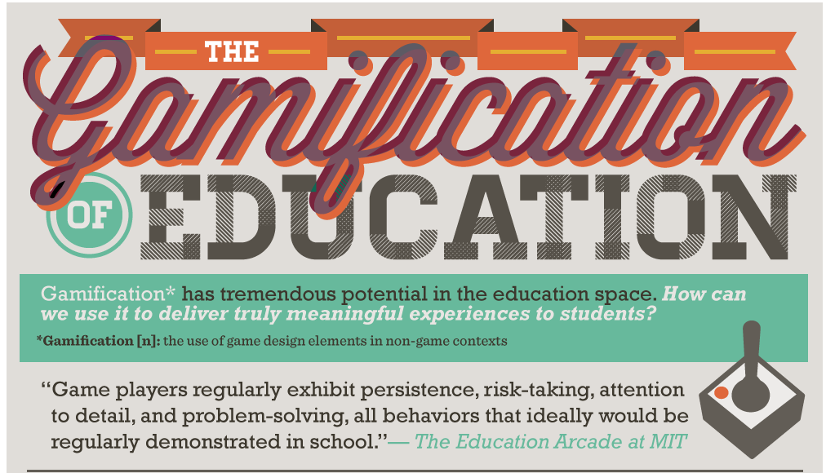
The Promise of Gamification

Slide 11
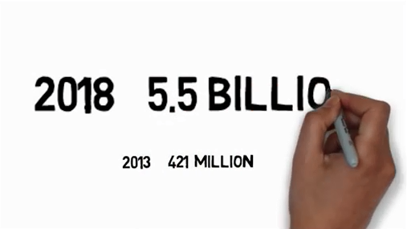
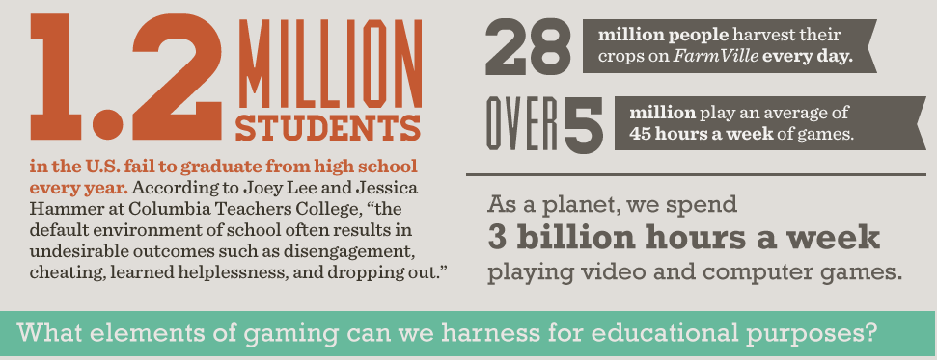
The Promise of Gamification

Slide 12
Q&A and Discussions

