Slide 1
Gamification - Project Management

Slide 2
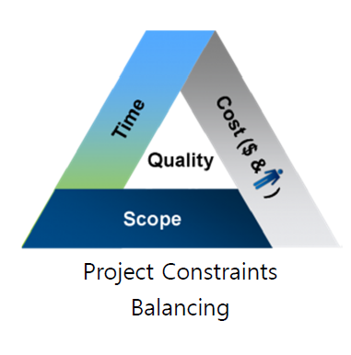
What is the project?
“A Project is Temporary endeavor
undertaken to create a Unique
Product, Service, or Result”
“Work with People to Deliver
- The Requested Output (Scope)
- On Time, On Budget”

Slide 3
Project Scope: A Startup Business with Gamification App.
Product: Mobile Application for English Education for Adults
Killer Contents: English Interview
Target Customer: New Graduates / Potential Job Seekers
who are preparing for English Job interview
Development Period: 6 months
Total Budget estimated: 90Mil. KRW (Funded from Gov. program)
Resources : 3 per., Product building/testing/operating will be outsourced

Slide 4
For the Success of Project Management
Integration
Cost
Human resources
Stakeholder management
Scope
Quality
Communications
Time
Procurement
Risk management

Slide 5
Gamification theory
Increased engagement
Higher motivation levels
Increased interaction with the user (customer or employee)
Greater loyalty.

Slide 6
Brainstorming
Job Interview
English
Speaking
Fast Feedback
Exposure
Confidence
Levelling Up
Measureable
Gamification
Points Badges

Slide 7
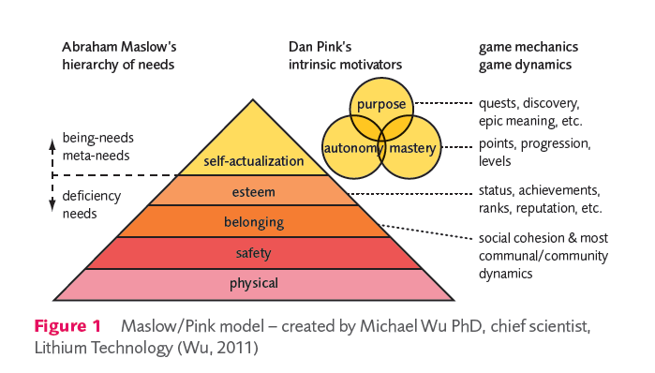
Competition, Achievement, Recognition & Self-expression

Slide 8
Gamification - Project Management
Scope
Target
Validation
Monitor
Control
Develop
Design

Slide 9
WBS – Work Breakdown Structure
A WBS is not an exhaustive list of work.
It is instead a comprehensive classification of project scope.
A WBS is neither a project plan, a schedule, nor a chronological listing. It specifies what will be done, not how or when.
A WBS is not an organizational hierarchy, although it may be used when assigning responsibilities.

Slide 10
Gantt Chart & Critical Path
[Project Name] Mobile Application Development for English Job Interviewees |  |  |  |  |  |  |  |  |  |  |  |  |  |  |  |  |  |  |  |  |  |  |  |  |  |  | Gantt Chart Template © 2015 by Vertex42.com.
[Company Name]
 | Project Lead: |  |  | Carol
 | Project Start Date: |  |  | 3-23-2015 (Monday) |  |  |  |  | ## | ## | ## | ## | ## | ## | ## | ## | ## | ## | ## | ## | ## | ## | ## | ## | ## | ## | ## | ## | ## | ## | ## | ## | ## | ## | ## | ## | ## | ## | ## | ## | ## | ## | ##
 | Display Week: |  |  | 1 |  |  |  |  | Week 1 |  |  |  |  |  |  | Week 2 |  |  |  |  |  |  | Week 3 |  |  |  |  |  |  | Week 4 |  |  |  |  |  |  | Week 5
 |  |  |  |  |  |  |  |  | 3 - 23 - 15 |  |  |  |  |  |  | 3 - 30 - 15 |  |  |  |  |  |  | 4 - 6 - 15 |  |  |  |  |  |  | 4 - 13 - 15 |  |  |  |  |  |  | 4 - 20 - 15
WBS | Task | Lead | Prede cessor | Start | End | Cal. Days | % Done | Work Days | M | T | W | T | F | S | S | M | T | W | T | F | S | S | M | T | W | T | F | S | S | M | T | W | T | F | S | S | M | T | W | T | F | S | S
1 | [Marketing Research] | Project Mgr.
1.1 | Prepare for Survey |  |  | Mon 3-23-15 | Fri 3-27-15 | 5 | 100% | 5 | x | x | x | x | x
1.2 | Target Customer |  |  | Sat 3-28-15 | Wed 4-01-15 | 5 | 50% | 3 |  |  |  |  |  | x | x | x | x | x
1.3 | Collect the Survey |  |  | Thu 4-02-15 | Sun 4-05-15 | 4 | 75% | 2 |  |  |  |  |  |  |  |  |  |  | x | x | x | x
1.4 | Analyze the Result |  |  | Wed 3-25-15 | Sat 3-28-15 | 4 | 50% | 3 |  |  | x | x | x | x
1.5 | Apply the Result |  |  | Sun 3-29-15 | Mon 3-30-15 | 2 | 50% | 1 |  |  |  |  |  |  | x | x
2 | [Brainstorming] | Project Mgr.
2.1 | Set up a session |  |  | Mon 3-23-15 | Mon 3-23-15 | 1 | 0% | 1 | x
2.2 | Find a direction |  |  | Tue 3-24-15 | Tue 3-24-15 | 1 | 0% | 1 |  | x
3 | [UX, UI development]
3.1 | Gaming Structure |  |  | Mon 3-23-15 | Mon 3-23-15 | 1 | 0% | 1 | x
3.2 | [Task] |  |  | Tue 3-24-15 | Tue 3-24-15 | 1 | 0% | 1 |  | x
3.3 | [Task] |  |  | Wed 3-25-15 | Wed 3-25-15 | 1 | 0% | 1 |  |  | x

Slide 11
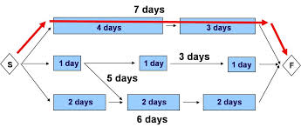
On going project - Critical Path management - Risk management - Change management

