Slide 1
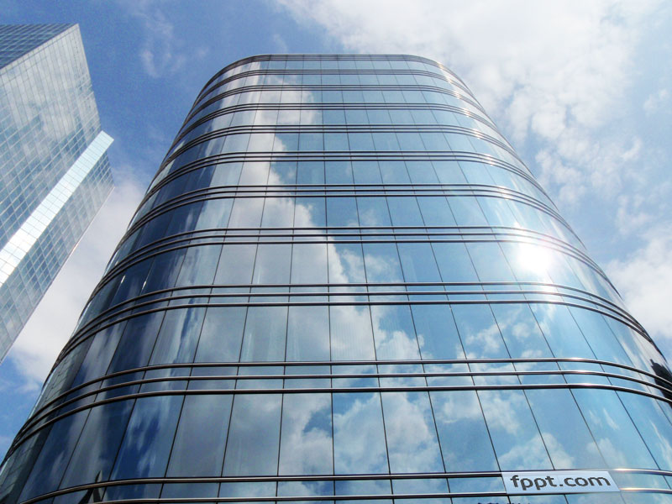
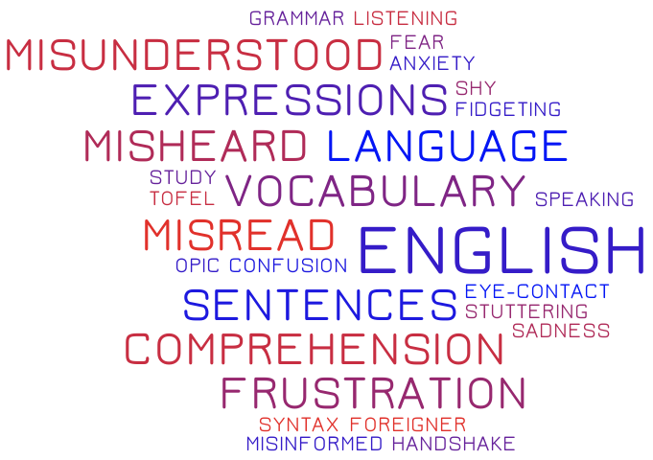
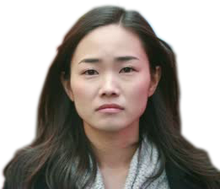
What happened?
Notes:
----- Meeting Notes (4/11/15 01:42) -----
- Ju Hee, graduate applying for foreign company
- asked for photo
- references and credentials but failed in English Ability

Slide 2
Notes:
----- Meeting Notes (4/11/15 01:42) -----
- Ju Hee part of % applying to foreign companies
- CEO survey

Slide 3
Who is Ju Hee?
Young hopeful/Graduate-Post Grad
Looking to work at foreign company within Korea or abroad
Avid user of smart devices and apps
English interview in person or by vidchat, not just for English proficiency
Notes:
----- Meeting Notes (4/11/15 01:42) -----
Who: Young hopefuls applying for foreign companies
Where:
What: This lead me to thinking there should be...
Why:

Slide 4
160,000-500,000 KRW/month
6,000,000+ KRW/year!
Notes:
----- Meeting Notes (4/11/15 01:42) -----
- These are all reputable companies
- Don't focus on interviewing
- Usually for already employed

Slide 5
High Cost
Low
Quality
High
Quality
???
Low Cost
Notes:
----- Meeting Notes (4/11/15 01:42) -----
Perceptual Map:
Vids: cheap but no practice
CD's/Books: Same
Tutor: Better, but I can tell you I'm expensive
Is there a product...

Slide 6
Simterview
Authentic Simulation
Real-time Feedback
Simulation Practice
Affordable
Notes:
----- Meeting Notes (4/11/15 01:42) -----
Our gen uses this:
App that provides real P2P simulation
Feedback
Practice
Affordable

Slide 7
Derek: Okay, Ju Hee! How do you think it went?
Authentic Simulation
Ju Hee: Ah not bad. But I think I kept mixing up my tenses.
Real-time Feedback
Derek: Okay, but I’d focus more on your eye contact.
Ah not bad. But I think I kept mixing up my tenses.
Recording audio….
Notes:
----- Meeting Notes (4/11/15 04:31) -----
give scenario

Slide 8
Simulation Practice
Simterview

Slide 9
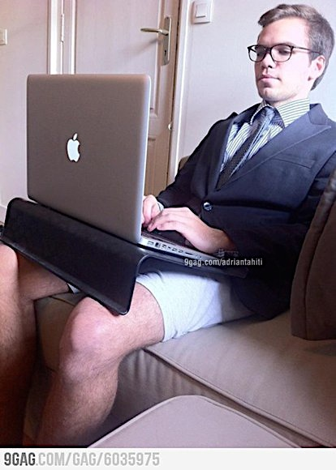
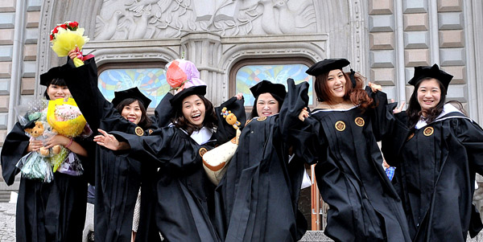
Affordable
The best part is…
Notes:
----- Meeting Notes (4/11/15 04:36) -----
because you're only seen from waist up...

Slide 10
opportunity.
We sell…
courage.
chances.
quality.
Simterview

Slide 11
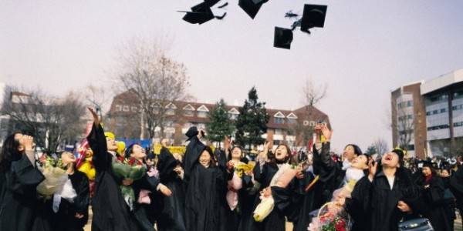
Let’s make some courage.
Thank you.

