Slide 1
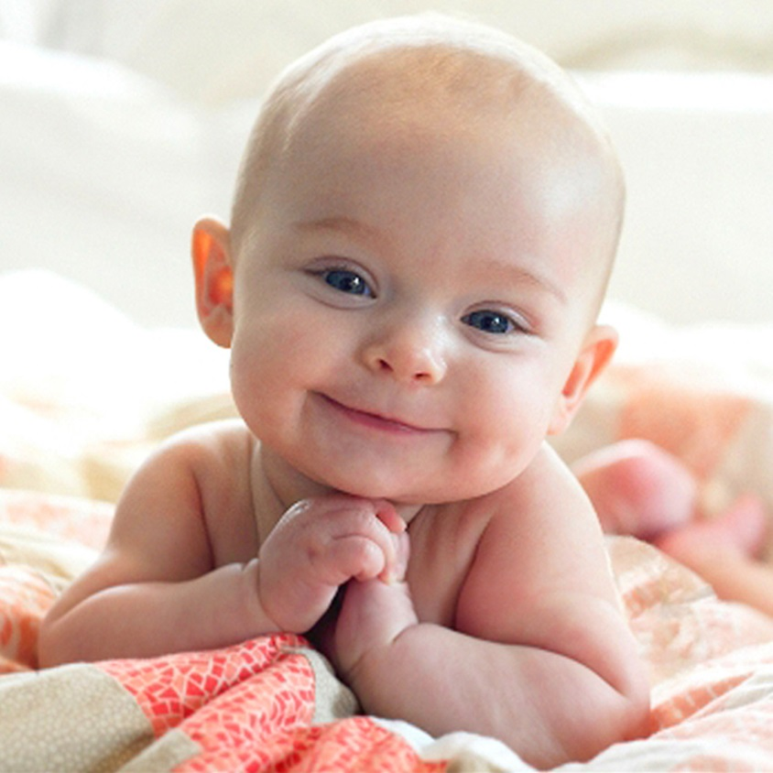
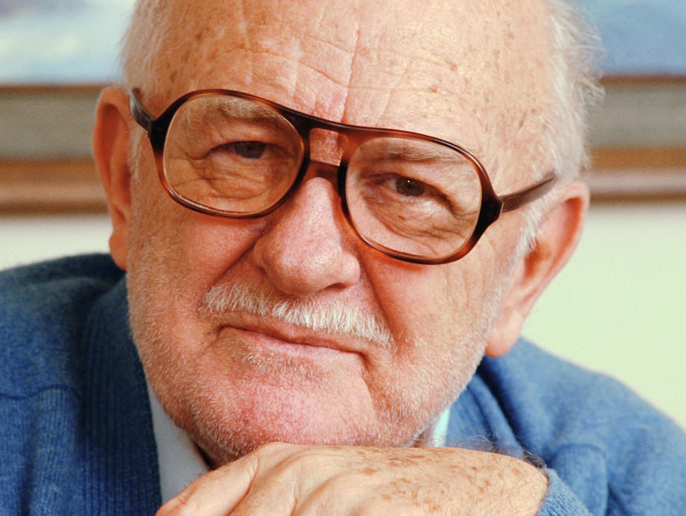
Age
Grace
William
Grace is
_______________
__younger_____
_______________
_______________
than William
William is
_______________
than Grace
__older_____
Notes:
http://www.usmagazine.com/celebrity-moms/news/new-gerber-baby-is-7-month-old-girl-named-grace-2015211
http://chataboutheroesrp.wikia.com/wiki/William_Williams

Slide 2
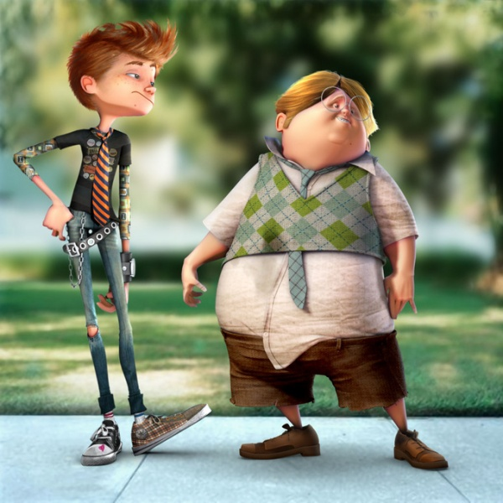
Body shapes
Milton
Max
Milton is
_______________
than Max
_______________
Max is
_______________
_______________
than Milton
Notes:
http://www.templates.com/blog/come-up-smiling-amazing-3d-characters/

Slide 3
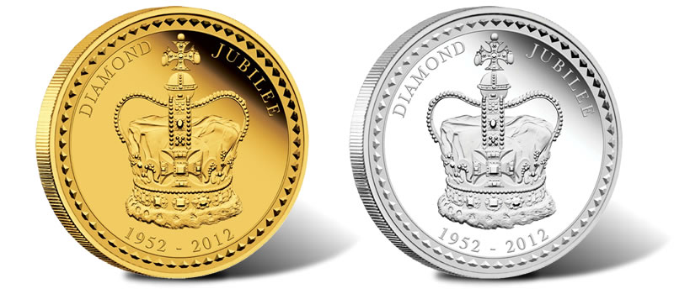
Cost
Silver
Gold
Silver is
____________________
than Gold
_______________
Gold is
____________________
_______________
than Silver
Notes:
http://www.livetradingnews.com/crude-oil-extended-losses-gold-silver-nat-gas-finish-in-the-green-56258.htm

Slide 4
Board race!!
Group 1:
Group 2:
-er | word | more
 | cheap
 | fat
 | tall
 | interesting
 | young
 | beautiful
-er | word | more
 | small
 | short
 | expensive
 | thin
 | exciting
 | rich
Point:
Point:

Slide 5
Feelings
Jim
Bill
Bill is
____________________
than Jim
_______________
Jim is
____________________
_______________
than Bill
Notes:
http://www.dreamstime.com/royalty-free-stock-photo-cartoon-businessman-pair-one-happy-other-sad-two-businessmen-image31231275

Slide 6
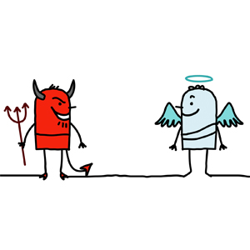
Status
Devil
Angel
Angel is
____________________
than Devil
_______________
Devil is
____________________
_______________
than Angel
Notes:
http://blog.saltmoney.org/the-good-the-bad-and-the-indebted-excerpt/

