Slide 1
Reading Lesson Plan
2015.06.27
Hyemy

Slide 2
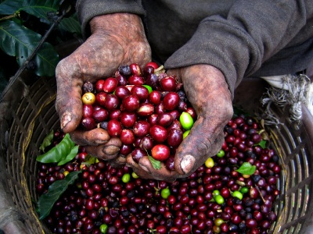

Slide 3
Vocabulary
Commodity
Abbot
Stimulant
Smuggle

Slide 4
Vocabulary
 | Dictionary Definition | Example
Commodity | an article of trade or commerce something of use, advantage, or value | crude oil is the world's most important commodity
Abbot | a man who is the head or superior, usually elected, of a monastery | monks started yelling and called the abbot
Stimulant | any food or beverage that stimulates, especially coffee, tea, or its initial effect, alcoholic liquor | it is well known fact that caffeine is a stimulant
Smuggle | to import, export, or convey goods surreptitiously or in violation of the law | a man caught trying to smuggle drugs into the country

Slide 5
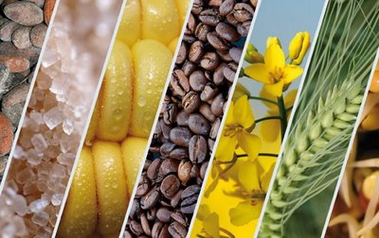
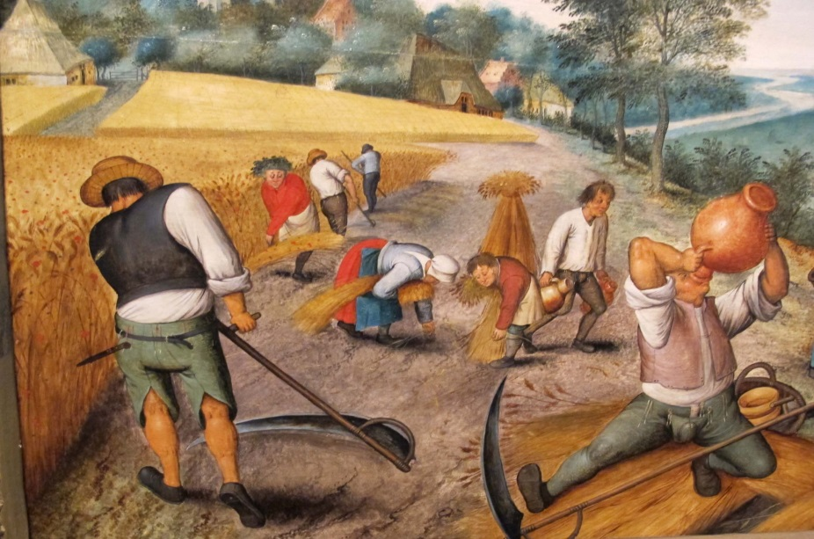
Commodity ? Or Not Commodity?
Rice, gold, crude oil, sugar, soybean,
Corn, flour
Labor, human being, slaves
“If you are not a brand, you are a commodity”

Slide 6
