Slide 1
READING
MICRO
TEACHING
Laura

Slide 2
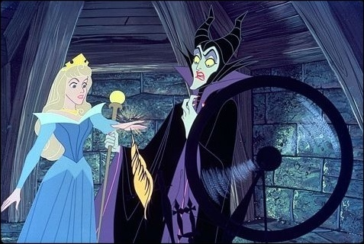
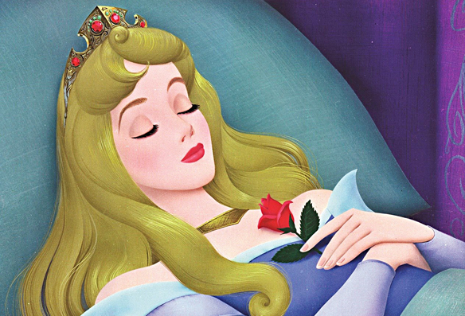
LEAD IN
The Sleeping Beauty

Slide 3
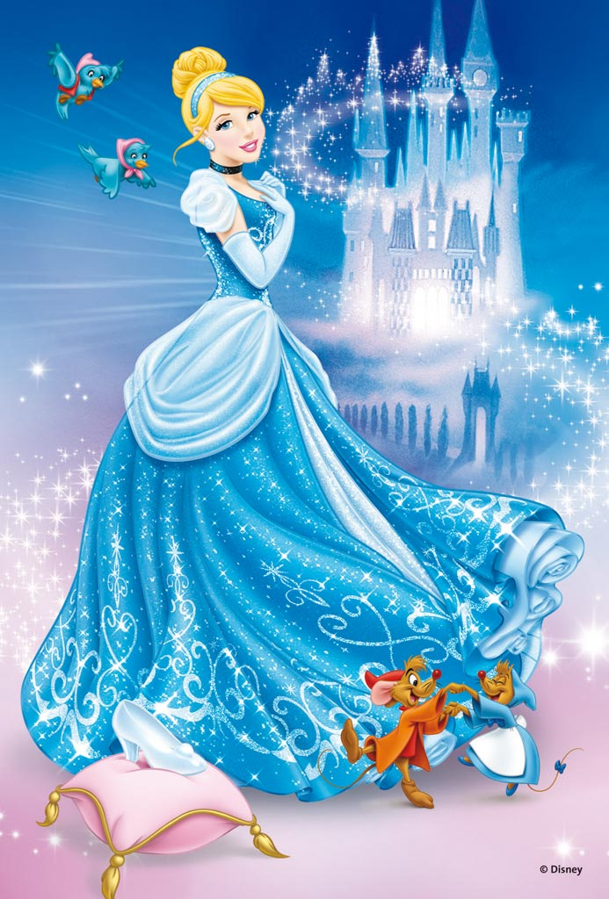
LEAD IN
Cinderella

Slide 4
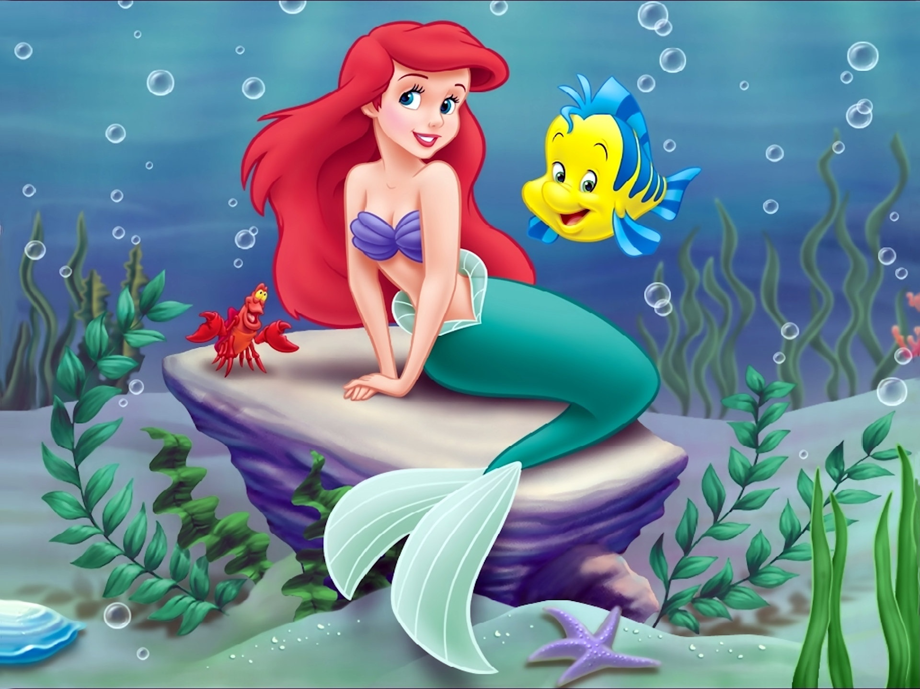
LEAD IN
The little
mermaid

Slide 5
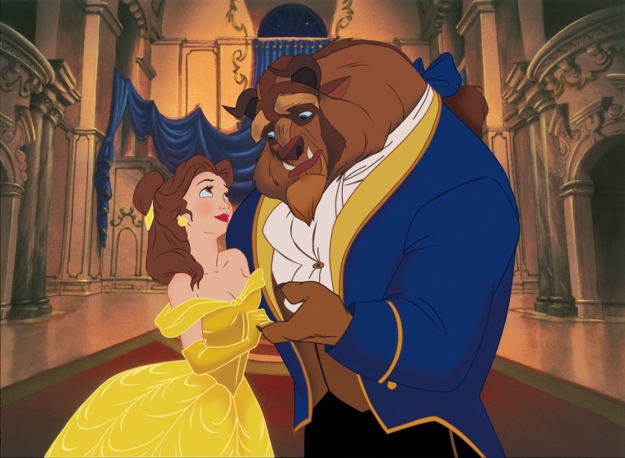
LEAD IN
Beauty and
The beast

Slide 6
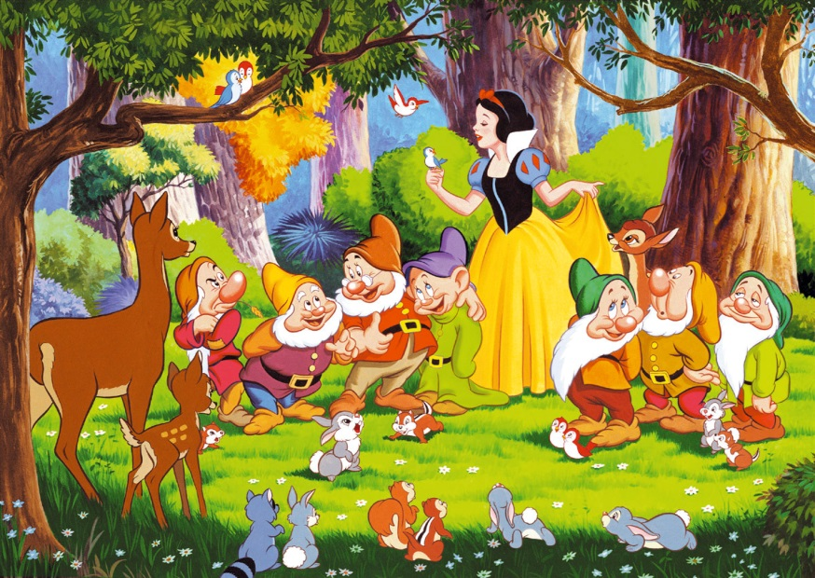
PRESENTATION
Snow White

Slide 7
PRESENTATION
Please fill in the square with numbers randomly.
The numbers range is from 1 to 19.
Please work all together this step.
This game will go along with teams.
Please make the teams.
3. Roll the dice and move your team’s piece.
The square is written by numbers.
The numbers have different questions.
Please answer the question.
If you don’t know, your piece goes behind one square.
I’ll give you only 1 minute to answer.
If you answer this turn, your friend have to answer the next turn.
GOOD LUCK! ☺

Slide 8
PRACTICE
What is the name of seven dwarfs?
What is this fairy tales title?
What is the princess’s hair style?
Why princess was kicked out the castle?
Had princess meet prince?
What did princess do in the strange cottage?
What is seven dwarfs job?
She ate poisoned apple, what happen next to her?
Which place the evil queen is disappeared?
Please make 1 or 2 sentence after the end of the story.
What happen to seven dwarfs after the princess’s wedding?
Why did evil queen hate princess? If you were queen, what will you do?
If you were king, what will you do?
Why the queen used the poison to falling into a deep sleep?
If you were hunter, what will you do? Why?
Which point do you think made the most famous fairy tale in the world?
What are the 4 fairy tales’ title begin the class?
What do you feel or learn by reading this story?
Feel in the blank
The wicked queen felt ________ when the mirror said
Snow White was the most beautiful. (jealous/happy)

Slide 9
BYE BYE
PLEASE DO YOUR
HOME WORK
1.FIND the meaning of
highlighted vocabulary.
2. Please answer
these questions.

