Slide 1
READING
MICRO
TEACHING
Laura
Notes:
Hello everyone!
Nice to see you again.
How was your weekend?
GOOD
Now Let’s start today’s lesson.

Slide 2
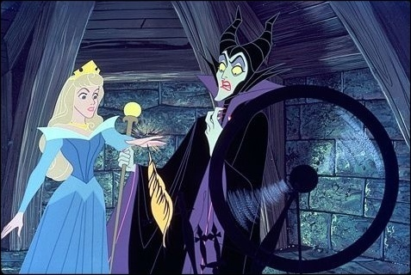
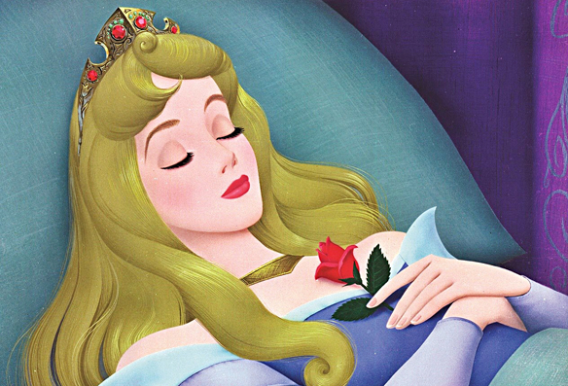
LEAD IN
The Sleeping Beauty
Notes:
Before the lesson, I have a question.
What is your favorite fairy tale?
(Ask them one by one.)
Do you remember whole story?
OK. Let’s see some pictures and guess the title of pictures.
Here is the first one.
What is this fairy tale’s title? Jessica?

Slide 3
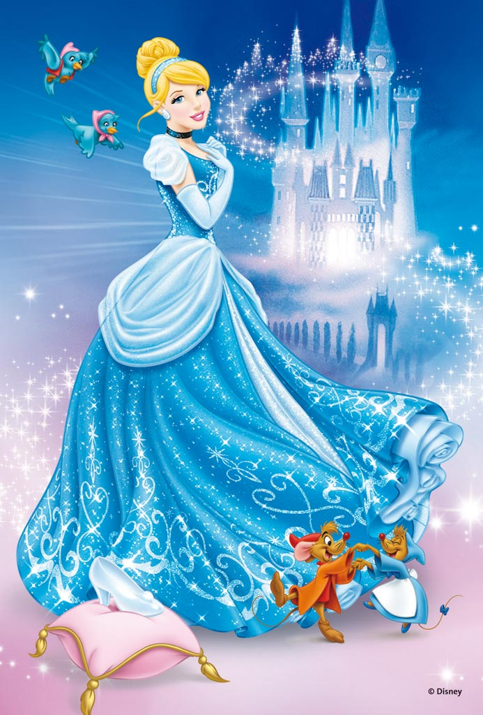
LEAD IN
Cinderella
Notes:
What is this fairy tale’s title? Bora?

Slide 4
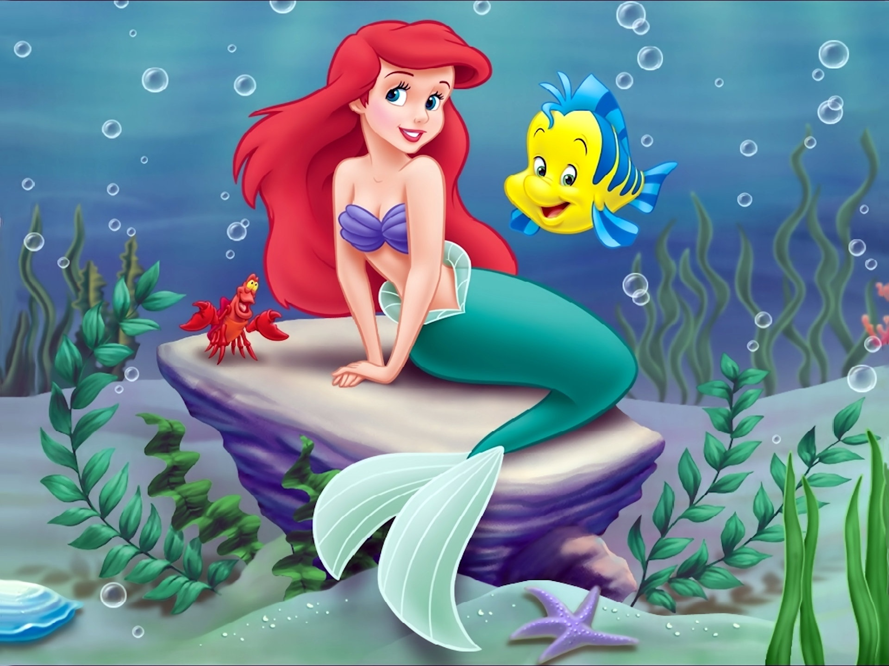
LEAD IN
The little
mermaid
Notes:
What is this fairy tale’s title? Jamie?

Slide 5
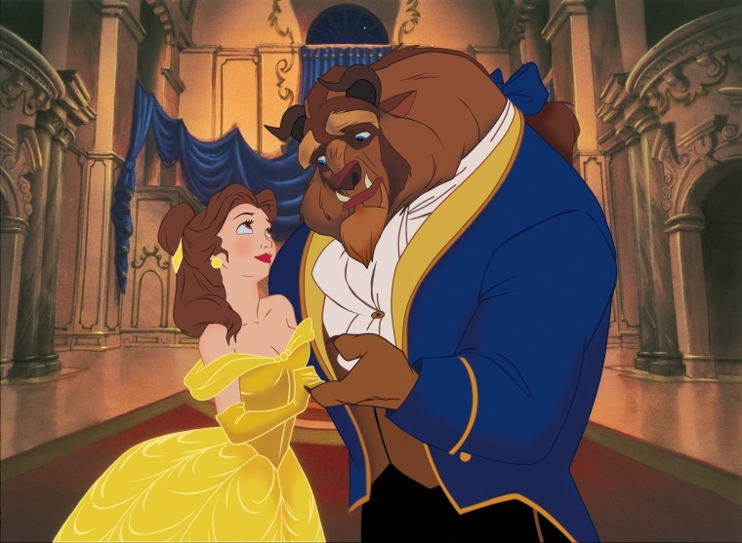
LEAD IN
Beauty and
The beast
Notes:
What is this fairy tale’s title? Stella?

Slide 6
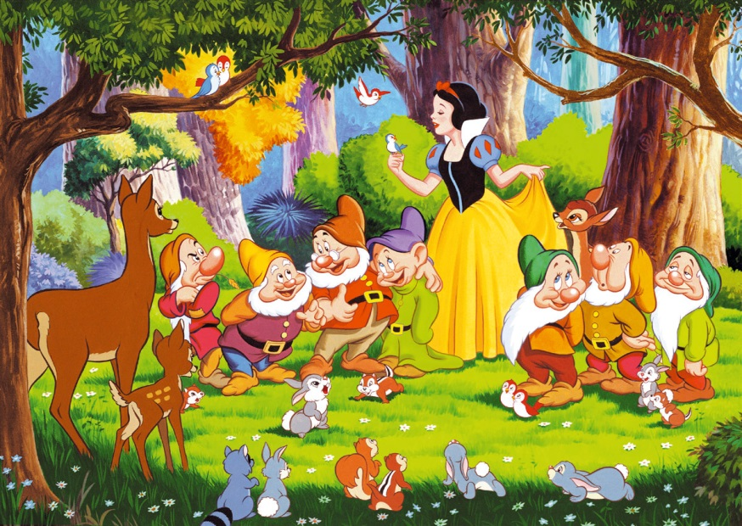
PRESENTATION
Snow White
Notes:
Well done.
Today you will read the SNOW WHITE.
I’ll give you 5 minutes.
I know that you ladies already known about this story, right?
BUT, I think maybe you don’t know precisely.
Before reading, I’ll give a guide line.
If you don’t know any vocabulary, please highlight or underline with your pens. Do you understand?
(After reading)
- Do you remember anything?
- Can you tell us what is the most
impressive scene?

Slide 7
PRESENTATION
Please fill in the square with numbers randomly.
The numbers range is from 1 to 19.
Please work all together this step.
This game will go along with teams.
Please make the teams.
3. Roll the dice and move your team’s piece.
The square is written by numbers.
The numbers have different questions.
Please answer the question.
If you don’t know, your piece goes behind one square.
I’ll give you only 1 minute to answer.
If you answer this turn, your friend have to answer the next turn.
GOOD LUCK! ☺
Notes:
NOW, you will play a board game.
Here is the instructions.
(READ IT)
Do you have any questions about the instructions?
-How much is given time for you to answer the question?
-If you don't know the answer, what happen to you?
OK. LET’s start with number one.
Are you done?
Pick up the sticker to attach on the piece.

Slide 8
PRACTICE
What is the name of seven dwarfs?
What is this fairy tales title?
What is the princess’s hair style?
Why princess was kicked out the castle?
Had princess meet prince?
What did princess do in the strange cottage?
What is seven dwarfs job?
She ate poisoned apple, what happen next to her?
Which place the evil queen is disappeared?
Please make 1 or 2 sentence after the end of the story.
What happen to seven dwarfs after the princess’s wedding?
Why did evil queen hate princess? If you were queen, what will you do?
If you were king, what will you do?
Why the queen used the poison to falling into a deep sleep?
If you were hunter, what will you do? Why?
Which point do you think made the most famous fairy tale in the world?
What are the 4 fairy tales’ title begin the class?
What do you feel or learn by reading this story?
Feel in the blank
The wicked queen felt ________ when the mirror said
Snow White was the most beautiful. (jealous/happy)

Slide 9
BYE BYE
PLEASE DO YOUR
HOME WORK
1.FIND the meaning of
highlighted vocabulary.
2. Please answer
these questions.
Notes:
Did you have fun with your class?
What is the most impressive question?
(Ask them one by one.)
Next time, we will read about sleeping beauty.
Please do your homework.
And thank you for your attention. BYE!

