Slide 4
Sit down, please

Slide 5
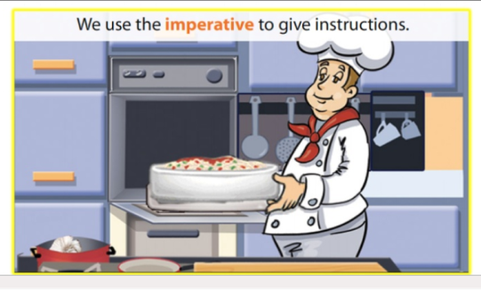

Slide 6
Put the spaghetti dish in the oven

Slide 8
Don’t feed the animals!

Slide 10
Sign this form, please

Slide 12
Have a snack

Slide 13
Imperative sentence
We can use imperative to give a
-direct order
-instructions
-invitation
-on signs and notices
-friendly informal advice

