Slide 1
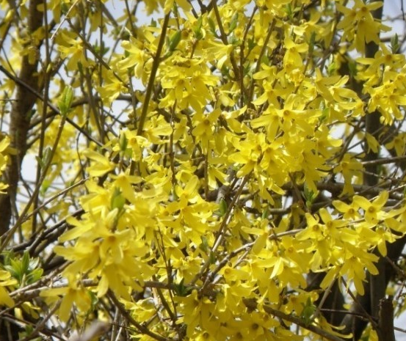
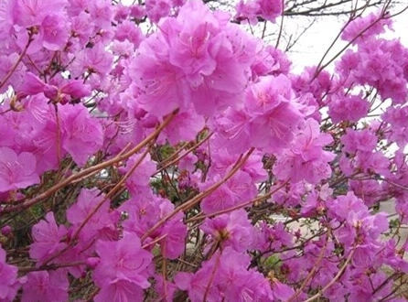
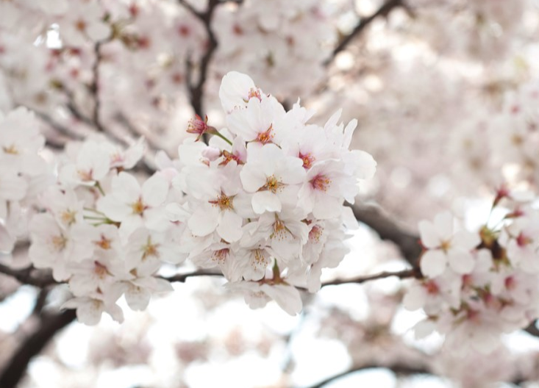
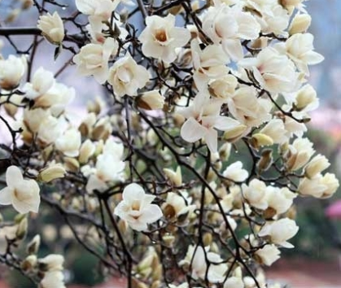

Slide 2
Spring Flower Festival

Slide 3
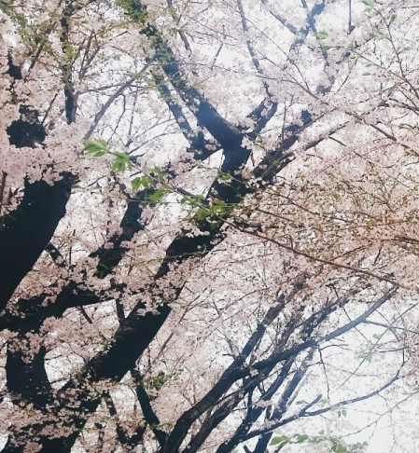
ㅈㅈㅈ

Slide 4
Cherry blossom

Slide 5
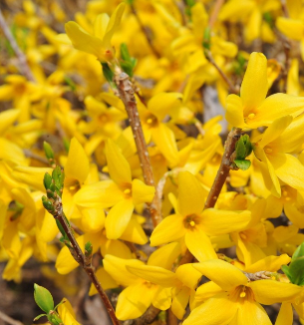
ㅈㅈㅈ

Slide 6
forsythia

Slide 7
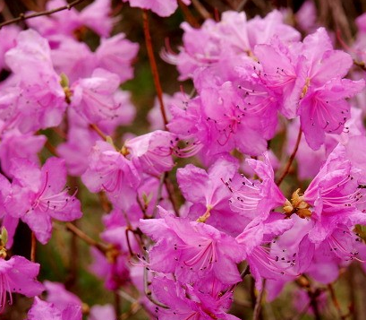
ㅈㅈㅈ

Slide 8
azalea

