Slide 1
Brainstorming

Slide 2
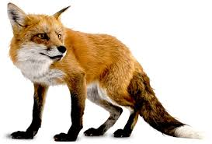
Words to describe a Fox
sharp
cunning / crafty / sly / un-trusting
fast / quick
clever
Notes:
Ask students to list adjectives describing a fox. (it doesn’t need to be a real characteristics of a fox. let’s brainstorm)

Slide 3
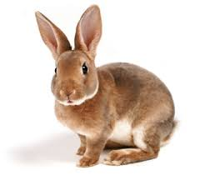
Words to describe a Bunny
cute
cuddly
sweet
furry
tiny

Slide 4
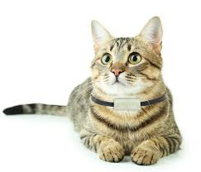
Words to describe a Cat
finicky
smart
independent

Slide 5
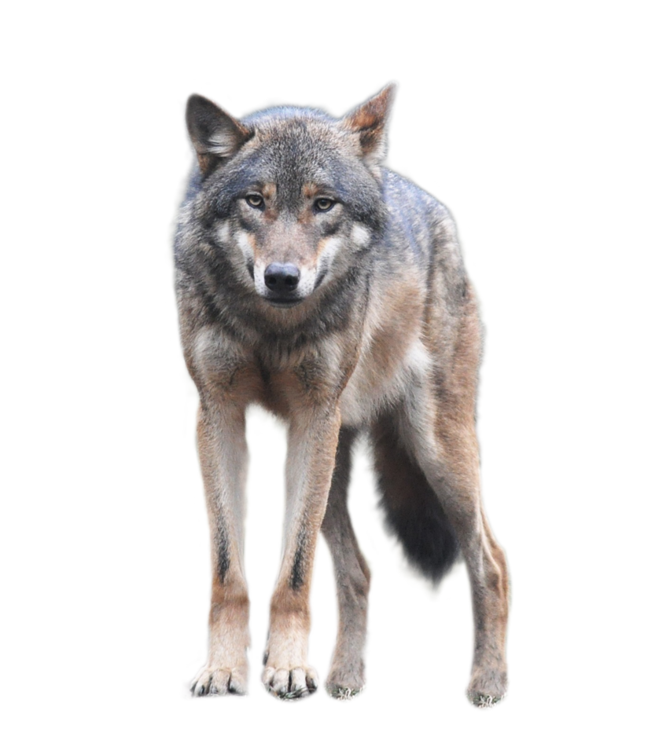
Words to describe an Wolf
aggressive
cold
savage
lonely
frightening

