Slide 1
Comparative
Kimmy

Slide 2
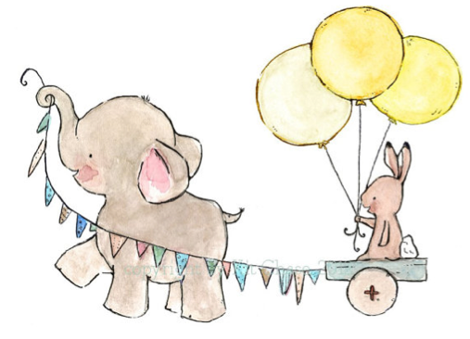
Comparative Adjectives
(used to compare 2 things)
“The elephant is bigger than the rabbit”
Two syllables ending in ‘y’
- Change ‘y’ to ‘i’ and add er
One syllable
Two or more syllables
Form: +er than
Form: +ier than
Form: More… than
Mine is
Mine is
Easier
Prettier
Heavier
Happier
Friendlier
Busier
than yours.
Mine is more
beautiful
dangerous
intelligent
understanding
complex
interesting
difficult
than yours.
Bigger
Smaller
Nicer
Shorter
Stronger
Weaker
Longer
than yours.
I’m
than you.

Slide 3
Double the consonant
The adjective is one syllable
the last two letters are a vowel + consonant
one syllable
vowel + consonant
double consonant
hot
Big
soft
o + t
i + g
f + t
hotter (yes)
bigger (yes)
softer (no)
But, if the consonant is w, we don’t double the consonant
slow – slower new - newer

Slide 4
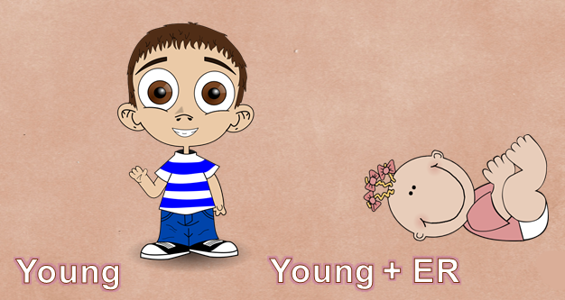

Slide 5
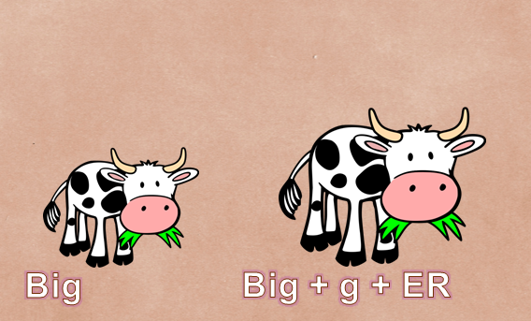

Slide 6
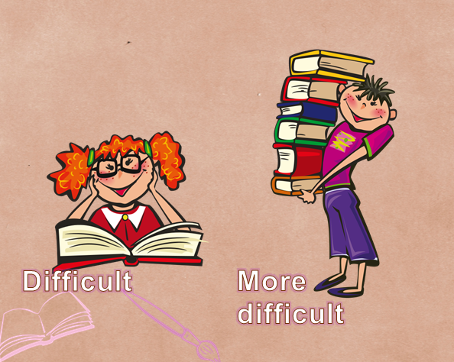

Slide 7
Irregular
good
better
bad
worse
much
more
many
more
far
farther
little
less

Slide 8
Comparative as … as
Comparative adjectives can express equality
Form:
as + adjective/adverb + as
Examples
My book is as interesting as yours.
His car runs as fast as a race car.
Their house is as big as that one.

Slide 9
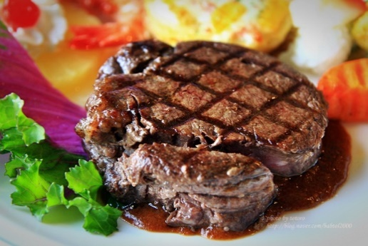
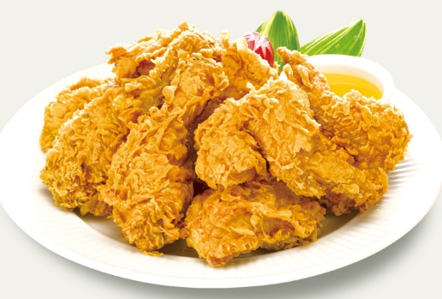
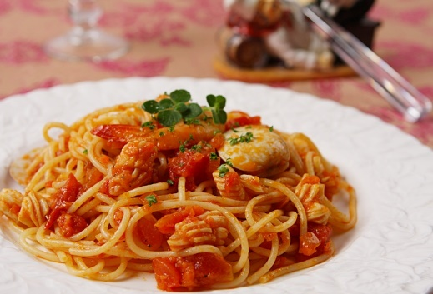
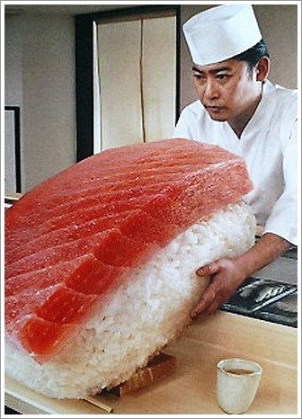
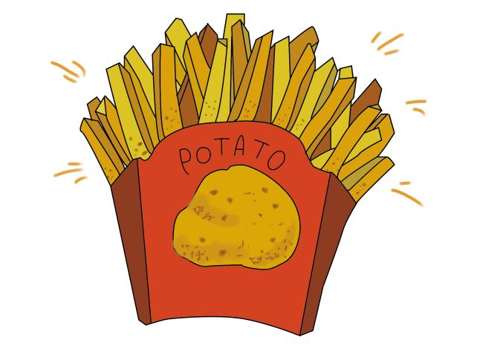
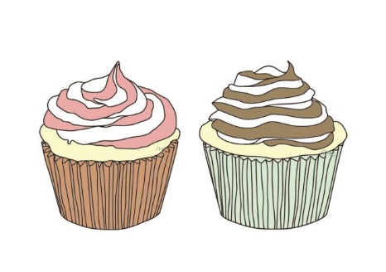
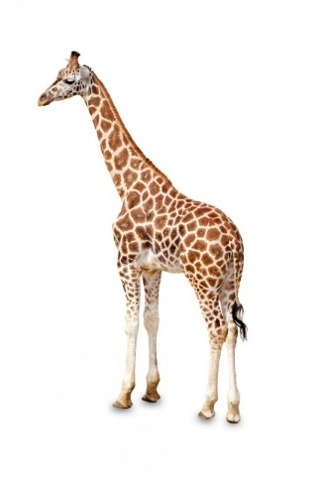
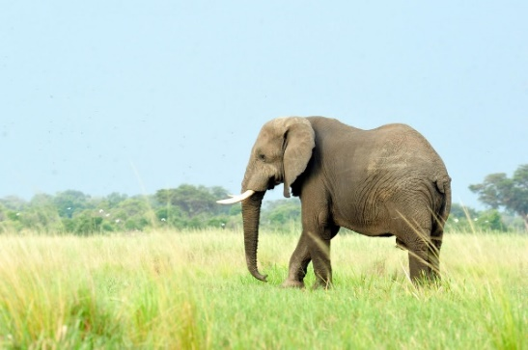
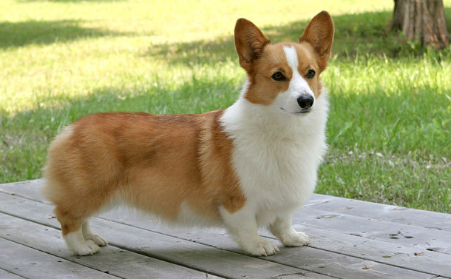
Use the adjectives to make at least two comparisons
cheap
A
expensive
etc
B
big
small
etc
tall
C
short
etc

Slide 10
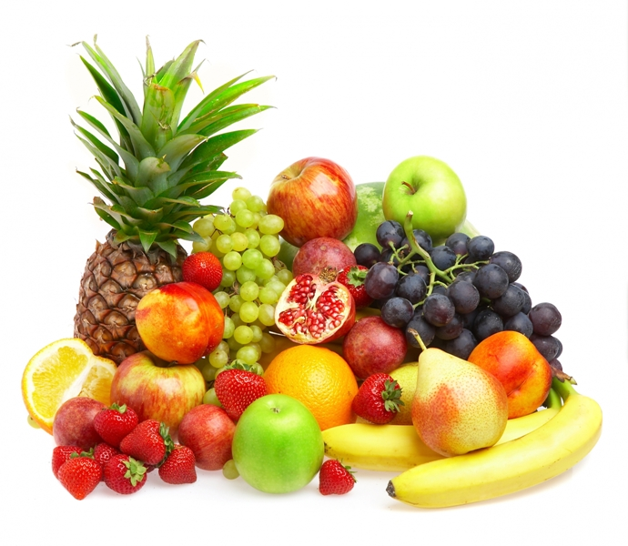
What do you think?
comparative adjective + than
as + adjective + as
sour
salty
healthy
tasty
sweet
bland
delicious

Slide 11
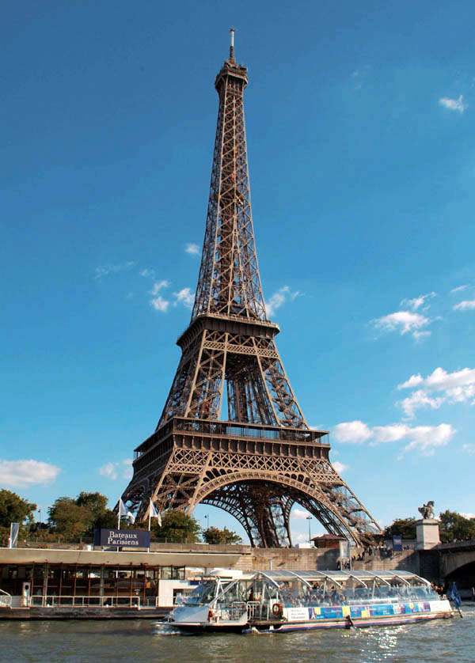
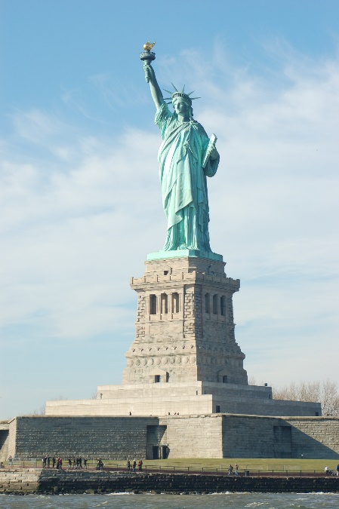
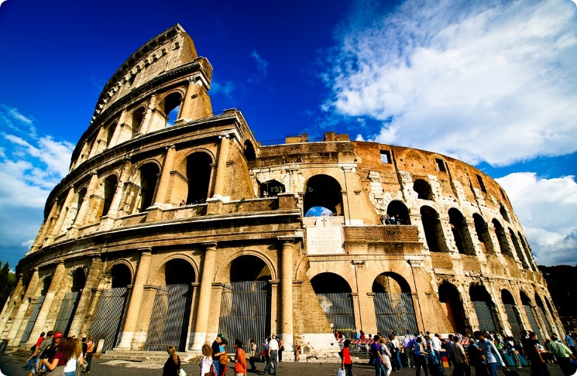
And for these?
comparative + adjective + than
as + adjective + as
historic
expensive
beautiful
busy
energetic
crowded
interesting

