Slide 1
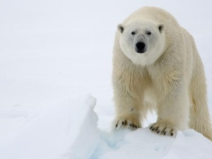
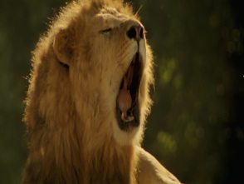
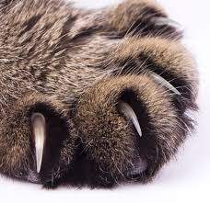
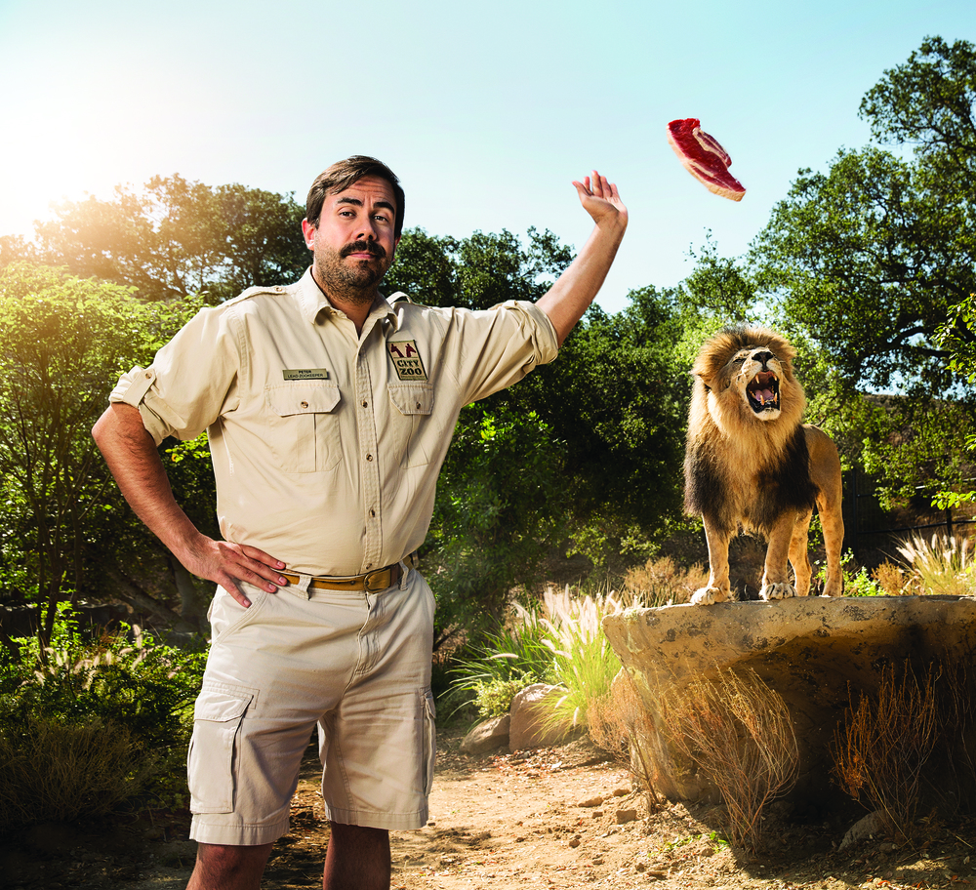
Write the words in the blanks.
roars claws zookeeper polar bear
1. The angry lion ________________ .
2. A ______________ lives in very cold places.
3. A ______________ works at a zoo.
4. Bears have big ____________ .
Track 1
Listen and match. Then, write the words in the blanks.
1
2
3
4
.
.
.
.

Slide 2
Circle the words you hear.
Track 2
cool cold bears snow ice rain zoos
home make have do
Listen to the passage and the questions. Fill in the blanks with the correct words.
Track 2
1. Many zoos have ________________ .
2. There are too __________ for polar bears.
3. They like ________ and __________.
4. The _________ help keep the polar bears cool.
Listen to the clues. Then, choose the correct answer to each one.
Track 3
1.
A shark
A monkey
A zebra
2.
Zookeepers
claws
Aquariums
3.
A monkey
A shark
A lion
4.
A monkey
A lion
A zebra

Slide 3
Script
Track 1
1. claws 2. polar bear 3. zookeeper 4. roar
Track 2
Many zoos have polar bears. Sometimes, zoos are too warm for polar bears. Why is this? Polar bears live in cold places. They like snow and ice. There is no snow at the zoo.
So, zookeepers make snow for them. Snow helps keep the bears cool.
Track 3
1. This animal swims. It has big teeth.
2. Lions and bears have these on their feet.
3. This animal roars.
4. This animal looks like a horse. It is black and white.

