Slide 1
Weddings
Instructor: Lizzie
Oct. 8th 2016

Slide 2
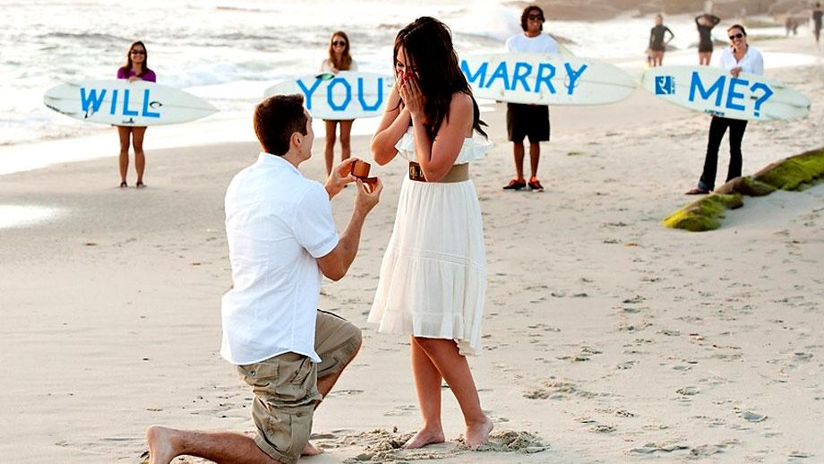
POP THE QUESTION

Slide 3
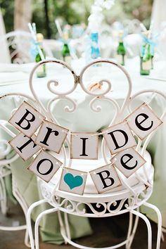
BRIDAL SHOWER
Notes:
At a bridal shower, guests shower the bride with gifts.
신부 파티에서 손님들은 신부에게 선물로 샤워를 시킨다.

Slide 4
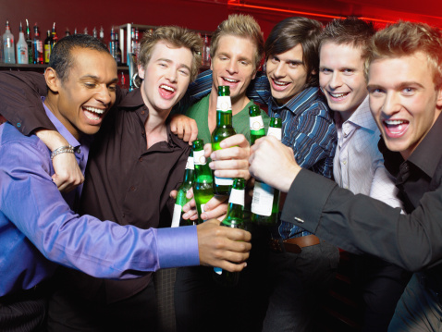
STAG NIGHT
/ BACHELOR PARTY

Slide 5
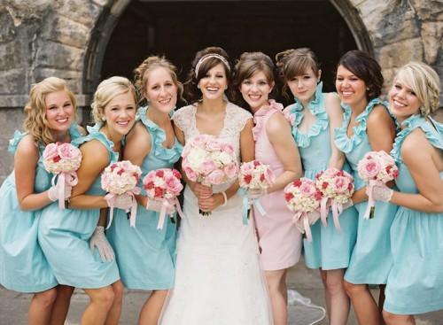
MAID OF HONOR
BRIDESMAID

Slide 6
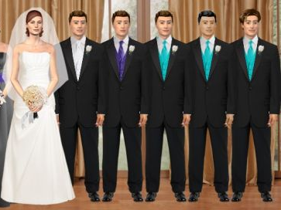
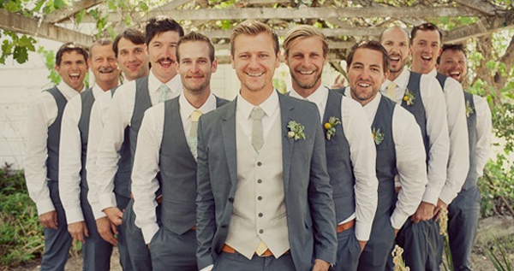
BEST MAN
GROOMS MEN

Slide 7
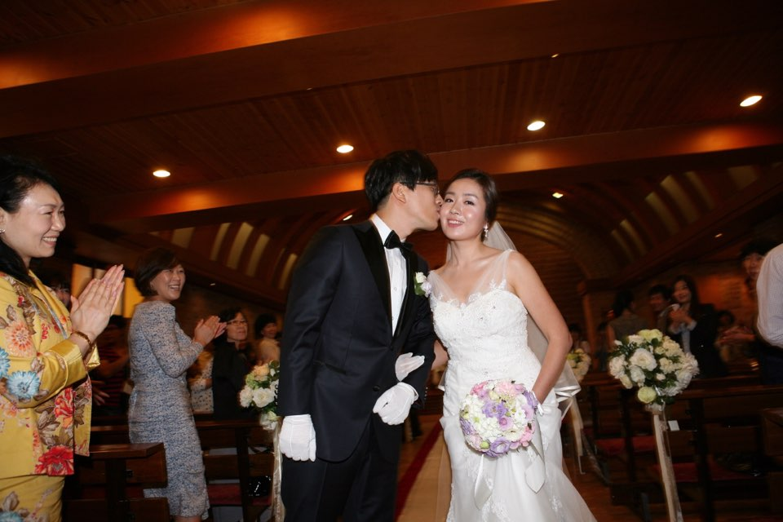
BRIDE & GROOM

Slide 8
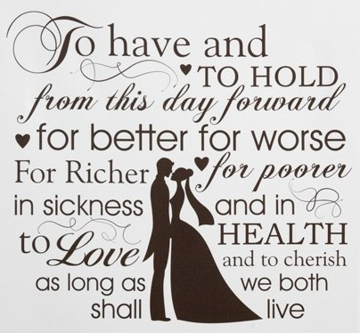
MARRIAGE VOWS

Slide 9
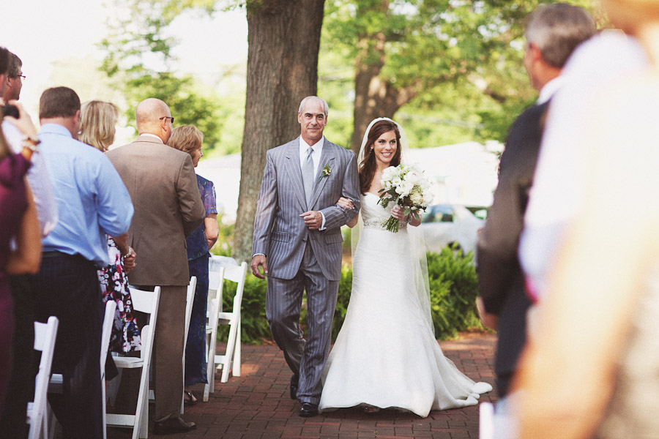
GIVE AWAY

Slide 10
I remember he POPped THE QUESTION
while we were strolling along the beach.

Slide 11
I’m throwing a BRIDAL SHOWER.

Slide 12
I’m getting married soon and
tonight is my BACHELOR PARTY.

Slide 13
MAID OF HONOR
How many BRIDESMAIDs are you going to have?

Slide 14
BEST MAN
He was a GROOMSMAN in my wedding.

Slide 15
BRIDE and GROOM you are now husband and wife
in the sight of God, and of all people.

Slide 16
Groom, as you look into bride’s eyes,
please say your VOWS.

Slide 17
Bride’s father GIVEs AWAY on his daughter’s wedding day.

Slide 18
/

Slide 19
Notes:
At a bridal shower, guests shower the bride with gifts.
신부 파티에서 손님들은 신부에게 선물로 샤워를 시킨다.

Slide 26
Meaning of the Words
Pop the question
: (for a man) to ask a woman to marry him
2. Bridal shower
: a gift-giving party held for a bride-to-be in anticipation of her wedding
Stag night / bachelor party
: a party for men only, especially one held for a man before he is married
Bridesmaid
: a woman who attends the bride at a wedding
Groomsman
: a man who attends the bridegroom at a wedding
Bride: a woman who is about to be married
Groom: a man who is about to be married
Marriage vows
: promises each partner in a couple makes to the other during a wedding ceremony
Give away
: to present a bride formally to her spouse in a wedding ceremony

Slide 27
Plan Our Weddings
<Assumption>
You are NOT already married.
<Your Scripts Could Include…>
In what season are you going to get married?
(Spring, Summer, Autumn, Winter)
What is a concept/theme of your wedding? ex) nature, musical…
Where are you going to get married? ex) Outside, at chapel…
Who are you going to invite?
What kind of special programs you want to include
in your wedding?

Slide 28
My Wedding
Name: Lizzie
I want to get married in spring, when flowers bloom so that people who come to my wedding comes with warmness. The concept of my wedding is flowers. I would like to see flowers everywhere in the place I get married. I have not chosen where to get married yet but I want to throw my wedding abroad. I will invite only my family members and close friends and will send them the airplane tickets and provide places to stay.

Slide 29
My Wedding
Name:

Slide 30
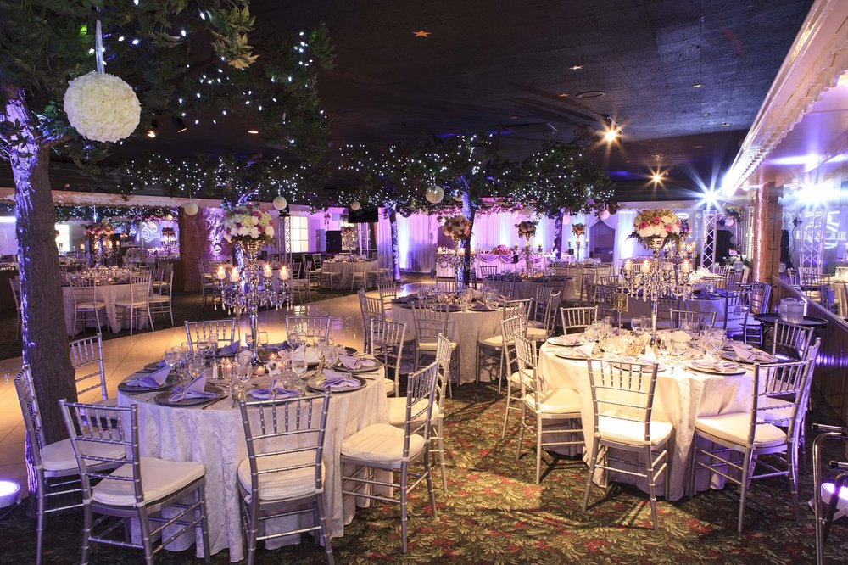

Slide 31
Questions
What was the best wedding you have ever been to?
What was the worst wedding you have ever been to?
Questions
What was the best wedding you have ever been to?
What was the worst wedding you have ever been to?

