Slide 1
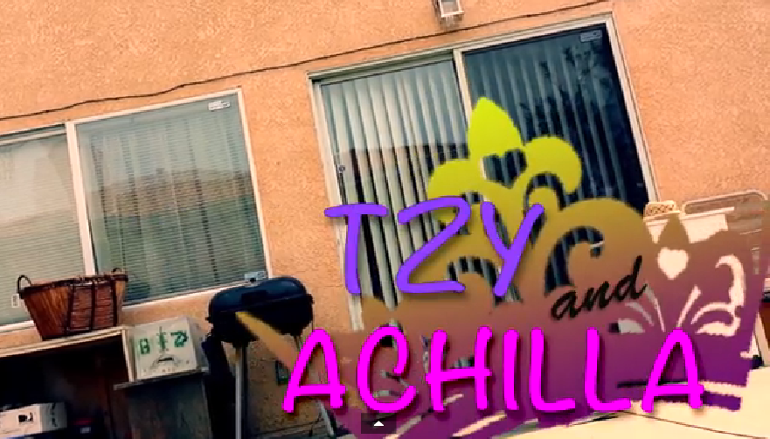

Slide 2
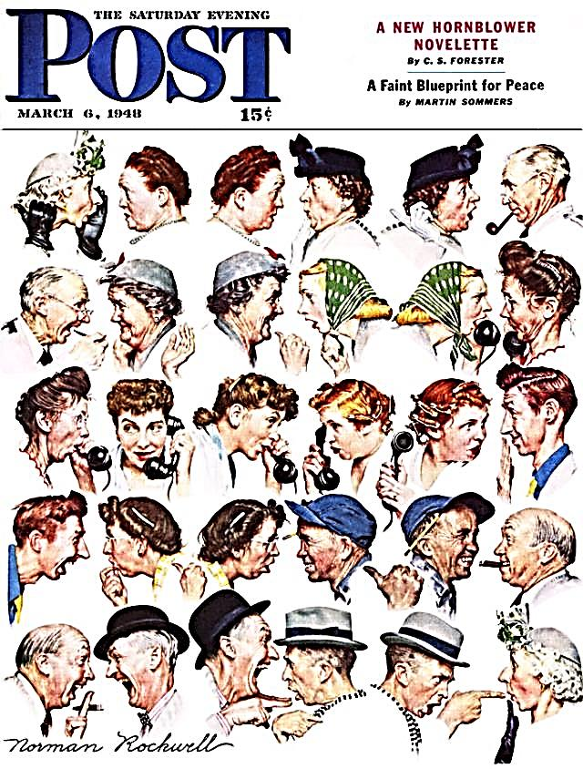
Reported speech
┌Direct speech
└Indirect speech

Slide 3
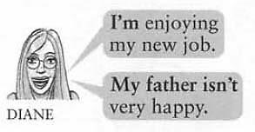
Am ☞ Was
Is ☞ Was

Slide 4
Are ☞ Were
They said that~
I said that
They said me~
I said to Sarah~

Slide 5
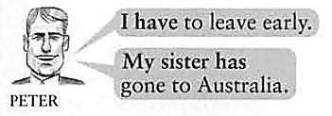
Have ☞ Had
Has ☞ Had

Slide 6
Can ☞ Could
Will ☞ Would

Slide 7
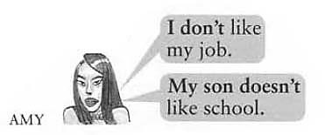
Do ☞ Did
Does ☞ Did

Slide 8
Look ☞ Looked
Feel ☞ Felt

Slide 9
She said that~

Slide 10
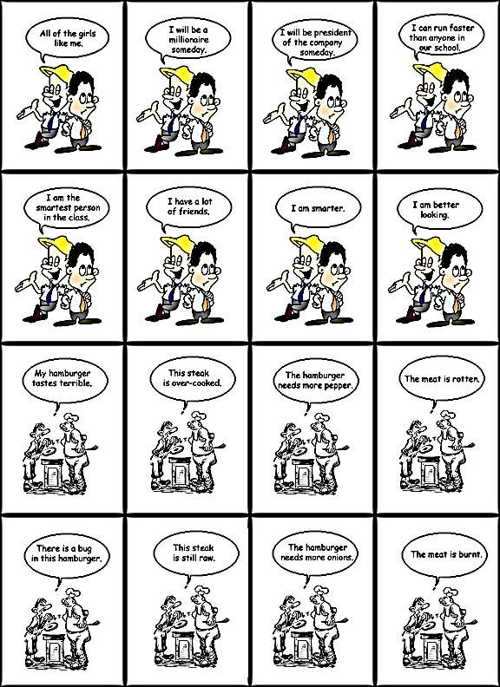

Slide 12
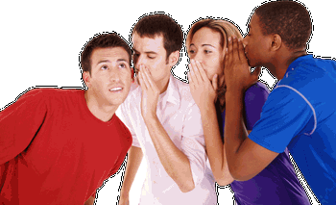
He said that
Thanked you.

