Slide 1
“First Conditional”
Lizzie
Oct. 15th 2016

Slide 2
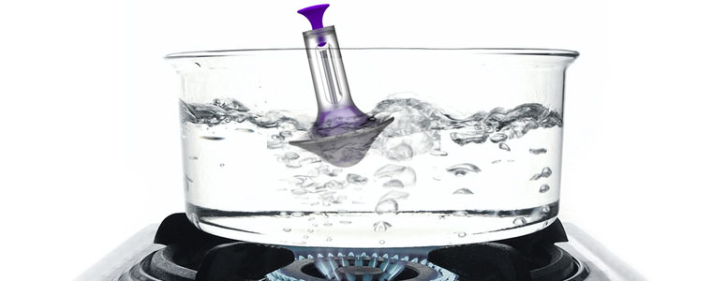
Review “ZERO CONDITIONAL”
Structure
: If + present simple , … present simple.
When to use?
: when talking about general truths and general habits
Example
If clause
main clause
If water reaches 100 degrees,
it always boils.

Slide 3
Warm-up “ZERO CONDITIONAL”
Fill-out the blanks
If you drink alcohol, ______ not drive.
If you close the door, it ______ automatically.
If you disconnect the battery, the computer ______ off.
Choose the correct Options
If you study hard in TESOL class,
a) you get good grades b) you got good grades
c) you getting good grades d) you will get good grades
2. If you eat fast food every time,
a) you will gain weight b) you gains weight
c) you gain weight d) you gained weight

Slide 4
Today’s Lesson “FIRST CONDITIONAL”
Structure
: If + present simple , …will + infinitive.
When to use?
: when taking about possible or likely things in the future
Example
If clause
main clause
If I finish studying tonight,
I will go partying tomorrow.
today
tomorrow
Notes:
It's used to talk about things which might happen in the future. Of course, we can't know what will happen in the future, but this describes possible things, which could easily come true.

Slide 5
Infinitive
Q. What is infinitive?
The base form of a verb.
Usually referring to the present infinitive.
There are two forms: the to-infinitive and the zero infinitive
To-infinitive | Zero infinitive
To sit | Sit
To eat | Eat
To have | Have
To remember | Remember

Slide 7
♬Count On Me by Bruno Mars♬
Q1. Can you find sentences of FIRST CONDITIONAL?
Q2. How many are they?
Q3. Tell me what they are.

Slide 8
♬Count On Me by Bruno Mars♬
[Verse 1] Oh uh-huh If you ever find yourself stuck in the middle of the sea I'll sail the world to find you If you ever find yourself lost in the dark and you can't see I'll be the light to guide you We find out what we're made of When we are called to help our friends in need
[Verse 2] If you're tossing and you're turning And you just can't fall asleep I'll sing a song beside you And if you ever forget how much you really mean to me Every day I will remind you Oooh We find out what we're made of When we are called to help our friends in need

Slide 9
♬Count On Me by Bruno Mars♬
Q1. Can you find sentences of FIRST CONDITIONAL?
Q2. How many are they?
Q3. Tell me what they are.

Slide 10
♬Count On Me by Bruno Mars♬
[Verse 1] Oh uh-huh If you ever find yourself stuck in the middle of the sea I'll sail the world to find you If you ever find yourself lost in the dark and you can't see I'll be the light to guide you We find out what we're made of When we are called to help our friends in need
[Verse 2] If you're tossing and you're turning And you just can't fall asleep I'll sing a song beside you And if you ever forget how much you really mean to me Every day I will remind you Oooh We find out what we're made of When we are called to help our friends in need
1
2
3
4

Slide 11
★Idioms★
① Stuck in _____
→ meaning: unable to move in a particular position, place, or
a way of thinking
→ example: The wheels were stuck in the mud.
② Find someone lost in _____
→ meaning: someone found someone who is lost
in a particular position, place, etc.
→ example: Jen found Dooley lost in a street.
③ Toss and turn
→ meaning: to be unable to sleep because of worrying
→ example: Jennine was tossing and turning all night.

Slide 12
“FIRST CONDITIONAL”
Structure
: If + present simple , …will + infinitive.
When to use?
: when taking about possible or likely things in the future
Example
If clause
main clause
If I finish studying tonight,
I will go partying tomorrow.
today
tomorrow
Notes:
what if?//???

Slide 13
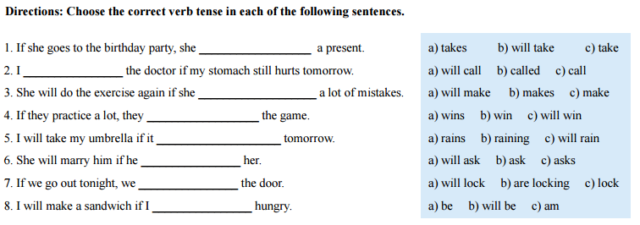
★Practice★
b) will take
Notes:
http://www2.estrellamountain.edu/faculty/stonebrink/ESL040/Conditional%20Handouts%20p1&3%20ESL%20Library.pdf

Slide 14
★Practice★
goes
will sleep in

Slide 15
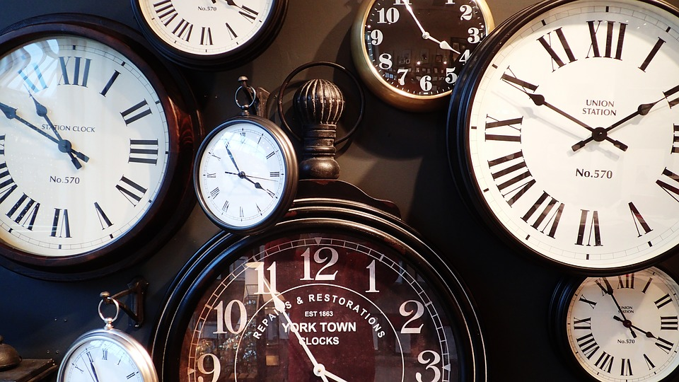
★Chain Activity★
If I have only 24 hours to live, I will…
Notes:
Instruction:
Starting from the person on the right side,
complete the sentence by using first conditional.
The next person will make the main clause into first conditional
and will make the sentence.
The activity will end when the person on the left side
completes the sentence.

Slide 16
THANK YOU ☺

