Slide 1
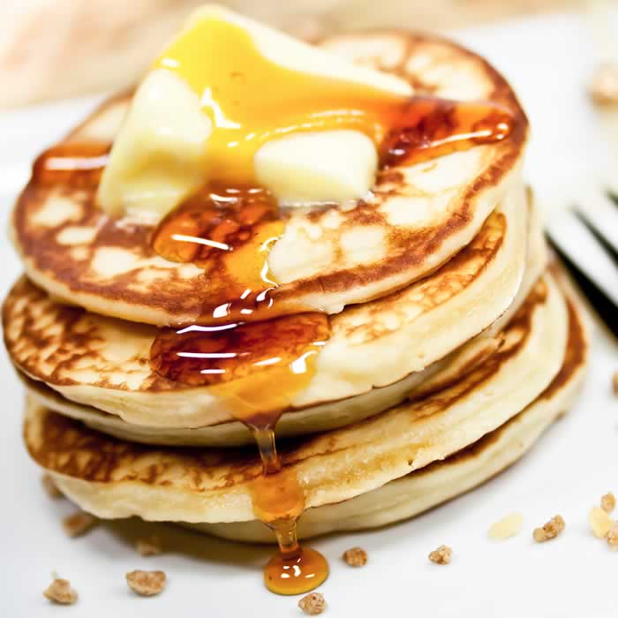
Jamie Oliver makes pancakes
1) Who are the two girls?
2) What do they use for measurement?
3) What is the first ingredient they pour in?
4) Which flavors can you add?
5) How do you know that the pancakes are ready?

Slide 2
RECIPE using an imperative sentence
First , __________ one cup of self-raising flour and ____________ it in a bowl.
Then ________ one cup of milk and a _______ of salt.
And _______ in one egg and _______ the whole batter with a whisker.
Finally, _______ in some pear or other fruit.
Then _________ little piles of the batter into a heated pan with butter.
When they are ready on both sides, you can _______ a spoonful of yogurt on top and _______ some honey on it.
measure – put - mix - pinch – pour (2x) - grate–put- add –drizzle

Slide 3
A, An, partitives Pear Pancake with Jamie Oliver
A cup of flour A pinch of salt 1 cup of milk
One egg A knob of butter A pear
3 scoops of pancake batter A dollop of yogurt some honey
Task 1: Fill in the blanks with the phrases from the box above.
1. First, you measure ________________and put them in a big mixing bowl.
2. Next, pour in __________________ into the mixing bowl.
3. Then, add in __________________.
4. After that, you need to break in ______________ and whisk everything.
5. Once that’s done, you need to grate in _______________.
6. Then, you heat the frying pan. Once it’s heated, put in __________________________.
7. Next, you put ______________ into the hot pan.
8. Once they’re cooked, serve them in a plate and put _____________________________ on top.
9. You can also drizzle ______________.

Slide 4
Task 2: Read the dialogue below and use ONLY A, An, Some & Any and fill in the blanks.
A. How many cups of flour does Jamie Oliver ask Poppy to add in the mixing bowl?
B. Jamie asks Poppy to put 1)____ cup of flour.
A. What does he do next?
B. Next, he asks her to pour in 2)____ mug of milk using the same cup.
Does he add in 3)____ pinch of salt? What about eggs?
Does he use 4)____ eggs in his pancake recipe?
A. Of course. He adds in 5)____ pinch of salt and he breaks in 6)____ egg.
He whisks everything then he grates in 7)____ pear with the core and all.
B. I see. Well, I never grate 8)_____ fruit in my pancake and to be honest, I do not
grate in 9)____fruit all. Maybe I should try it next time!
A. I don’t grate in 10)____ fruit either which is why I’m definitely going to try his
recipe next time I’m making a pancake.
Then he heats the pan and adds in 11)___ knob of butter.
Then he puts 12)______ spoonfuls of pancake mixture.
Once they’re cooked, serve them in a plate.
B. Hang on a second, does he enjoy his pancakes with 13)____ yogurt?
What about 14)______ honey? I always drizzle 15)_____ honey on my pancakes!
A. Oh yes! I completely forgot, sorry! Yes he does!
He serves the pancake with 16)____ dollop of yogurt and he also enjoys his
pancake like you do by drizzling 17)_____ honey.

Slide 5
RULES
Some Affirmative Positive
There are some bananas in the fruit bowl.
There are some chocolate bars for you.
There is some sugar in the jar.
There is some vinegar.
Any Negative (not/ never)
There aren’t any bananas in the fruit bowl.
There isn’t any sugar in the jar.
Any Interrogative?
Are there any bananas in the fruit bowl?
Is there any sugar in the jar?
Any Interrogative & negative
Aren’t there any bananas in the fruit bowl?
Are there not any chocolate bars for you?
Isn’t there any sugar in the jar?
Plural
(pears, eggs, apples, )
Uncountable
(oil, salt, rice, oat, juice)

Slide 6
Task 3: Correct these mistakes.
There are some cheese in the fridge.
There aren’t any sugar left in the jar.
Is there any bananas in the fruit bowl?
There isn’t any red apples in the kitchen.
Are there any soy sauce in the bottle?
There is some oranges in the basket.
There isn’t an peach pie on the plate.
Is there a apple tart in the oven?

Slide 7
Answer Key
Task 1:
1. A/ One cup of flour
2. A/ One cup of milk
3. A/ One pinch of salt
4. An/ One egg
5. A/ One pear
6. A/ One knob of butter
7. 3 scoops of pancake batter
8. A/ One dollop of yogurt
9. Some honey
Task 2:
1. a
2. a
3. any
4. any
5. a
6. an
7. a
8. any (never – negative form)
9. any (not - negative)
10. any (not - negative)
11. a
12. some
13. some/ any
14. some
15. some
16. a
17. some
Task 3:
There is some cheese in the fridge.
There isn’t any sugar left in the jar.
Are there any bananas in the fruit bowl?
There aren’t any red apples in the kitchen.
Is there any soy sauce in the bottle?
There are some oranges in the basket.
There isn’t any peach pie on the plate.
Is there an apple tart in the oven?

Slide 9
Task 4: Now, create my own recipe
Title : How to make _________
First,
Then
Second,
Finally

Slide 10
SOS ACTIVITY QUNTITY
glass can
bunch glass
bowl glass
slice basket
piece cup
carton bar

