Slide 1
GMT
Instructor: Joshua & Nate

Slide 2
#1. Many Jobs

Slide 3
#2. First Person Present Simple Timeline

Slide 4
#3. Singular Present Simple

Slide 5
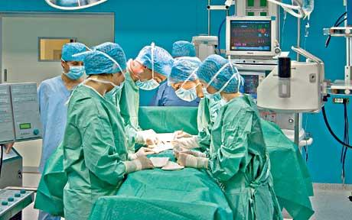
#4. Plural Present Simple

Slide 6
#5. Substitution Table
Subject | Present Simple Verb | Object
I | teach | English
We
You
They
He | teaches
She

