Slide 1
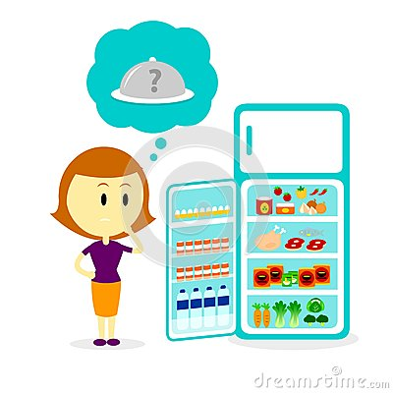

Slide 2
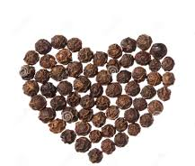
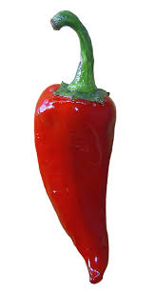
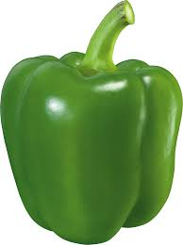
What are these?

Slide 3
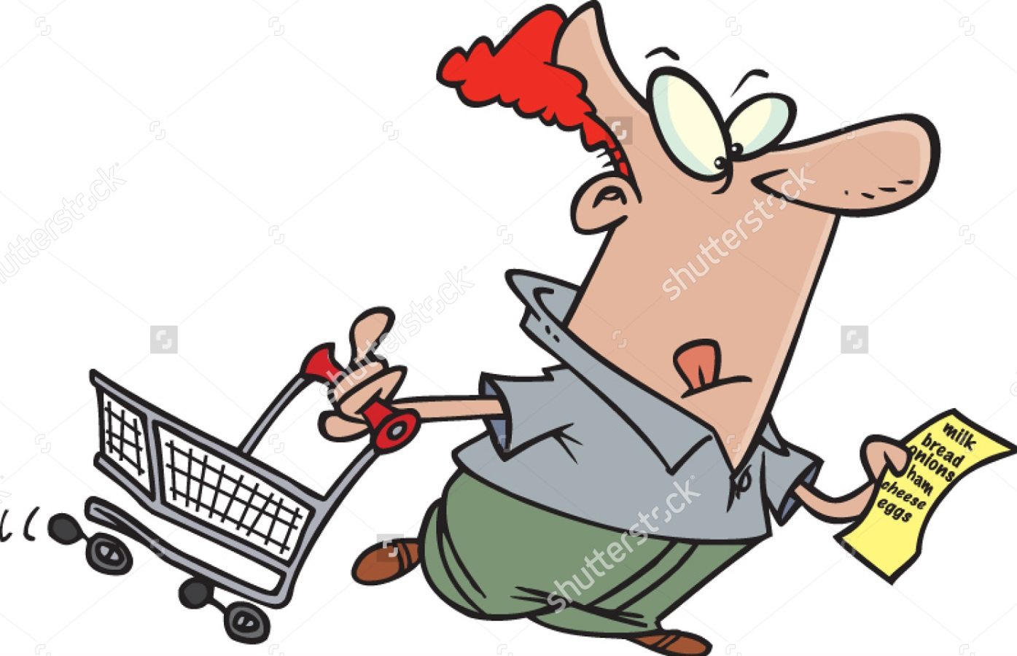

Slide 4
Have you run an errand of grocery shopping for dinner?
What do you need to know before grocery shopping?
What did you buy in the supermarket?

Slide 5
Worksheet 1. Remember Words
Words | O/X
Supermarket
Apples
Cheese
Restaurant
Refrigerator
Lunch
Shopping
Television

Slide 6
Worksheet 2. T(True) / F(False)
There are a little like and a little juice. ( )
Charles is looking in his suitcase. ( )
A refrigerator is called a ‘fridge’. ( )
Charles is making shopping list. ( )
There isn’t some cheese. ( )
There is some pasta noodles. ( )
Charles’ wife is making dinner. ( )

Slide 7
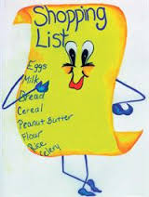

Slide 8
Worksheet 3. Discuss with your partner
What kind of breakfast can Charles make with the foods they already have in the refrigerator?
Who cook the dinner normally?

Slide 9
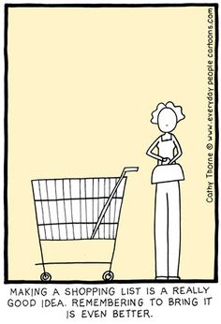
2)Shopping list
1)Dinner menu

Slide 10
Answer 1. Remember Words
Words | O/X
Supermarket | O
Apples | O
Cheese | O
Restaurant | X
Refrigerator | O
Lunch | X
Shopping | O
Television | X

Slide 11
Answer 2. True/False
There are a little like and a little juice. ( T )
Charles is looking in his suitcase. ( F )
A refrigerator is called a ‘fridge’. ( T )
Charles is making shopping list. ( T )
There isn’t some cheese. ( F )
There is some pasta noodles. ( T )
Charles’ wife is making dinner. ( F )
Green pepper
Lettuce
Garlic
Butter
Bread
Charles’ shopping list

Slide 12
Worksheet 3. Discuss with your partner
What kind of breakfast can Charles make with the foods they already have in the refrigerator?
Who cook the dinner normally?
Egg salad, garlic bread, fried rice
Charles’ wife

