Slide 1
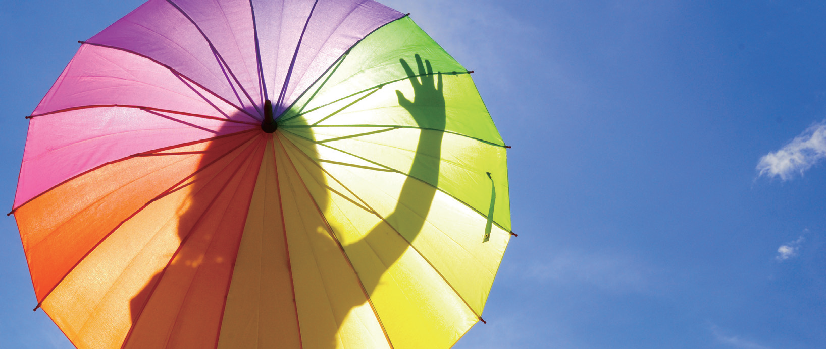
What is your favorite color?

Slide 2
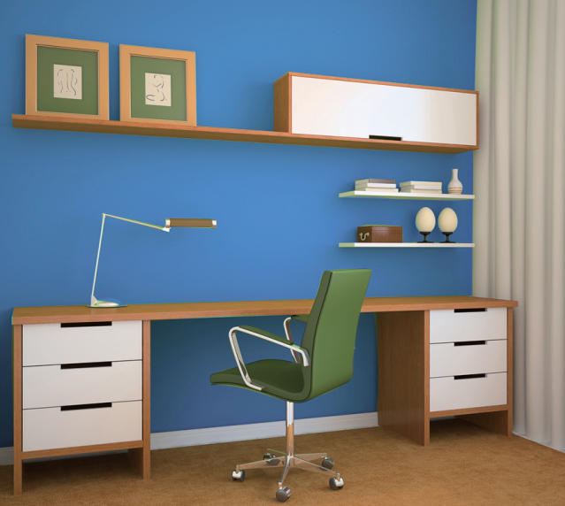
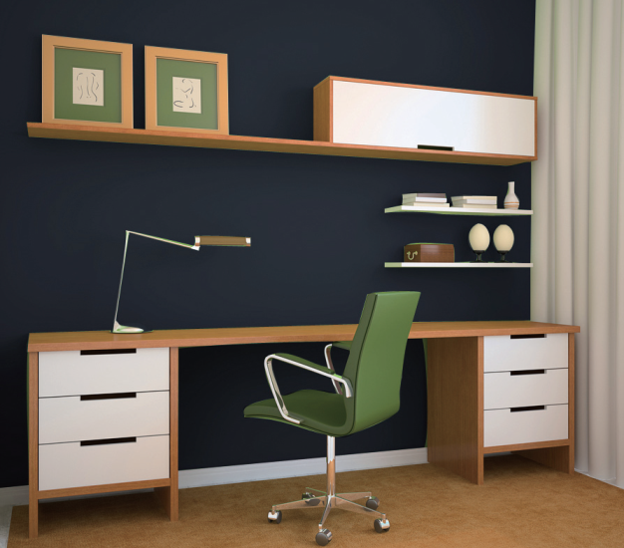
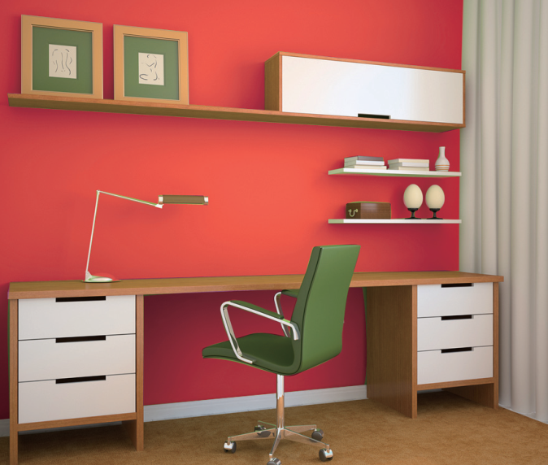
What color makes you happy? And Why?

Slide 3
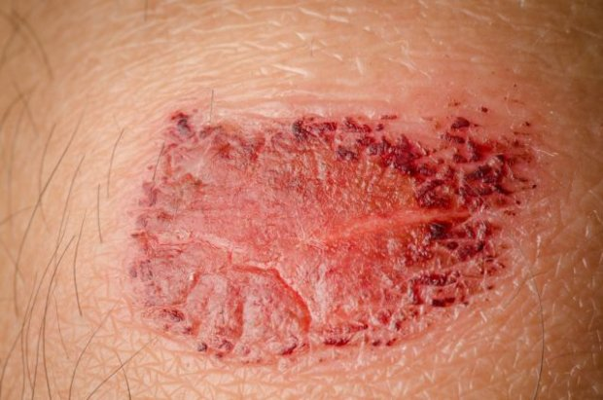
1.
2.

Slide 4
3.

Slide 5
 | Warm colors | Cool colors
Colors included | Red, ___________________________ | Violet,blue and green
Effects | _________________________ | ____________
examples | 1)red -helps increase ________________ -reduce tiredness -relieve a ________ 2)yellow -makes you feel _______ -helps you __________ food | 3)blue and violet -relieve ____________ -help heal ___________ -help you to have a good night’s _______

Slide 6
 | Warm colors | Cool colors
Colors included | Red, orange and yellow | Violet,blue and green
Effects | __energizing | _____calming_______
examples | 1)red -helps increase blood flow__ -reduce tiredness -relieve a _____cold___ 2)yellow -makes you feel _better-helps you ___digest____ food | 3)blue and violet -relieve _____headaches_ -help heal ____wounds -help you to have a good night’s _sleep______

