Slide 1
Nathaniel’s Reading Lesson
Instructor: NATHANIEL bAE

Slide 2
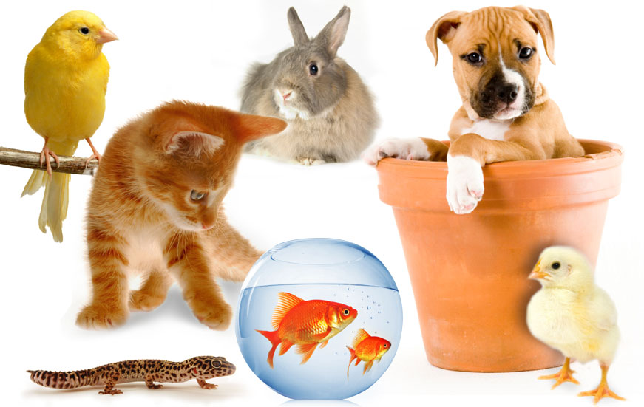
So many pets!!

Slide 3
More detailed comprehension
1. Which dog is the most helpful to human?
2. Why do you think dogs help us?
3. Do you think dogs are smarter than man?

Slide 4
Discussion Topic
1. What do you think of dogs?
2. Do you know any other pet stories that you like to share?
3. Do you think dog is the best pet ever?
4. Did you have pets before? Were they loyal and friendly like the dogs in the texts?

