Slide 1
#1

Slide 2
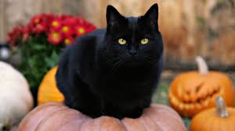
#2

Slide 3
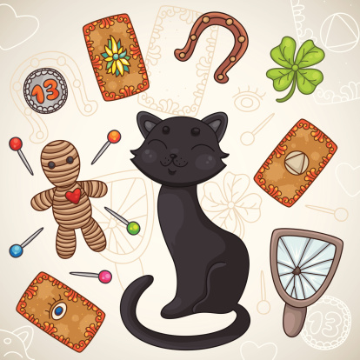
#3

Slide 4
#4

Slide 5
Choose top 3s out of the list
Which superstition scared you most when you were young?
2. Which superstition do you still believe?
3. Which of these you don’t believe anymore?
4. How to overcome belief in superstitions. Give at least one advice to overcome your fear.
#5

Slide 6
How to overcome belief in superstition.
Be aware that the first source of superstitious belief is your own family.
Write down a list of your superstitious beliefs that you can identify.
Note how much each superstition is impacting you and the way you lead your life.
4. Start dealing with the superstition.
5. Do your research.
6. Face one superstition at a time.
7. Educate your family about not being superstitious.
8. Get professional help if you are still in the grip of superstitions and feeling anxious all the time.
#6

