Slide 1
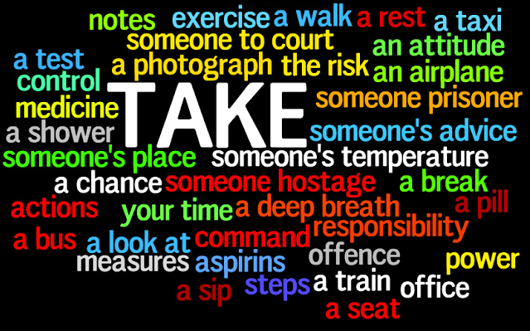
Verb Collocations

Slide 2
_______ a chance
_______ a taxi
_______ a break
_______ an exam
_______ medicine
take
Notes:
__________ a chance
__________ a taxi
__________ a break
__________ an exam
__________ medicine
take

Slide 3
____ the news to
____ someone’s hear
____ a record
____ a window
____ the ice
break

Slide 4
_____ the change
_____ a secret
_____ quiet
_____ in mind
_____ in touch
keep

Slide 5
____ missing
____ deaf
____ out of business
____ bankrupt
____ abroad
go

Slide 6
Thanks:)

