Slide 1
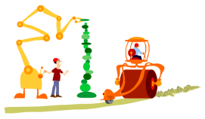
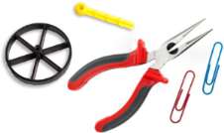
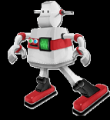
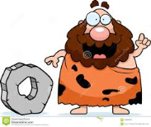
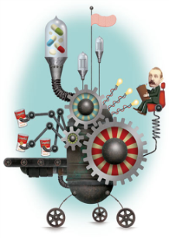
Start
Which story do you like most?
Who did Ryan Patterson
want to help?
Who invented a brake for a shopping cart?
What is it?
a small machine that is used for mathematical calculations
Go ahead 2
What would have happened if he put stirrer into other liquid?
How did Ashley Kling help firefighters?
Besides the brake, what would you invent for shopping carts?
What did Ryan Patterson use to invent a sigh translator?
Trade Places
What is the name of a reading and writing system for the blind?
What is it?
 the ability to make something original
Do you think the deaf boy thought it was convenient using the translator?
What are the inventions that Ryan Patterson would have made instead of a sign translator?
Go back to Start!
Finish
Can you think of upgraded version of earmuff?
Who invented the first earmuffs and how old was he?
What are the ways the deaf boy ordered food when he didn’t have the sign translator?

